Slide 1


Atlantic Bluefish
Joint Council/Board Meeting
February 10, 2021

Slide 2

Meeting Goal
Overview of public hearing document
Review FMAT discussion
Approve public hearing document and Commission draft amendment
Notes:
At this meeting, Dustin and I will provide an overview of the public hearing document and draft amendment as well as the most recent FMAT discussion. The goal is to approve the Council’s public hearing document and Commission's draft amendment for public comment.
We currently have 2 documents associated with this action and a third will be developed later: ​
A draft joint public hearing document​
A commission version of the amendment, which the Board needs to approve before public hearings to take out for public comment. The Board version of the amendment is essentially a longer version of the public hearing document. It contains additional background information, such as a description of the fisheries, stock status information, habitat considerations, and FMP history. The protected species section and portions of the habitat section will be added after public hearings prior to final action.​
And a Council version of the amendment which will be an environmental assessment. This includes documentation of compliance with federal laws and will be completed after final action. ​
Important to note that the alternatives in all three documents will be identical.

Slide 3

Timeline
December 2017
June-July 2018
October 2019
November 2019
Amendment Initiation
Scoping Comment Period
Rebuilding Incorporated
Overfished Declaration
2 yrs
February- March 2020
May
2020
Summer-Fall
2020
October
2020
Supplemental Scoping Period
Review Scoping Comments
Refine Draft Alternatives
Approve Alternatives for Public Hearing Document
February
2021
March-April 2021
June 2021
Winter
2021
Approve Public Hearing Document / Draft Amendment
Final Rule
Public Hearings
Final Action
Notes:
Here is a snapshot reminder of the timeline that this amendment is on. While not a complete timeline, this shows some of the big steps taken thus far (in blue) followed by upcoming big steps in the amendment process (in green). After we approve the public hearing document, we will run public hearings and work towards taking final action in June, with implementation by the end of 2021. At this point in the amendment timeline, any deviations from the planned milestones will have major implications as to when this amendment will be completed.
As a note, the public comment period will open as soon as the public hearing document is final and posted. Everyone will be notified via a press release. Additionally, we have slightly revised the comment form that we use for Amendments. Since we have so many alternatives in play, we plan to recruit comments organized by alternative set. I will pull up the new draft comment form at the end of the presentation for your review.
Supplemental Notes
If the Board and Council is unable to approve of the public hearing document and the Draft Amendment today, the rebuilding plan will need to be removed from the amendment and staff will focus our efforts on implementing the rebuilding plan through a framework/addendum while the amendment is put on hold.

Slide 4
Public Hearing Document Contents
  Table of contents
  Comment instructions
  Intro & amendment purpose
  Fishery management plan goals and objectives
  Commercial/recreational allocation
  Commercial allocations to the states
  Rebuilding plan
  Quota transfer
  Management uncertainty
  De minimis
  Appendices
Notes:
For this presentation, we will follow the numbering that is detailed within the PHD. Amendment topics will be detailed by their section in the document. Discussions surrounding specific alternatives will follow the individual alternative numbering within each section.

Slide 5
4.1.1 Current FMP Goals and Objectives
Goal: Conserve the bluefish resource along the Atlantic coast.
Objective 1: Increase understanding of the stock and of the fishery.
Objective 2: Provide the highest availability of bluefish to U.S. fishermen while maintaining, within limits, traditional uses of bluefish.
Objective 3: Provide for cooperation among the coastal states, the various regional marine fishery management councils, and federal agencies involved along the coast to enhance the management of bluefish throughout its range.
Objective 4: Prevent recruitment overfishing.
Objective 5: Reduce the waste in both the commercial and recreational fisheries.
Notes:
The first section discussed in the PHD is the FMP goals and objectives. Similar to how other FMP Amendments have addressed Goals and Objectives, there is one alternative in addition to the status quo FMP goals and objectives. ​Presented here are the current FMP goals and objectives that will be revised.

Slide 6
4.1.2 Impacts of Maintaining the FMP Goals and Objectives
The majority of comments received during scoping were in support of revising the goals and objectives
Public comments helped to inform the revised FMP goals and objectives
Notes:
The majority of comments received during scoping were in support of revising the goals and objectives, and there was no strong opposition to revisions. The many public scoping comments helped to inform the new FMP goals and objectives.

Slide 7
4.2.1 Proposed FMP Goals and Objectives
Goal 1 Conserve the bluefish resource through stakeholder engagement to maintain sustainable recreational fishing and commercial harvest. ​
Objective 1.1. Achieve and maintain a sustainable spawning stock biomass and rate of fishing mortality.
Objective 1.2. Promote practices that reduce discard mortality within the recreational and commercial fishery.
Objective 1.3. Maintain effective coordination between the National Marine Fisheries Service, Council, Commission, and member states by promoting compliance and to support the development and implementation of management measures.
Objective 1.4. Promote compliance and effective enforcement of regulations.
Objective 1.5. Promote science, monitoring, and data collection that support and enhance effective ecosystem-based management of the bluefish resource.
Notes:
The first goal within the proposed FMP goals and objectives is to conserve the bluefish resource through stakeholder engagement to maintain sustainable recreational fishing and commercial harvest. This goal is then supplemented by 5 different objectives.

Slide 8
4.2.1 Proposed FMP Goals and Objectives
Goal 2 Provide fair and equitable access to the fishery across all user groups throughout the management unit.
Objective 2.1 Ensure the implementation of management measures provides fair and equitable access to the resource across to all groups along the coast.
Objective 2.2 Consider the economic and social needs and priorities of all groups that access the bluefish resource in the development of new management measures.
Objective 2.3 Maintain effective coordination with stakeholder groups to ensure optimization of economic and social benefits.
Notes:
The second goal within the proposed FMP goals and objectives is to provide fair and equitable access to the fishery across all user groups throughout the management unit. This goal is then supplemented by 3 different objectives.

Slide 9
4.2.2 Impacts of Revising the FMP Goals and Objectives
A commitment to stakeholder engagement and fair and equitable access to the resource is likely to improve attitudes about the FMP among bluefish fishery stakeholders.
Notes:
Related to the impacts of revising the FMP Goals and Objectives, the FMAT noted that a commitment to stakeholder engagement and fair and equitable access to the resource is likely to improve attitudes about the FMP among bluefish fishery stakeholders.

Slide 10
5.0 Commercial/Recreational Sector Allocation
ABC
ACL
83%
17%
Rec ACT
Comm ACT
Rec Discards
Comm Discards
RHL
Quota
Notes:
Section 5: the sector allocations.
Under the current Fishery Management Plan (FMP) for bluefish, the Acceptable Biological Catch (ABC) equals the fishery level Annual Catch Limit (ACL), which is then divided into a commercial and recreational Annual Catch Target (ACT) based on the allocation percentages defined in the FMP. The percentages are currently 83% recreational and 17% commercial. Sector-specific expected discards are subtracted from the sector-specific ACTs to derive a commercial quota and a Recreational Harvest Limit (RHL). Aside from the status quo option, the following approaches revise the allocation percentages based on modified base years with updated MRIP and commercial data.

Slide 11
5.1.1 Commercial/Recreational Sector Allocation Alternatives
Allocation Percentages
Alternative | Basis
2a-1: 83% recreational, 17% commercial | No action/status quo (1981-1989 landings data)
2a-2: 89% recreational, 11% commercial | Multiple approaches: 2014-2018 and 2009-2018 catch data
2a-3: 87% recreational, 13% commercial | 1999-2018 catch data
2a-4: 86% recreational, 14% commercial | Multiple approaches: 1981-2018 catch data; 2014-2018 and 2009-2018 landings data
2a-5: 84% recreational, 16% commercial | Multiple approaches: 1981-2018 and 1999-2018 landings data
Alternative | 2a-1 | 2a-2 | 2a-3 | 2a-4 | 2a-5
Proposed Recreational Allocation | 83% | 89% | 87% | 86% | 84%
% Change from Status Quo | 0% | +7% | +5% | +4% | +1%
Proposed Commercial Allocation | 17% | 11% | 13% | 14% | 16%
% Change from Status Quo | 0% | -35% | -24% | -18% | -6%
Notes:
There are 5 sector allocation alternatives including status quo. Each alternative is presented in the top table with the basis to the right. The alternatives range from status quo of 83% rec and 17% comm to 89% rec and 11% comm. The table on the bottom of the slide presents the percent change from status quo for each alternative. Given the commercial sector has a smaller allocation, percent change for each alternative is much higher than those associated with the proposed recreational allocations.

Slide 12
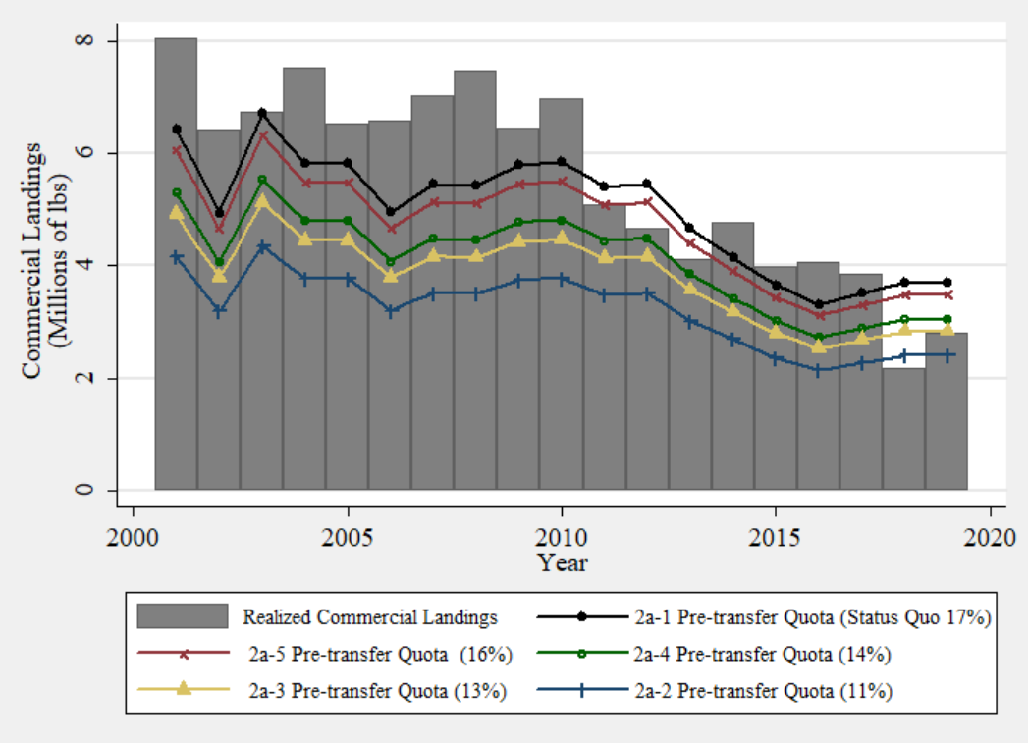
5.1.2 Commercial/Recreational Sector Allocation Impacts
Notes:
We used realized and predicted bluefish landings for the commercial sector to assess the economic impacts of reallocation. The time series used spans from 1999-2019 where realized landings are compared to pre-transfer quota across the proposed alternatives. Each alternative contains at least one year in which the pre-transfer commercial allocation exceeds the realized annual commercial landings, suggesting that in these years, the pre-transfer allocation would not have been a limiting factor in landing bluefish. Ultimately, losses in landings resulting from smaller pre-transfer quota allocations relative to realized landings becomes relevant if transfers from the recreational sector to the commercial sector become less frequent in the near term.

Slide 13
5.1.2 Commercial/Recreational Sector Allocation Impacts
Time Series | Average Differences in Estimated Revenues (Millions of 2020 Constant Dollars)
 | 11% Commercial Quota (2a-2) vs 17% Status Quo (2a-1) | 13% Commercial Quota (2a-3) vs 17% Status Quo (2a-1) | 14% Commercial Quota (2a-4) vs 17% Status Quo (2a-1) | 16% Commercial Quota (2a-5) vs 17% Status Quo (2a-1)
Averaged over Entire Time Series (1999-2019) | -$1.19M | -$0.79M | -$0.59M | -$0.20M
Standard Deviation | 0.14 | 0.09 | 0.07 | 0.02
Averaged over Past 10 Years (2010-2019) | -$1.09M | -$0.72M | -$0.54M | -$0.18M
Standard Deviation | 0.12 | 0.08 | 0.06 | 0.02
Averaged over Past 5 Years (2015-2019) | -$0.98M | -$0.65M | -$0.49M | -$0.16M
Standard Deviation | 0.03 | 0.02 | 0.01 | 0.00
Average Percent Decrease Relative to Annual Status Quo Revenues (1999-2019) | 35% | 24% | 18% | 6%
Notes:
This analysis was taken one step further by comparing the estimate of commercial revenue under the status quo alternative to the commercial revenues under the four other alternatives. The price model described in Appendix B was used to generate average annual ex-vessel prices at the various landings levels. Over 1999-2019, average percent decrease relative to the annual status quo revenues ranged from 35 to 6%. This analysis demonstrates the potential economic impacts to the commercial sector, but these impacts may be lessened as the stock rebuilds or if quota is transferred from the recreational to the commercial sector.

Slide 14
5.1.2 Commercial/Recreational Sector Allocation Impacts
Difficult to quantify economic impacts to the recreational sector
  No demand model; data limitations
Qualitative discussion of impacts
  Increase in quota may result in liberalization of bag limits, especially as stock rebuilds
  Increases angler satisfaction
  Potential to increase party/charter boat and supporting business revenues
Notes:
All the alternatives provide an increase in allocation to the recreational sector compared to status quo. However, it is difficult quantify economic impacts stemming from increases in recreational bluefish quota. Without a demand model, it is impossible to estimate the changes in angler effort and expenditures resulting from allocation increases. Qualitatively, an increase in recreational bluefish allocation is expected to have slightly positive economic impacts. As a result, we would expect to see potential liberalization in management measures resulting in increased angler satisfaction as well as increased revenue for for-hire operators.

Slide 15
5.1.2 Commercial/Recreational Sector Allocation Impacts
Plurality of scoping comments received on issue
Commercial Crew Survey results
Recreational fishing engagement scores by community
Notes:
In regard to the social impacts, information can be drawn from the scoping comments, the majority of which pertained to this amendment topic. Comments from commercial industry members indicated support for leaving the allocations unchanged or increasing the commercial allocation and vice versa from recreational stakeholders. The social scientist on the FMAT then looked at commercial crew survey results and determined that a reduction in commercial quota could create a need for more restrictive measures, something which has already been identified as a point of contention for this sector.

Slide 16
5.1.2 Commercial/Recreational Sector Allocation Impacts: Comm. Engagement Scores
Notes:
Social impacts were also analyzed at the community level. Presented here are the commercial engagement scores for the top 15 bluefish ports. NOAA Fisheries social scientists produce indicators of commercial and recreational fishing engagement and reliance characteristics for fishing communities throughout the U.S. The Social Indicators are composite indices that help characterize commercial fishing engagement or social vulnerability. The strength of these indicators is that they provide greater depth and contextualization to our understanding of fishing communities, as compared to landings and revenue statistics.
The top 5 commercial fishing communities were: Wanchese, Montauk, Narragansett, Shinnecock, and New Bedford.
If questioned:
The Social Indicators provide a more comprehensive view of fishing communities by including social and economic conditions that can influence the viability of commercial and recreational fishing activities, such as gentrification pressure, poverty, and housing characteristics, among other factors.
It should be noted that a high engagement score does not necessarily mean that a community or its fishery participants are solely dependent upon commercial fishing activities. There may be other fishing or economic activities that may sustain the livelihoods of individuals or entities within these communities that have relied on commercial fishing historically.

Slide 17
5.1.2 Commercial/Recreational Sector Allocation Impacts: Rec. Engagement Scores
Notes:
Presented here are the recreational engagement scores for the top 15 bluefish communities. As with the commercial scores, it should be noted that a high engagement score does not necessarily mean that a community or its fishery participants are solely dependent upon recreational fishing activities.
The top 5 recreational fishing communities were: Jacksonville, Babylon, Outer Banks, Montauk, and Melbourne Beach.

Slide 18
5.2.1 Allocation Change Phase-in Alternatives and Impacts
Phase-in Alternatives
2b-1: No phase-in
2b-2: Allocation change spread evenly over the same duration as the selected rebuilding plan
Bluefish Allocation Change Phase-In
Current allocation (2a-1): 83% recreational, 17% commercial
Allocation Alternatives | 4-year phase-in | 5-year phase-in | 7-year phase-in
2a-2: 89% Rec., 11% Comm. | 1.5% change per year | 1.2% change per year | 0.86% change per year
2a-3: 87% Rec., 13% Comm. | 1% change per year | 0.8% change per year | 0.57% change per year
2a-4: 86% Rec., 14% Comm. | 0.75% change per year | 0.6% change per year | 0.43% change per year
2a-5: 84% Rec., 16% Comm. | 0.25% change per year | 0.2% change per year | 0.14% change per year
Notes:
Section 5.2.1 discusses the potential to phase-in allocation changes over the duration of the selected rebuilding plan. The percent changes are presented in the bottom table. Considering the small range that the phased-in allocations would change over 4-7 years, minimal impacts are expected for the recreational fishery. However, a 1.5% shift in allocation away from the commercial sector is a much larger annual impact relative to its smaller initial allocation. Therefore, a phase-in approach may slightly reduce the economic burden on commercial stakeholders.

Slide 19
6.1.1 Commercial Allocations to the States Alternatives
Landings-Based Allocation Alternatives
State | 3a-1 | 3a-2 | 3a-3 | 3a-4
 | No action/ Status quo (1981-1989) | 5 year (2014-2018) | 10 year (2009-2018) | 1/2 '81-'89 1/2 '09-'18
ME | 0.67% | 0.00% | 0.01% | 0.49%
NH | 0.41% | 0.03% | 0.12% | 0.33%
MA | 6.71% | 10.64% | 10.16% | 7.66%
RI | 6.80% | 11.81% | 9.64% | 7.59%
CT | 1.26% | 1.18% | 1.00% | 1.19%
NY | 10.37% | 20.31% | 19.94% | 13.01%
NJ | 14.79% | 11.23% | 13.94% | 14.57%
DE | 1.88% | 0.58% | 0.40% | 1.47%
MD | 3.00% | 1.50% | 1.84% | 2.68%
VA | 11.86% | 4.62% | 5.85% | 10.26%
NC | 32.01% | 32.06% | 32.38% | 32.13%
SC | 0.10% | 0.00% | 0.00% | 0.03%
GA | 0.10% | 0.00% | 0.00% | 0.01%
FL | 10.04% | 6.07% | 4.75% | 8.59%
Total | 100.00% | 100.01% | 100.03% | 100.00%
Notes:
Section 6.1.1: commercial allocations to the states.
There are four alternatives including status quo. The three proposed alternatives all revise the commercial allocations to the states using updated time series as compared to the status quo of 1981-1989. The proposed alternatives use a 5-year and 10-year time series, as well as a combination of time series in alternative 3a-4.

Slide 20
6.1.2 Commercial Allocations to the States Impacts
Allocation Alternatives Based on Landings Data
 | 3a-1 | 3a-2 |  | 3a-3 |  | 3a-4
State | Status quo (1981-1989) | 5 year (2014-2018) |  | 10 year (2009-2018) |  | 1/2 '81-'89 1/2 '09-'18
ME | 0.67% | 0.00% | -100% | 0.01% | -99% | 0.49% | -27%
NH | 0.41% | 0.03% | -93% | 0.12% | -71% | 0.33% | -20%
MA | 6.71% | 10.64% | 59% | 10.16% | 51% | 7.66% | 14%
RI | 6.80% | 11.81% | 74% | 9.64% | 42% | 7.59% | 12%
CT | 1.26% | 1.18% | -6% | 1.00% | -21% | 1.19% | -6%
NY | 10.37% | 20.31% | 96% | 19.94% | 92% | 13.01% | 25%
NJ | 14.79% | 11.23% | -24% | 13.94% | -6% | 14.57% | -1%
DE | 1.88% | 0.58% | -69% | 0.40% | -79% | 1.47% | -22%
MD | 3.00% | 1.50% | -50% | 1.84% | -39% | 2.68% | -11%
VA | 11.86% | 4.62% | -61% | 5.85% | -51% | 10.26% | -13%
NC | 32.01% | 32.06% | 0% | 32.38% | 1% | 32.13% | 0%
SC | 0.10% | 0.00% | -100% | 0.00% | -100% | 0.03% | -70%
GA | 0.10% | 0.00% | -100% | 0.00% | -100% | 0.01% | -90%
FL | 10.04% | 6.07% | -40% | 4.75% | -53% | 8.59% | -14%
Total | 100.00% | 100.01%4F4F4F |  | 100.03% |  | 100.00%
Notes:
This table was included for reference to help present the impacts of each alternative. The resulting percentage increase (blue) or decrease (red) relative to the current allocations (3a-1) are available for each state. Don’t be too concerned with the -100% changes for some states – we will be discussing the alternatives associated with a minimum default allocation in a few slides.

Slide 21
6.1.2 Commercial Allocations to the States Impacts
Notes:
Here, the distribution of each state’s annual bluefish landings are summarized by box and whisker plots. The interquartile range of state-level bluefish landings are portrayed by the gray boxes and whiskers, which indicate the maximum and minimum annual bluefish landing quantity for each state from 1999-2019.
Ultimately, there is no consistent trend in impacts stemming from each reallocation alternative when compared across states. When comparing which alternative is closest in value to the median realized landings of each state, the 10-year time series associated with alternative 3a-3 (green squares) performs the best, with landings predictions closest to 38% and furthest from only 9% of state median landings values. By determining which alternative best predicts state landings, the need for transfers will decrease—increasing efficiency within the commercial sector. Therefore, a slight economic advantage is expected for states which are allocated quota above their historic median landings value.

Slide 22
6.2.1 Commercial Allocations to the States Phase-In Alternatives
Phase-in Alternatives
3b-1: No phase-in
3b-2: Allocation change spread evenly over the same duration as the selected rebuilding plan
 |  | 5 year (2014-2018) See 3a-2 |  |  | 10 year (2009-2018) See 3a-3 |  |  | 1/2 '81-'89 1/2 '09-'18 See 3a-4
State | Current Allocations | 4-year | 5-year | 7-year | 4-year | 5-year | 7-year | 4-year | 5-year | 7-year
ME | 0.67% | -0.17% | -0.13% | -0.10% | -0.17% | -0.13% | -0.09% | -0.05% | -0.04% | -0.03%
NH | 0.41% | -0.10% | -0.08% | -0.05% | -0.07% | -0.06% | -0.04% | -0.02% | -0.02% | -0.01%
MA | 6.71% | 0.98% | 0.79% | 0.56% | 0.86% | 0.69% | 0.49% | 0.24% | 0.19% | 0.14%
RI | 6.80% | 1.25% | 1.00% | 0.72% | 0.71% | 0.57% | 0.41% | 0.20% | 0.16% | 0.11%
CT | 1.26% | -0.02% | -0.02% | -0.01% | -0.07% | -0.05% | -0.04% | -0.02% | -0.01% | -0.01%
NY | 10.37% | 2.49% | 1.99% | 1.42% | 2.39% | 1.91% | 1.37% | 0.66% | 0.53% | 0.38%
NJ | 14.79% | -0.89% | -0.71% | -0.51% | -0.21% | -0.17% | -0.12% | -0.06% | -0.04% | -0.03%
DE | 1.88% | -0.33% | -0.26% | -0.19% | -0.37% | -0.30% | -0.21% | -0.10% | -0.08% | -0.06%
MD | 3.00% | -0.38% | -0.30% | -0.21% | -0.29% | -0.23% | -0.17% | -0.08% | -0.06% | -0.05%
VA | 11.86% | -1.81% | -1.45% | -1.03% | -1.50% | -1.20% | -0.86% | -0.40% | -0.32% | -0.23%
NC | 32.01% | 0.01% | 0.01% | 0.01% | 0.09% | 0.07% | 0.05% | 0.03% | 0.02% | 0.02%
SC | 0.10% | -0.03% | -0.02% | -0.01% | -0.03% | -0.02% | -0.01% | -0.02% | -0.01% | -0.01%
GA | 0.10% | -0.03% | -0.02% | -0.01% | -0.03% | -0.02% | -0.01% | -0.02% | -0.02% | -0.01%
FL | 10.04% | -0.99% | -0.79% | -0.57% | -1.32% | -1.06% | -0.76% | -0.36% | -0.29% | -0.21%
Notes:
The next set of alternatives within the commercial allocations to the states are the options to phase-in allocation changes. The phase-in alternatives are tied to whichever alternative is selected in section 6.1.1 and to the duration of the preferred rebuilding alternative.

Slide 23
6.2.2 Commercial Allocations to the States Phase-In Impacts
The impacts are dependent on three main factors:
  Difference between the status quo allocation percentage and the allocation percentage selected
  Duration of the phase-in period, which will be the same duration as the preferred rebuilding plan
  Continuation of state-to-state transfers
Allocations could shift by as much as 2.49 percentage points per year (NY), or as little as 0.01 percentage points (NH, SC, GA) per year
Potential to mitigate negative social impacts by providing a buffer through smaller percentage changes over time, but also slow the realization of some states’ increases in quota and their associated positive social impacts.
Notes:
When considering the commercial allocations to the states, the impacts are dependent on three main factors:
Difference between the status quo allocation percentage and the allocation percentage selected
Duration of the phase-in period, which will be the same duration as the preferred rebuilding plan
Continuation of state-to-state transfers
Allocations could shift by as much as 2.49 percentage points per year (NY), or as little as 0.01 percentage points (NH, SC, GA) per year.
Ultimately, this alternative may slightly reduce the economic burden on commercial stakeholders and likely have short-term economic benefits in the form of increased landings and revenues over the non-phase-in alternative, if all else was held constant.

Slide 24
6.3.1 Commercial Allocations to the States Quota Trigger Alternatives
Commercial Quota Time Series | No Trigger Alternative: 3c-1 | Pre-Transfer Alternative: 3c-2 | Post Transfer Alternative: 3c-3
No Action/Status quo [3a-1] | No trigger approach implemented | N/A | N/A
5-year (2014-2018) [3a-2] |  | 3.67 M lbs | 6.67 M lbs
10-year (2009-2018) [3a-3] |  | 4.31 M lbs | 8.21 M lbs
½ 1981-1989 and ½ 2009-2018 [3a-4] |  | 4.31 M lbs* | 8.21 M lbs*
Allocation of additional quota greater than the trigger threshold.
State | Status quo (1981-1989) | 5 year (2014-2018) | 10 year (2009-2018) | 1/2 '81-'89 1/2 '09-'18
ME | 0.10% | 0.10% | 0.10% | 0.10%
NH | 0.10% | 0.10% | 0.10% | 0.10%
MA | 7.50% | 16.60% | 19.60% | 7.50%
RI | 7.50% | 16.60% | 7.50% | 7.50%
CT | 3.00% | 3.00% | 0.10% | 3.00%
NY | 15.12% | 16.60% | 19.60% | 17.03%
NJ | 15.12% | 16.60% | 19.60% | 17.03%
DE | 3.00% | 0.10% | 0.10% | 3.00%
MD | 3.00% | 3.00% | 3.00% | 3.00%
VA | 15.12% | 3.00% | 7.50% | 17.03%
NC | 15.12% | 16.60% | 19.60% | 17.03%
SC | 0.10% | 0.10% | 0.10% | 0.10%
GA | 0.10% | 0.10% | 0.10% | 0.10%
FL | 15.12% | 7.50% | 3.00% | 7.50%
Total | 100% | 100% | 100% | 100%
Range of Baseline Quota Tiers | Associated Additional Quota Allocations
<=1% | 0.10%
>1-5% | 3.00%
>5-10% | 7.50%
>10% | Remainder
Notes:
Presented here are the quota trigger alternatives. Alternatives 3c-1 to 3c-3 will dictate if a trigger is implemented and whether the value is tied to pre- or post-transfer commercial quota time series. *I want to note that no formal commercial quota existed before the implementation of Amendment 1 in 2000, so the values presented represents the quota for available years only.
On the bottom left are the range of baseline quota tiers developed by the FMAT that were revised based on Council/Board feedback. On the bottom right we present the allocation of additional quota greater than the trigger threshold for each state using the associated additional quota allocations.

Slide 25
6.3.2 Commercial Allocations to the States Quota Trigger Impacts
Post
Post
Pre
Pre
Notes:
Presented here for reference is the time series of commercial quotas as it relates to the proposed trigger thresholds. Over the past 5 years of the time series, the commercial quotas consistently remained above the pre-transfer trigger thresholds. For the post-transfer trigger thresholds over the same period, the 5-year trigger would have been tripped in 3 of the 5 years, while the 10-year and ½ and ½ would have been tripped only once.

Slide 26
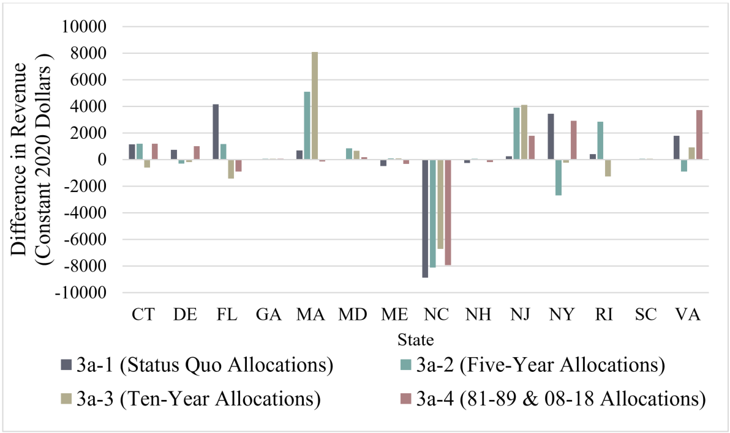
6.3.2 Commercial Allocations to the States Quota Trigger Impacts
Notes:
To analyze the economic impacts of the difference in allocation with a trigger, we used a commercial quota 100,000 lbs. above both the pre- and post-transfer threshold. Revenues were calculated at the state-level using allocations under the trigger approach. The revenues generated from the trigger-allocated quota were compared to revenues generated under a no-trigger allocation scenario across all alternatives. Annual state ex-vessel prices averaged over 1996-2019 were used for the calculation of revenues and reported in 2020 constant dollars.
When an additional 100,000 lbs. is allocated under the trigger vs. the non-trigger status quo, average revenues decrease for NC, ME and NH, when averaged across all state allocation alternatives. The highest increases in revenues when averaged across the alternatives are earned by MA, NJ and VA.
This analysis highlights the variation in economic outcomes and their dependence on the allocation alternatives proposed in section 6.3. As with other analyses, here we assume that each state will fully utilize their allocated quota and have no state-to-state transfers.
Do not read:
Conceptually, when the trigger is activated, states will receive greater quantities of quota if they are grouped into an allocation category which results in higher allocations than the non-trigger alternative allocation method. For example, MA would be allocated 6.71% of quota under the status quo, but quota allocation after the trigger threshold would increase to 7.50% under the trigger sub-alternative resulting in positive economic benefits for MA. The opposite, for example, is true for NC where a pre trigger status quo allocation would be reduced from ~32% to ~15%. However, when compared to overall revenue throughout the year, this is a relatively small percentage.

Slide 27
6.4.1 Commercial Allocations to the States Minimum Default Allocation Alternatives
Minimum Default Allocation Alternatives
3d-1 | No Action/Status quo: No Minimum Default Allocation
3d-2 | 0.10% Minimum Default Allocation
3d-3 | 0.25% Minimum Default Allocation
3d-2 |  | 0.10% Minimum Default Allocation
State | No Action 1981-1989 | Status quo 1981-1989 | 5-year 2014-2018 | 10-year 2009-2018 | 1/2 '81-'89 1/2 '09-'18
ME | 0.67% | 0.76% | 0.10% | 0.11% | 0.58%
NH | 0.41% | 0.51% | 0.13% | 0.22% | 0.42%
MA | 6.71% | 6.72% | 10.59% | 10.12% | 7.65%
RI | 6.81% | 6.81% | 11.74% | 9.61% | 7.58%
CT | 1.27% | 1.35% | 1.26% | 1.09% | 1.28%
NY | 10.38% | 10.33% | 20.12% | 19.76% | 12.93%
NJ | 14.81% | 14.70% | 11.17% | 13.85% | 14.46%
DE | 1.88% | 1.95% | 0.67% | 0.49% | 1.55%
MD | 3.00% | 3.06% | 1.57% | 1.92% | 2.75%
VA | 11.94% | 11.88% | 4.65% | 5.87% | 10.22%
NC | 32.03% | 31.68% | 31.71% | 32.03% | 31.78%
SC | 0.04% | 0.13% | 0.10% | 0.10% | 0.13%
GA | 0.01% | 0.11% | 0.10% | 0.10% | 0.11%
FL | 10.06% | 10.02% | 6.08% | 4.78% | 8.57%
3d-3 |  | 0.25% Minimum Default Allocation
State | No Action 1981-1989 | Status quo 1981-1989 | 5-year 2014-2018 | 10-year 2009-2018 | 1/2 '81-'89 1/2 '09-'18
ME | 0.67% | 0.89% | 0.25% | 0.26% | 0.72%
NH | 0.41% | 0.65% | 0.28% | 0.36% | 0.56%
MA | 6.71% | 6.73% | 10.52% | 10.05% | 7.64%
RI | 6.81% | 6.82% | 11.65% | 9.56% | 7.57%
CT | 1.27% | 1.47% | 1.39% | 1.22% | 1.40%
NY | 10.38% | 10.26% | 19.85% | 19.49% | 12.80%
NJ | 14.81% | 14.54% | 11.09% | 13.70% | 14.31%
DE | 1.88% | 2.06% | 0.81% | 0.64% | 1.67%
MD | 3.00% | 3.15% | 1.69% | 2.03% | 2.84%
VA | 11.94% | 11.78% | 4.71% | 5.89% | 10.16%
NC | 32.03% | 31.16% | 31.19% | 31.50% | 31.25%
SC | 0.04% | 0.28% | 0.25% | 0.25% | 0.28%
GA | 0.01% | 0.26% | 0.25% | 0.25% | 0.26%
FL | 10.06% | 9.95% | 6.10% | 4.83% | 8.54%
Notes:
Presented here are the minimum default allocation alternatives. Each alternative applies a fixed minimum quota of either 0.1 or 0.25%. Then, the remainder of the TAL is allocated based on average landings using the time series selected by the Council/Board for this Amendment.​
Towards the left of the table, you see the “no action” allocations. These are the current allocations with no minimum default included. Then, you see the status quo alternative, but with a minimum default allocation of 0.10 or 0.25% applied, followed by each other time series tied to section 6.1 (the commercial allocations to the states). ​These alternatives allow states that would lose their allocation through the reallocation process to retain a minimum default allocation.

Slide 28
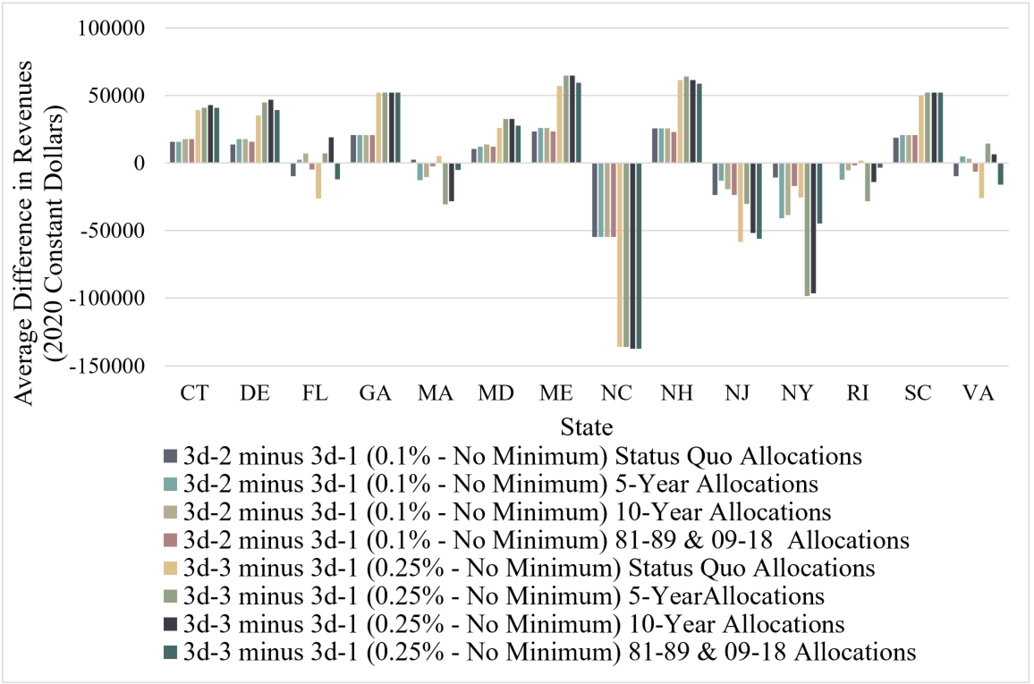
6.4.2 Commercial Allocations to the States Minimum Default Allocation Impacts
Notes:
Here, we present bluefish revenues with minimum defaults vs. allocations without the minimum defaults for each state. Revenues are estimated and compared across both of the proposed minimum default allocations (0.10% and 0.25%).
In terms of revenue gains or losses, NC’s revenues decrease the most under the minimum default allocation, with average losses of $55K and $137K for the 0.10% and 0.25% minimum defaults, respectively. The change in NC’s revenue under a minimum default allocation relative to the change in its total revenue is actually quite small because they have such a large allocation. The states with the highest increases in revenues are NH, ME, GA and SC. This is not surprising given that these states have the lowest allocations. Lastly, if transfers are to occur and if the states receiving minimum allocations are not projected to land their quota, it is possible for quota transfers to counteract the decreases in revenue stemming from minimum default allocations.
Only read if questioned
Landings for each allocation series (3a-1 to 3a-4) are simulated using historic pre-sector transfer quota quantities given that pre-sector transfer allocations are closer to realized landings relative to post-transfer quantities (1999-2019) and the assumption that all allocated quota is landed is necessary for the analysis. The simulated allocated quota, and therefore estimated landings, for each series is multiplied by the average state ex-vessel bluefish price. Average annual state bluefish prices ($/lb) are used rather than an econometric model as a peer-reviewed state-level annual price model has yet to be developed. The use of average state bluefish prices omits the inverse relationship between price and quantity of bluefish landed, which is a limitation of this specific analysis. The average difference in revenues under minimum default allocations and their non-minimum default counterparts are presented in Figure 9.

Slide 29
7.1 Rebuilding Plan Alternatives
Alternative | Rebuilding Plan | Duration | Adjustment to Council Risk Policy
4a | No Action/ Status Quo | N/A | N/A
4b | Constant Harvest | 4 years | No
4c | P* (Council Risk Policy) | 5 years | N/A
4d | Constant Fishing Mortality | 7 years | Yes
Notes:
Section 7 of the public hearing document covers the rebuilding plan alternatives and their impacts. At the last meeting in October, the alternatives were narrowed down to three rebuilding plans and the no action/status quo alternative. The Council is legally required to implement a rebuilding plan following the overfished designation for bluefish, so in effect only three alternatives are under consideration. Alternative 4b is the 4 year constant harvest scenario, alternative 4c is the 5 year plan that would follow the Council’s updated risk policy, and alternative 4d is the 7 year constant fishing mortality rate rebuilding plan. Alternative 4d would require a special case adjustment to the Council risk policy because it would allow fishing mortality that is higher than what the risk policy dictates.
The two figures on this slide depict projected catch and spawning stock biomass for the three rebuilding plans. It is important to remember that these catch values, SSB levels, and biomass reference points are subject to change. Regardless of which alternative is selected, the stock assessment scientist will perform assessment updates and rerun projections every two years. Each projection is based on current stock status information, meaning the catch values are subject to change depending upon the latest assessment. It will be important to convey this to the public during hearings, and the public hearing document also has language to that effect.

Slide 30
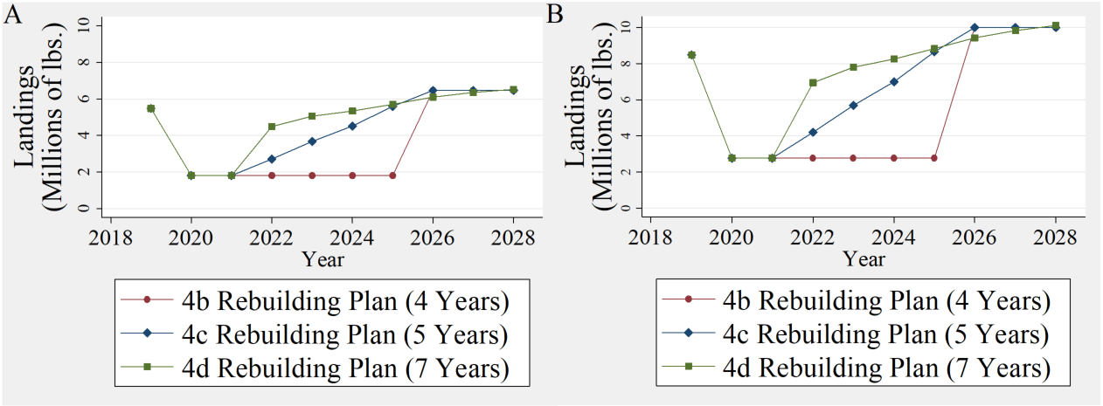
7.2 Rebuilding Plan Impacts
Figure 13. Projected commercial bluefish landings under an 11% and 17% commercial sector allocation (A and B, respectively) by rebuilding plan for years 2019-2028.
Notes:
These landings graphs will help to convey the economic impacts to the commercial industry resulting from each of the rebuilding plan alternatives. Figure 13A displays projected commercial bluefish landings under each of the rebuilding plans under the assumption of an 11% commercial allocation and B represents projected landings under a 17% commercial allocation. This is meant to provide a lower and upper bound for reference.

Slide 31
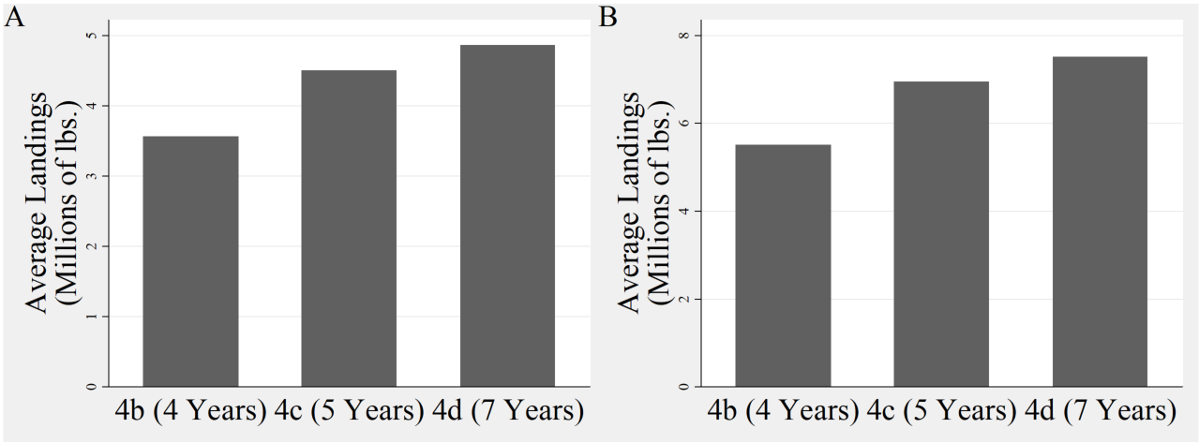
7.2 Rebuilding Plan Impacts
Figure 14. Average projected commercial bluefish landings (2019-2028) under an 11% and 17% commercial sector allocation (A and B, respectively) by rebuilding plan.
Notes:
A quick aside here, figures 14 and 16 in the public hearing document display the aggregate landings and revenue, when they should in fact display average landings and revenue as displayed here in the presentation. These changes will be updated along with any other recommended changes provided here today before being posted for public comment. Projected average landings are summarized in Figure 14, where A and B represents the 11% and 17% commercial allocations, respectively. Alternative 4b (i.e., the 4-year plan) had the lowest average landings of 3.6 M lbs and 5.5 M lbs under the 11% and 17% commercial allocations. Alternative 4d had the highest average annual landings with averages of 4.9 M lbs and 7.5 M lbs under the 11% and 17% commercial allocations.

Slide 32
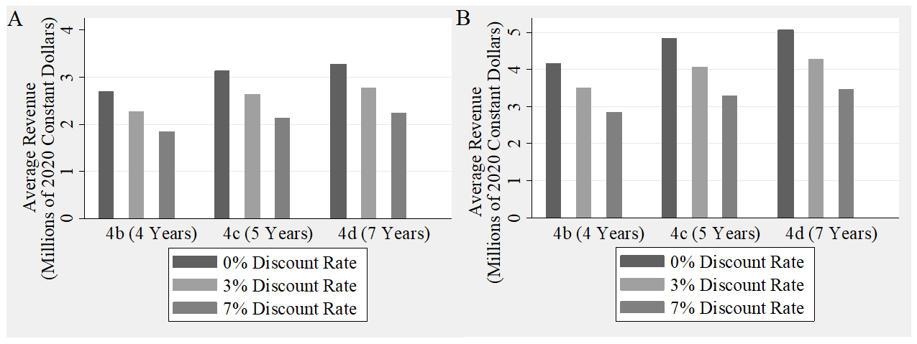
7.2 Rebuilding Plan Impacts
Figure 16: Average annual commercial bluefish revenues (2019-2028) discounted at 0%, 3% and 7% by rebuilding alternative and under 11% (A) and 17% (B) commercial quota allocations.
Notes:
The public hearing document also contains an analysis of commercial bluefish landings revenue across the three rebuilding plan alternatives. The three different shaded bars represent three different discount rates of 0%, 3%, and 7%. Revenue streams are estimated using the predicted landings and ex-vessel bluefish prices are predicted using the modeling methods and parameters specified in Appendix B. You can see similar trends across all three discount rates where alternative 4b results in the lowest revenue, and alternative 4d provides the most revenue.

Slide 33
7.2 Rebuilding Plan Impacts
Without a demand model, it is unclear how the proposed rebuilding plans will impact recreational bluefish fishing effort
Transition to new measures in 2020 and data challenges in 2020 further complicates impact analysis
Notes:
When it comes to assessing the economic impacts to the recreational sector, the analysis is not as straightforward. Without a demand model, it is unclear how the proposed rebuilding plans will impact recreational bluefish fishing effort.
Transition to the new recreational bag limits in 2020 combined with covid-related data challenges in 2020 further complicates any impact analysis. However, generally speaking a higher recreational harvest limit may allow for liberalized measures which affects angler access to the resource and potentially more revenue for for-hire operators.

Slide 34
8.0 Quota Transfers
Alternatives | Annual Quota Transfer Alternatives
5a-1 | No Action/Status Quo
5a-2 | Allow for optional bi-directional transfers through the annual specifications process with pre-defined guidelines and process. The transfer would consist of a portion of the total ABC in the form of a landings limit (i.e., commercial quota and RHL) transfer. Transfers would not occur if the stock is overfished or overfishing is occurring.
Alternatives | Transfer Cap
5b-1 | No Action/Status Quo
5b-2 | Up to 10% of the ABC
Notes:
Section 8.0 covers the sector quota transfers. The first alternative set 5a covers the sector transfer process. Alternative 5a-1 would maintain the current process for sector transfers, whereby quota can only be transferred from the recreational sector to the commercial sector through the specifications process. Alternative 5a-2 would allow for optional bi-directional transfers through the annual specifications process with pre-defined guidelines as outlined in table 21 of the public hearing document. The transfer would consist of a portion of the total ABC in the form of a landings limit transfer. Transfers would not occur if the stock is overfished or overfishing is occurring.
Alternative set 5b covers the transfer cap, which I will describe in more detail on a later slide.

Slide 35
8.1.1 Sector Transfer Alternatives
Existing bluefish quota transfer process (5a-1) described in table 21, proposed revisions (5a-2) to the process highlighted in green
Key changes to process under alt 5a-2:
  Council and Board are able to consider direction of transfer
  No post-implementation review and adjustments by NOAA Fisheries in February
Notes:
As mentioned before, the existing bluefish quota transfer process ( alternative 5a-1) is described in table 21, with proposed revisions to the process under alternative 5a-2 highlighted in green.
The key changes under alternative 5a-2 are the Board and Council’s ability to consider bi-directional transfers and no post-implementation review or adjustment by NOAA Fisheries in February. Under the existing sector transfer process, specifications are implemented in January for the new fishing year. NOAA Fisheries later reassesses the transfer amount in February based on new data and an adjustment notice is released in March or April. The timing of setting recreational measures makes this timeline untenable under bi-directional transfers, so post-specifications adjustments would not be possible.

Slide 36
8.1.2 Sector Transfer Impacts
Alt 5a-1 (status quo) provides less flexibility and less access to quota increases for the recreational sector
Alt 5a-2 may only provide positive socioeconomic impacts to the recreational sector if the transfer is large enough to support the liberalization of recreational measures
  Bi-directional transfers have the potential to increase political complexity during the specifications process
Notes:
Now to cover the impacts. Alt 5a-1 provides less flexibility and less access to quota increases for the recreational sector, which many recreational stakeholders said they were displeased about during the scoping process.
However, Alt 5a-2 may only provide positive socioeconomic impacts to the recreational sector if the transfer is large enough to support the liberalization of recreational measures
One down-side is that Bi-directional transfers have the potential to increase political complexity during the specifications process, where representatives from neither side are inclined to support a transfer. The commercial sector may be inclined to maintain higher quotas for the possibility of landing more fish, and the recreational sector may be inclined to maintain a higher RHL for the chance for a liberalization of measures. For that reason, transfers may be more common and less contentious at higher biomass levels when one sector is significantly under harvesting its landings limit.

Slide 37
8.2.1 Transfer Cap Alternatives
5b-1 maintains existing recreational to commercial sector transfer cap of 10.5 million lb
  Combination of alt 5a-2 and 5b-1 would only cap transfers from the recreational to the commercial sector
5b-2 implements a cap on transfers in either direction equal to 10% of the ABC
Notes:
Now I’ll go over the sector transfer cap alternatives. Alternative 5b-1 maintains the existing recreational to commercial sector transfer cap of 10.5 million lbs. A key thing to note here is that if bi-directional transfers are implemented along with the status quo transfer cap alternative, the transfer cap would only apply to transfers from the recreational to the commercial sector. This alternative would take no action on implementing a cap on transfers in the opposite direction. The FMAT noted that a transfer of 10.5 million lbs from the commercial to the recreational sector is highly unlikely considering its smaller allocation, so a 10.5 million lb cap would likely not be restrictive anyway. Alternative 5b-2 would revise the cap on transfers in either direction equal to 10% of the ABC

Slide 38
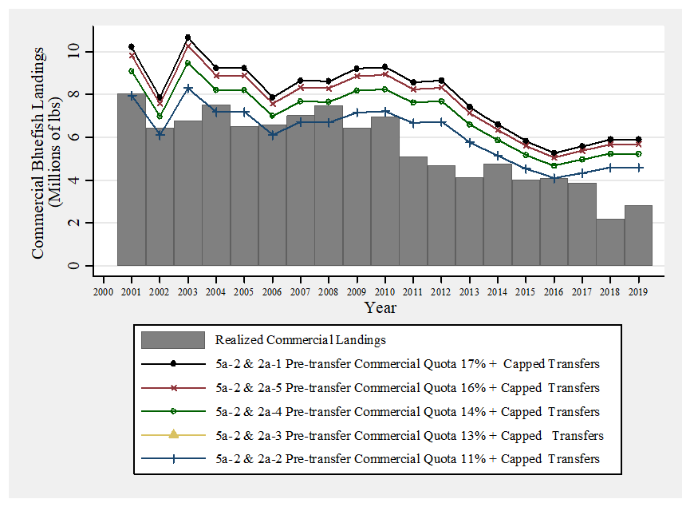
8.2.1 Transfer Cap Impacts
Notes:
The FMAT thought it would be helpful to analyze the impacts of the sector transfer cap if it had been applied over the period 2001-2019. So here we have a graph that displays realized commercial landings over the period 2001 to 2019. The gray bars indicate the amount of landings that actually occurred. Each line represents the hypothetical commercial sector quota under each of the commercial/recreational allocation alternatives with a transfer of 10% of the ABC as described in the legend. The key thing to note here is the realized landings exceed the hypothetical quota in only a few years under alternative 2a-2 where the commercial sector is allocated only 11% of the ABC. This historical analysis suggests that the proposed 10% transfer cap is not likely to be an overly constraining factor on transfers moving forward, yet still provides a reasonable upper bound to the transfers. The FMAT also points out that the 10% cap scales with increases in biomass, which allows for larger transfers when the stock is healthy, and caps transfers at a lower level when biomass is low.

Slide 39
9.0 Management Uncertainty
Alternatives | Management Uncertainty Alternatives
6a | No Action/Status Quo
6b | Post-Sector Split
Alt 6b would modify how the Monitoring Committee, Board, and Council account for management uncertainty by allowing for a more targeted approach
Notes:
Section 9 covers sector specific management uncertainty. Refining this tool will enable management uncertainty to target one specific sector while avoiding negatively affecting the other sector.
For example, the recreational discard calculations have been a management uncertainty concern for a while, however, no reductions for management uncertainty have occurred in recent years because it would lead to reductions in the commercial quota.

Slide 40
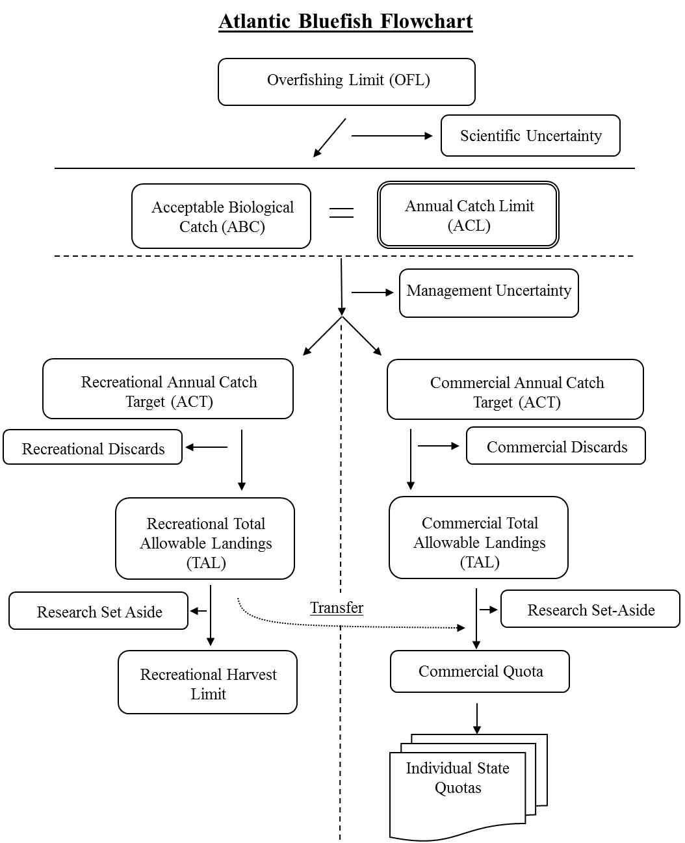
9.1 Management Uncertainty
Sector Specific Management Uncertainty
Status Quo
Notes:
As you can see, in the bluefish flow chart from amendment 1, which is the status quo alternative, management uncertainty is accounted for prior to the sector split. Any reduction for management uncertainty trickles down into reductions for both the commercial and recreational ACTs.

Slide 41
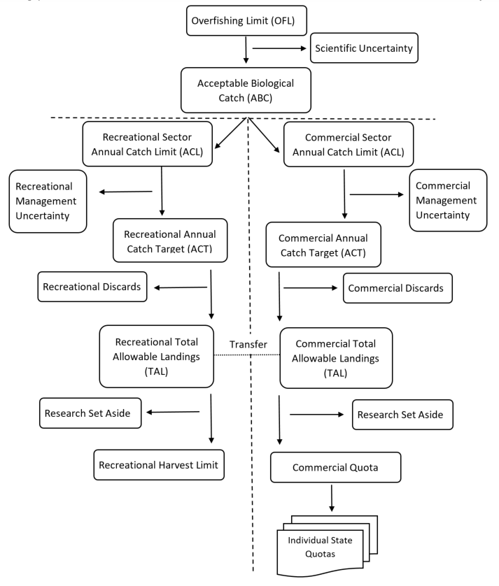
9.1 Management Uncertainty
Sector Specific Management Uncertainty
Post-Sector Split
Notes:
The new proposed bluefish flow chart would add sector specific ACLs which together equal the ABC. Catch would be allocated to the two sectors depending on the allocation selected in this amendment. Then each sector’s ACT would equal the sector specific ACLs minus any deductions for management uncertainty.

Slide 42
Accountability Measures (AMs) – 8.0 & 9.0
Management Uncertainty
  Adoption of 6b would implement sector specific ACLs, which would require adjustments to AMs
  This change would model the AMs currently in effect for summer flounder, scup, and black sea bass
Sector Transfers
  Adoption of 5a-2 (bi-directional transfers) would require adjustments to AMs
The AMs would be updated through the federal rulemaking process for this action
Notes:
Updating management uncertainty and the sector transfers would require adjustments to accountability measures through the federal rule making process. Adoption of management uncertainty alternative 6b would implement sector specific ACLs, which would require adjustments to AMs. This change would model the AMs currently in effect for summer flounder, scup, and black sea bass.
In regards to sector transfers, implementation of bi-directional transfers would require adjustments to AMs as well. The current AMs indicate that if the monitoring committee determines that a transfer from the recreational to commercial sector caused the fishery-level ACL to be exceeded, the transfer amount could be deducted from the receiving fishery in a subsequent year. This language would be updated to reflect the new bi-directional transfer process

Slide 43
10.0 De Minimis
Alternatives | De Minimis Alternatives
7a | No Action/Status Quo
7b | Recreational De Minimis
7c | Recreational De Minimis with Default Plan Provisions
Notes:
Section 10 covers de minimis status. As a reminder, the Commission's ISFMP Charter defines de minimis as a situation in which, under existing conditions of the stock and scope of the fishery, conservation and enforcement actions taken by an individual state would be expected to contribute insignificantly to a coastwide conservation program required by an FMP or amendment. Under the Commission’s current bluefish FMP, states which land less than 0.1% of the coastwide commercial landings in the year prior are exempt from fishery independent monitoring requirements for the following year. However, it is important to note that the federal plan does not require states to submit fishery independent monitoring reports, and as such has no de minimis provision.

Slide 44
10.1 De Minimis Alternatives
Alternative 7b
During scoping, Georgia DNR proposed a de minimis provision
De minimis status would exempt the state from recreational measures
To qualify for de minimis status:
  3-year average of total landings (commercial + recreational) < 1% coastwide landings
Alternative 7c
Minimum default measures
  3 fish bag limit (private anglers), 5 fish bag limit (party/charter), no minimum size, open all year round.
Notes:
During the scoping process the Georgia Department of Natural Resources submitted a proposal to revise the de minimis provision for bluefish. Alternative 7b expands upon the Commission’s current de minimis provision. A state’s three-year average of combined recreational and commercial landings compared against coastwide landings for the same period with a 1% threshold would be used to determine status. A de minimis determination would exempt the state from recreational measures in addition to the existing exemption of the requirement to conduct fishery independent monitoring.
Alternative 7c was included in the alternative set at the last Board meeting in October. Qualifying for de minimis status would be identical under alternatives 7b and 7c. The key difference is that a de minimis determination would allow a state to maintain a set of minimum default recreational measures. The fixed set of minimum default measures would consist of a bag limit of 3 fish for anglers fishing from shore or private vessels and 5 fish for anglers fishing on a for-hire trip, no minimum size, and an open season all year. These measures are consistent with the coastwide measures that were implemented in 2020.
A key distinction here is that de minimis states would have the option to choose from the minimum default measures or whatever coastwide measures are currently in place. If the coastwide bag limit is lower at some point in the future than it is now, then de minimis states would stand to benefit. However, if the coastwide bag limit is higher in the future, de minimis states wouldn’t be beholden to the 3/5 bag limit, they could still implement the coastwide bag limit if they so choose.

Slide 45
10.2 Impacts of De Minimis
Alternatives 7b and 7c complicate enforcement
Alt 7b slightly reduces catch accountability in short term
Alternative 7b provides minor economic benefits to de minimis states
Notes:
Alternatives 7b and 7c have the potential to complicate enforcement especially for states that share bodies of water, such as bays. From a catch accounting perspective, the proposed de minimis provision in alternative 7b would reduce a state’s accountability for its recreational harvest in the short term. In the short term, it is possible that harvest could spike upwards in one year with an increase in availability of bluefish combined with liberal measures. However, if the spike in harvest was significant enough, the state would no longer meet the de minimis requirement for the following year and thus would have to adjust measures to align with the coastwide regulations. Overall, the risk of this negatively impacting the stock is quite low. Overall alternative 7b provides minor economic benefits to de minimis states through higher bag limits and less administrative burden.

Slide 46
Next Steps
March/April 2021: Public Hearings
June 2021: Final Action
August 2021: Formal submission to NOAA Fisheries
2021: Management Track Assessment
2022: Bluefish Rebuilding Plan Implemented
Public comment period will open after the document is posted
First hearing can not be scheduled until 30 days after posting – we will be in touch to schedule hearings.

Slide 47
Backup Slides

Slide 48
Rebuilding Example
Specification | Rebuilding Plan Alternatives with Estimated Specifications
 | 4a - No Action/ Status Quo | 4b - Constant Harvest | 4c - P* (Council Risk Policy) | 4d - Constant Fishing Mortality
 | 2022 Fishing Year – M lbs (mt), Assuming 83% recreational , 17% commercial allocation
Rebuilding Plan Duration | n/a | 4 years | 5 years | 7 years
Adjustment to Risk Policy | n/a | no | n/a | yes
Catch | With no action, no rebuilding plan would be implemented, no changes to the current risk policy would occur, and the current specifications would remain in place. | 16.28 (7,385) | 24.74 (11,222) | 40.73 (18,477)
ACL |  | 16.28 (7,385) | 24.74 (11,222) | 40.73 (18,477)
Commercial ACT |  | 2.77 (1,255) | 4.21 (1,908) | 6.92 (3,141)
Recreational ACT |  | 13.51 (6,130) | 20.53 (9,314) | 33.81 (15,336)
Commercial Discards |  | 0 | 0 | 0
Recreational Discards (2019 estimate) |  | 5.17 (2,343) | 5.17 (2,343) | 5.17 (2,343)
Commercial TAL |  | 2.77 (1,255) | 4.21 (1,908) | 6.92 (3,141)
Recreational TAL |  | 8.34 (3,785) | 15.36 (6,971) | 28.64 (12,993)
Commercial Quota |  | 2.77 (1,255) | 4.21 (1,908) | 6.92 (3,141)
RHL |  | 8.34 (3,785) | 15.36 (6,971) | 28.64 (12,993)

Slide 49
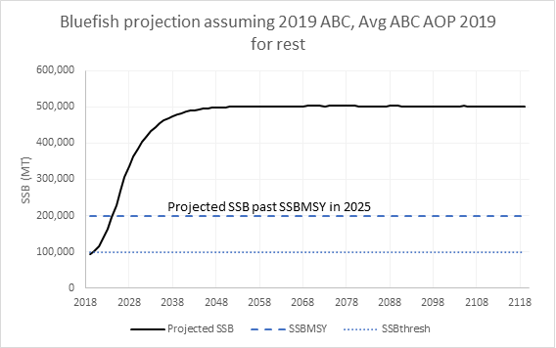

Slide 50
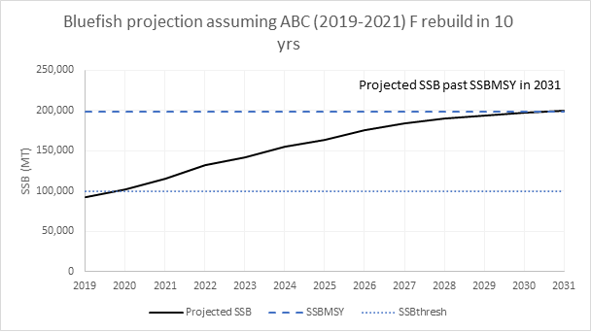

Slide 51
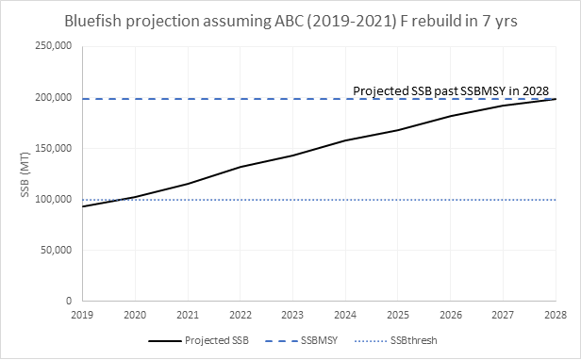

Slide 52
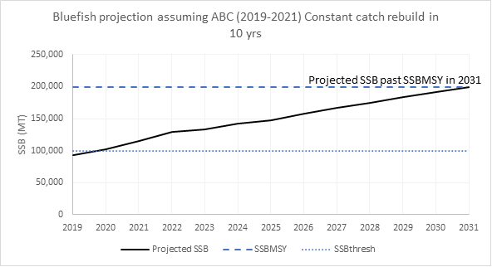

Slide 53
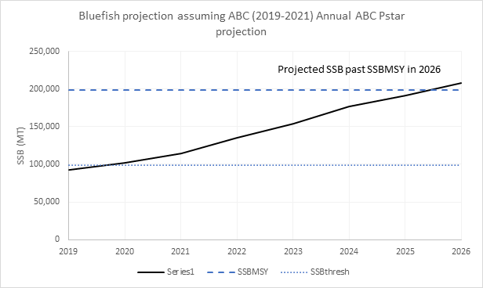

Slide 54
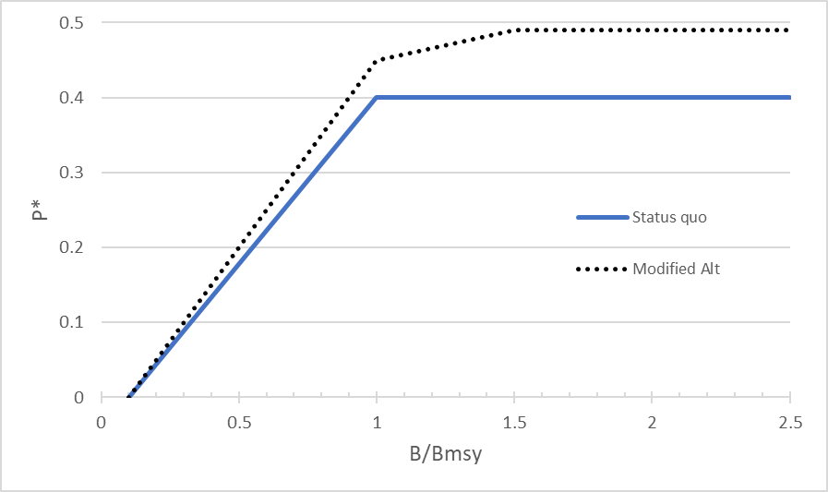
Risk Policy
Notes:
That figure is a graphical representation of the revised/new risk policy (the dotted line) that will be implemented beginning of 2021.

Slide 55
Commercial State-to-State Transfers
 | 2005 | 2006 | 2007 | 2008 | 2009 | 2010 | 2011 | 2012 | 2013 | 2014 | 2015 | 2016 | 2017 | 2018 | Average
ME | 0 | -52,000 | -25,000 | -45,000 | 0 | 0 | 0 | 0 | 0 | -45,000 | -30,000 | -32,000 | 0 | 0 | -16,357
NH | 0 | 0 | 0 | 0 | 0 | 0 | 0 | 100,000 | 0 | 0 | 0 | -20,000 | 0 | 0 | 5,714
MA | 0 | 0 | 0 | 0 | 0 | 0 | 0 | 0 | 200,000 | 45,000 | 250,000 | 225,000 | 0 | 0 | 51,429
RI | 0 | 60,000 | 155,000 | -50,000 | 0 | 0 | 0 | 0 | 0 | 100,000 | 180,000 | 132,000 | 150,338 | 0 | 51,953
CT | 0 | 0 | 0 | -20,000 | -75,000 | 0 | 0 | 0 | 0 | 0 | 0 | 0 | 0 | 0 | -6,786
NY | 0 | 250,000 | 450,000 | 455,000 | 425,000 | 0 | 200,000 | 50,000 | 300,000 | 250,000 | 550,000 | 420,000 | 0 | 0 | 239,286
NJ | 0 | 0 | 309,125 | 0 | 0 | 0 | 0 | 0 | -300,000 | -50,000 | 0 | -40,000 | -50,000 | 0 | -9,348
DE | 0 | -15,000 | -80,000 | -90,000 | 0 | 0 | 0 | 0 | 0 | 0 | 0 | -50,000 | 0 | 0 | -16,786
MD | 0 | -45,000 | -50,000 | -50,000 | 0 | 0 | 0 | 0 | 0 | -50,000 | 0 | -50,000 | 0 | 0 | -17,500
VA | 0 | -525,000 | -350,000 | 0 | -150,000 | 0 | 0 | 0 | 0 | 0 | -250,000 | -210,000 | -338 | 0 | -106,096
NC | 0 | 652,000 | 0 | -100,000 | 0 | 0 | 0 | -100,000 | -200,000 | 0 | -550,000 | -225,000 | -100,000 | 0 | -44,500
SC | 0 | 0 | 0 | 0 | 0 | 0 | 0 | 0 | 0 | 0 | 0 | -150,000 | 0 | 0 | -10,714
GA | 0 | 0 | 0 | 0 | 0 | 0 | 0 | 0 | 0 | 0 | 0 | 0 | 0 | 0 | 0
FL | 0 | -325,000 | -409,125 | -100,000 | -200,000 | 0 | -200,000 | -50,000 | 0 | -250,000 | -150,000 | 0 | 0 | 0 | -120,295
Dealer Data
Notes:
Transitioning to Issue 4 but focusing on commercial state to state transfers:
The FMAT commented that the state-to-state transfers are likely to be used less frequently following successful commercial state quota reallocation, but it is still a very useful tool for adaptive management.
In the table, you can see in light grey which states have consistently been receiving quota in the form of a transfer and in dark grey which states have consistently sent quota to another state.
It’s important to note that the majority of public opinion supports the ability to transfer commercial quota between states.

Slide 56
Year | Sector Transfer (million lbs) | TAC/ABC (million lbs) | Sector Transfer % of ABC
2002 | 5.933 | 29.1 | 20%
2003 | 4.161 | 39.5 | 11%
2004 | 5.085 | 34.22 | 15%
2005 | 5.254 | 34.22 | 15%
2006 | 5.367 | 29.15 | 18%
2007 | 4.78 | 32.03 | 15%
2008 | 4.088 | 31.89 | 13%
2009 | 4.838 | 34.08 | 14%
2010 | 5.387 | 34.38 | 16%
2011 | 4.772 | 31.74 | 15%
2012 | 5.052 | 32.04 | 16%
2013 | 4.686 | 27.47 | 17%
2014 | 3.34 | 24.43 | 14%
2015 | 1.579 | 21.54 | 7%
2016 | 1.577 | 19.45 | 8%
2017 | 5.033 | 20.64 | 24%
2018 | 3.535 | 21.81 | 16%
2019 | 4 | 21.81 | 18%
2020 | 0 | 16.28 | 0%
TAC through 2011, ABC 2012 onwards
2002-2020 average = 14% of ABC

Slide 57
10.0 De Minimis
Additional considerations:
  For-hire operators with a federal permit would be required to adhere to the more restrictive regulations (federal or state) regardless of where they are fishing.
  If a state’s de minimis status is not granted for the following year it would be required to implement all current commercial and recreational regulations for the next fishing year or be found out of compliance
Notes:
There are a few important considerations when it comes to this revised de minimis alternative. For-hire operators with a federal permit would be required to adhere to the more restrictive regulations (federal or state) regardless of where they are fishing.
If a state’s de minimis status is not granted for the following year, it would be required to implement all current commercial and recreational regulations for the next fishing year or they are likely to be found out of compliance with the Bluefish FMP

