Slide 1
Stock assessment of Summer flounder (Paralichthys dentatus)
Managed as a unit stock from New England to North Carolina
Maximum size & age fish in NEFSC SV and fishery samples:
SV: 2005 - 76 cm FL age 14; 2011 - 82 cm age 11
Comm land: 2005 - 75 cm FL age 13; 2011 - 74 cm age 13
2010 - 82 cm age 12
50% mature age 1.0; average M = 0.25
Commercial trawl fishery; recreational rod and reel fishery
Comm. landings ~60%; Comm. discards ~<5%
Rec. landings ~25%; Rec. discards ~10%
NEFSC SVs peaked in late 1970s, mid 2000s
Comm landings (and probably total catch) peaked in late 1970s

Slide 3
Assessment history Summer flounder (Paralichthys dentatus)
First comprehensive assessment: Chang and Pacheco (1975)
Compilation of catch and surveys, tagging data
Tag Fs ~0.3-9.6 for late 1950s-early 1960s
Survey Fs ~0.3-0.5 late 1960s-early 1970s
Un-tuned VPA, S-R data (M = 0.20): MSY = 21 kmt
Second comprehensive assessment: Fogarty (1981)
Updated tagging Fs, YPR analysis
Fmax combined sexes ~0.20 (M= 0.20), MSY = ~20 kmt
First analytical assessment (tuned VPA): 1990 SAW 11
"Overexploited and seriously depleted"; poor 1988 YC
Fmax = 0.23 (M=0.20)

Slide 4
Assessment history Summer flounder (Paralichthys dentatus)
Subsequent SAW analytical assessments:
1991 SAW 13, 1993 SAW 16, 1994 SAW 18, 1995 SAW 20,
1996 SAW 22
ADAPT VPA, YPR: generally found stock overexploited (overfishing) and at low to medium biomass (overfished),
Fmax = 0.23 (M=0.20; 1990 SAW 11)
1997 SAW 25: ADAPT VPA, new BRPs (YPR)
Overexploited, medium abundance; Fmax = 0.24 (M=0.20)
Subject to NRC review (NRC 2000)
1999 Amendment 12: SFA BRPs
FMSY = Fmax = 0.24 (M = 0.20); BMSY = 153 kmt
Initial Rebuild Deadline by 2006 (Amend 12)
1998, 1999 Updates: ADAPT VPA, new BRPs (YPR)
Fmax = 0.26 (M = 0.20), BMSY = 106 Kmt

Slide 5
Assessment history Summer flounder (Paralichthys dentatus)
2000 SAW 31, 2001 Update: ADAPT VPA, retain 1999 BRPs
Overfished (< ½ BMSY), Overfishing (F > FMSY)
However, F lowest and B highest since the early-1980s
2002 SAW 25: ADAPT VPA, retain 1999 BRPs
Overfished (< ½ BMSY), Overfishing (F > FMSY)
2003 Update: (Not Overfished, Not Overfishing)
2004 Update: (Not Overfished, Overfishing)
2005 SAW 41: ADAPT VPA, new BRPs (YPR)
Not Overfished, Overfishing
FMSY = Fmax = 0.276 (M = 0.20); BMSY = 93 kmt;
NMFS reset rebuild deadline to 2010

Slide 6
Assessment history Summer flounder (Paralichthys dentatus)
2006 Update and NMFS S&T Review: ADAPT VPA, new BRPs (YPR)
Not Overfished, Overfishing
FMSY = Fmax = 0.28 (M=0.20); SSBMSY = 89 kmt; MSY = 21 kmt
2006 MSA Reauthorization: 3 yr extension to rebuild deadline to 2013
2007 Update: Overfished, Overfishing
2008 SAW 47: ASAP SCAA, new BRPS, average M = 0.25
Not Overfished, Not Overfishing
FMSY = F35% = 0.310 (M=0.25); SSBMSY = 60 kmt; MSY = 15 kmt
2009, 2010, 2011 Updates: Not Overfished, Not Overfishing
2011 Update indicated SSB rebuilt to just above 60 kmt in 2010

Slide 8
Summer flounder: 2012 update
Stock definition: Cape Hatteras to Maine
Data - Add 2011 fishery and research survey data to the 2008 SAW 47, 2009-2011 updated assessment models
Data - Incorporate MRIP 2004-2011 estimates; adjust prior years by 2004-2011 average
Projections - through 2013 to determine OFL
Note that based on 2011 update, stock was declared
rebuilt in 2010 (Nov 2011)
)
Tagging
5
Poole (1962)
5
Murawski (1970)
5
Lux & Nichy (1981)
5
Monaghan (1992)
)
Morphometrics and Meristics
5
Wilk et al. (1980)
5
Fogarty et al. (1983)
)
Genetics
5
Jones and Quattro (1999): no subdivision at Cape
Hatteras

Slide 9
Assessment components
Stock definition: Cape Hatteras to Maine
Tagging
)
Fishery dependent
Poole (1962)
5
NER (ME-VA) and NC commercial landings
5
Murawski (1970)
Commercial discards
5
Lux & Nichy (1981)
Recreational landings
5
Monaghan (1992)
Recreational discards
)
Morphometrics and Meristics
Fishery independent
5
Wilk et al. (1980)
NEFSC trawl surveys
5
Fogarty et al. (1983)
State agency trawl surveys
)
Genetics
Analysis: NFT ASAP SCAA, AGEPRO Projection
5
Jones and Quattro (1999): no subdivision at Cape
Hatteras

Slide 10
Commercial Landings
Comm. Landings: MA to NC, out to edge of shelf
Mainly a mixed trawl fishery (>90% of landings)
Avg. ~10,000 mt (22 million lb) for 1955-60
Avg. < 5,000 mt (11 million lb) for 1968-72
Avg. ~13,000 mt (29 million lb) for 1974-87
Under quotas, avg. 5,800 mt (13 million lb) for 1993-2009
In 2010, 5,930 mt (13 million lb)
In 2011, 7,511 mt (17 million lb)
During 1993-2009, 50% of total catch in weight
In 2010, 63% of total catch weight
In 2011, 67% of total catch weight

Slide 12
Commercial Landings at age
NER 2008: 5% age 1, 16% age 2, 24% age 3, 55% age 4+
NER 2009: 5% age 1, 21% age 2, 29% age 3, 45% age 4+
NER 2010: 5% age 1, 16% age 2, 28% age 3, 51% age 4+
NER 2011: 2% age 1, 13% age 2, 32% age 3, 53% age 4+
NC 2008: 1% age 1, 10% age 2, 25% age 3, 64% age 4+
NC 2009: 0% age 1, 9% age 2, 28% age 3, 63% age 4+
NC 2010: 1% age 1, 14% age 2, 33% age 3, 52% age 4+
NC 2011: 0% age 1, 12% age 2, 23% age 3, 65% age 4+

Slide 13
Commercial Discards
Estimated as product of Observed rate (kg/df) and fishery effort from Vessel Trip Reports (VTR); assume 80% discard mortality
Since ~2000, Comm. Discards: 70% trawl, 30% scallop dredge
2008: 73% trawl, 27% scallop dredge
2009: 91% trawl, 9% scallop dredge
2010: 86% trawl, 14% scallop dredge
2011: 79% trawl, 21% scallop dredge
Since ~2000, About 500-700 mt, about 8-10% of comm. land.
2008: 309 mt, about 8% of comm. land.
2009: 118 mt, about 3% of comm. land.
2010: 198 mt, about 3% of comm. land.
2011: 126 mt, about 2% of comm. land.
Since ~2000, 5% of total catch in weight
2008: 4% of total catch weight
2009: 2% of total catch weight
2010: 2% of total catch weight
2011: 1% of total catch weight
Age comp 2008: 19% age 0 & 1, 18% age 2, 63% age 3+
Age comp 2009: 14% age 0 & 1, 37% age 2, 49% age 3+
Age comp 2010: 28% age 0 & 1, 31% age 2, 41% age 3+
Age comp 2011: 13% age 0 & 1, 38% age 2, 49% age 3+

Slide 14
Commercial Discards
Observer/VTR estimate of landings: potential indication
of accuracy of discard estimate
Compare Observer/VTR estimate with Dealer reported
1998: -28%, 1999: + 53%, 2000: +32%, 2001: -70%,
2002: +1%, 2003: -10%
2004: -36%, 2005: -55%, 2006: -72%, 2007: -77%, 2008: -65%,
2009: -74%, 2010: -56%, 2011: -81%
Over 1989-2003, no persistent pattern or bias evident -
but 2004-2011 well below dealer report - recent bias?
To date, no adjustment to the discard estimates
2008 SAW 47 WP1: Investigation of alternative estimation (SBRM: dflk/keptall) provided no improvement in precision or “accuracy” through 2003 – but recent bias suggests need to re-investigate change to SBRM method in next benchmark

Slide 15
Recreational Landings
Estimated by MRFSS: updated for 2000+ revisions
Recreational Landings: mainly in state waters
Under bag and size limits, avg. 4,500 mt for 1993-2009
2010: 2,238 mt; 2011 2,543 mt
During 2002-2004, 36% of total catch in weight
2005: 34% of total catch in weight
2006: 42% of total catch in weight
2007: 43% of total catch in weight
2008: 41% of total catch in weight
2009: 31% of total catch in weight
2010: 24% of total catch in weight
2011: 23% of total catch in weight

Slide 16
Recreational Discards
Estimated by MRFSS: Assume 80% discard mortality
(three 1999 studies)
Since ~2000, about 20% of rec. land.
2008: 35% of rec land.
2009: 50% of rec land.
2010: 41% of rec land.
2011: 42% of rec land.
Since ~2000, ~5-10% of total catch in weight
2008: 14% of total catch in weight
2009: 15% of total catch in weight
2010: 10% of total catch in weight
2011: 10% of total catch in weight

Slide 17
Recreational Catch at age
Landings 2008: 1% age 1, 4% age 2, 19% age 3, 76% age 4+
Landings 2009: 1% age 1, 6% age 2, 25% age 3, 68% age 4+
Landings 2010: 1% age 1, 3% age 2, 16% age 3, 80% age 4+
Landings 2011: <1% age 1, 2% age 2, 14% age 3, 84% age 4+
Discards 2008: 42% age 0&1, 27% age 2, 31% age 3+
Discards 2009: 47% age 0&1, 26% age 2, 27% age 3+
Discards 2010: 45% age 0&1, 26% age 2, 29% age 3+
Discards 2011: 28% age 0&1, 28% age 2, 44% age 3+

Slide 18
Recreational Catch
MRIP to MRFSS 2004-2011 ratio
Landed number (A + B1): 0.97
Landed weight (A + B1) : 0.99
Discarded number (B2) : 0.96
Use MRIP 2004-2011 landed weight and discarded weight in model
Adjust prior years by 2004-2011 average MRIP to MRFSS ratio
Final adjusted total fishery catch about 1% lower

Slide 19
Total Catch at age
2008: ~8.8 million fish
CL: NER 2.9 + NC 1.1 = 4.0 million (46%)
CD: 0.3 million (3%)
RL: 2.3 million (26%)
RD: 2.2 million (25%)
2009: ~9.3 million fish
CL: NER 3.5 + NC 1.4 = 4.9 million (53%)
CD: 0.1 million (1%)
RL: 1.9 million (20%)
RD: 2.4 million (26%)
2010: ~10.0 million fish
CL: NER 4.3 + NC 1.6 = 5.9 million (60%)
CD: 0.3 million (3%)
RL: 1.5 million (15%)
RD: 2.2 million (22%)
2011: ~11.3 million fish
CL: NER 5.9 + NC 1.4 = 7.3 million (64%)
CD: 0.2 million (2%)
RL: 1.8 million (16%)
RD: 2.0 million (18%)

Slide 22
Research Surveys
NEFSC: Spring 1968-2012, Fall 1963-2011,
Winter 1992-2007
MADMF: Spring and Fall, Seine YOY 1978-2011
RIDFW: Fall 1979-2011, Monthly Fixed 1990-2011
CTDEP: Spring and Fall, 1984-2011
NJBMF: Apr-Oct, 1988-2011
DEDFW: Annual, 1980-2011
MDDNR: YOY, 1980-2011
VIMS: YOY, Rivers 1980-2011
VIMS ChesMMAP: 2002-2011
VIMS NEAMAP: 2007-2011
NCDMF: YOY, 1987-2011

Slide 33
Summer flounder 2012
With respect to 2008 SAW 47 BRPs
Not Overfished: SSB2011 = 57,020 mt;
5% below Btarget = SSBMSY = SSB35% = 60,074 mt
Stock was declared rebuilt in 2010 based on 2011 update
(estimated at 60,238 mt in 2010)
Not Overfishing: F2011 = 0.241; below FMSY = F35% = 0.310
Recruitment in 2008: 47 million
Recruitment in 2009: 47 million
Recruitment in 2010: 32 million
Recruitment in 2011: 26 million
Average 1982-2011: 42 million
Retrospective: recent is reversed compared to 2004 pattern;
Now underestimate SSB and overestimate F;
Tendency to overestimate recent R

Slide 34
Summer flounder 2012
Estimate of 2009 year class is no longer large (initially was influenced by recent northern state [CT, RI, MA] and MD YOY indices, relatively large age 0 discards in 2009 rec fishery)
Developing retro pattern in recruitment estimates, 2009 year class is now 48% lower than initial estimate in 2010;
2010 & 2011 year classes below average

Slide 40
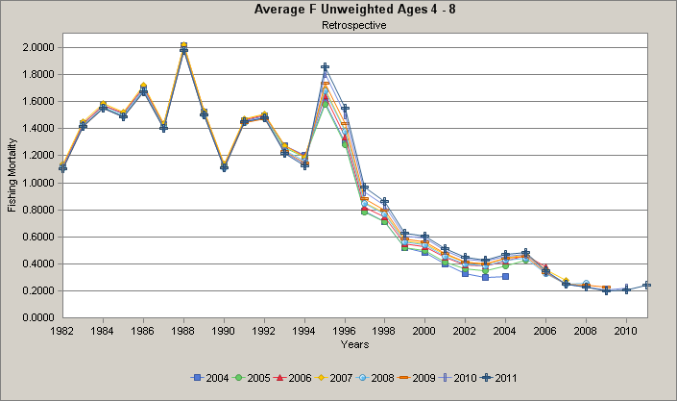
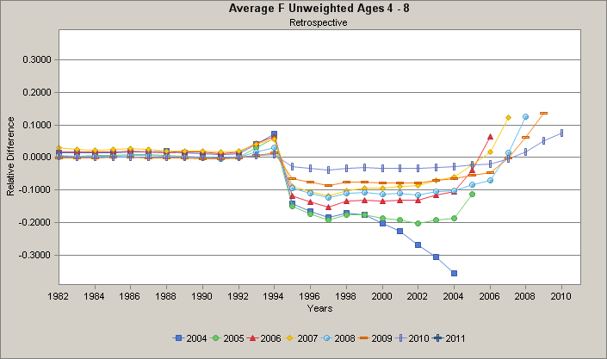

Slide 41
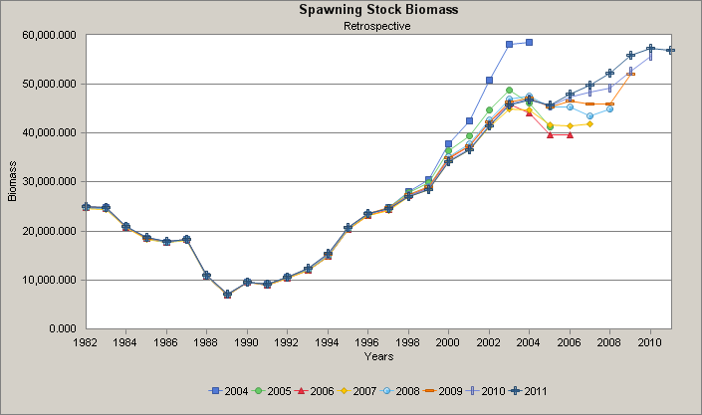
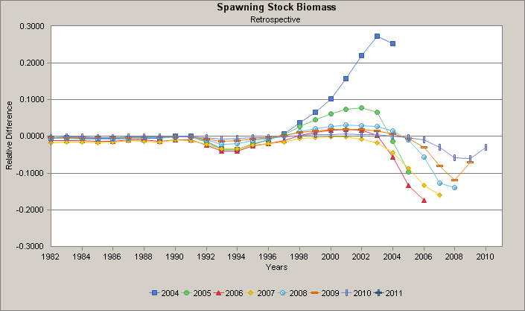

Slide 42
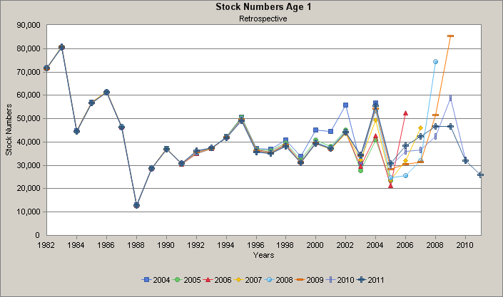
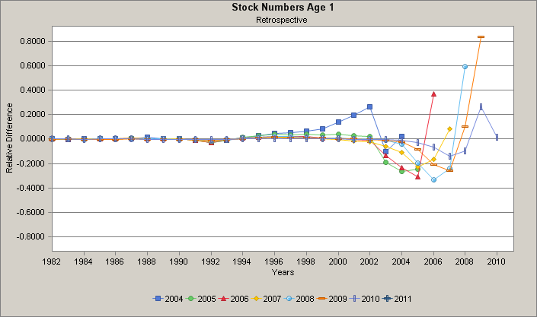

Slide 43
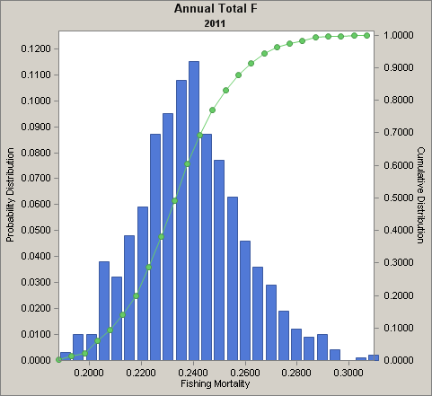
50% CI = 0.228 - 0.254

Slide 44
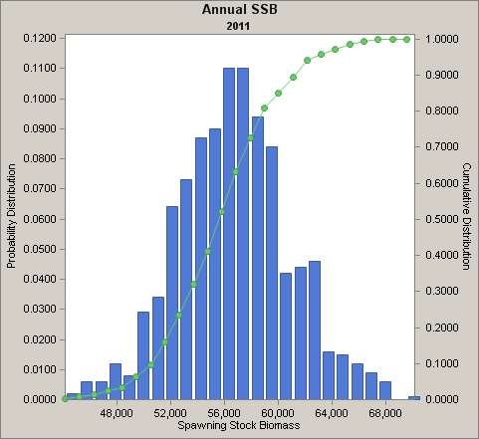
50% CI = 54,440 - 59,822 mt

Slide 48
Summer flounder 2012
Short term projection for 2013 OFL (at FMSY = 0.310)
Use 2008 SAW 47 BRPs; no explicit adjustment for retro (2006 S&T; Legault and Terceiro 2008 [GARM3 work])
AGEPRO stochastic projection
resample 1982-2011 CDF of age 0 recruitment
Note MSY = 13,122 mt of Total Landings + 1,510 mt Total Disc =
14,632 mt of Total Catch
Specify Landings in 2012 = TAL = 10,238 mt;
Median Discards = 1,455 mt; median Total Catch = 11,693 mt
Median F2012 = 0.247, below FMSY
Median SSB2012 = 55,300 mt, below Btarget (SSBMSY)

Slide 49
Summer flounder 2012
Specify F in 2013 = FMSY = 0.310
Total Catch = 13,523 mt = Overfishing Limit (OFL)
Landings = 11,892 mt and Discards = 1,637 mt
(note: independent medians so do not exactly total)
Median SSB2013 = 52,843 mt, below Btarget (88% of SSBMSY)

