Slide 1
Summer flounder Management Strategy Evaluation Example simulations walk-through
01 March 2022
Gavin Fay (gfay@umassd.edu)

Slide 2
What is Management Strategy Evaluation?
Process for:
Comparing the performance of management strategies under multiple (& often conflicting) management objectives
Examining impacts, tradeoffs, & robustness of management strategies.
MSEs include analytical simulation frameworks but can (should) be more than this.

Slide 3
Each advice time-step...
MSE: Compare performance of alternative policy options, quantify tradeoffs among objectives
Operating Model
Update Population dynamics given the new catch
Implementation Model
Data Generation Model
Realized recreational landings / discards based on management regulations
Catch estimates by fleet
Current biomass
Fishing mortality rate
F reference point
Management Procedure
Stock Assessment
Determine ABC
Set Recreational fishery regulations
Pseudo-assessment
Gavin Fay, gfay@umassd.edu

Slide 4
Each advice time-step...
MSE: Compare performance of alternative policy options, quantify tradeoffs among objectives
Operating Model
Update Population dynamics given the new catch
Implementation Model
Implementation Model
Data Generation Model
Management scenarios
Status quo
Coastwide regs
14” minimum size
2 fish bag limit
Realized recreational landings / discards based on management regulations
Realized recreational landings / discards based on management regulations
Catch estimates by fleet
Current biomass
Fishing mortality rate
F reference point
Management Procedure
Stock Assessment
Determine ABC
Set Recreational fishery regulations
Pseudo-assessment
Gavin Fay, gfay@umassd.edu

Slide 5
Each advice time-step...
MSE: Compare performance of alternative policy options, quantify tradeoffs among objectives
Angler behavior model
Use operating model length structure & management regulations
Predict numbers of recreational trips, #s of kept and released fish, & sizes of harvest and releases
Operating Model
Update Population dynamics given the new catch
Implementation Model
Implementation Model
Data Generation Model
Management scenarios
Status quo
Coastwide regs
14” minimum size
2 fish bag limit
Realized recreational landings / discards based on management regulations
Realized recreational landings / discards based on management regulations
Catch estimates by fleet
Current biomass
Fishing mortality rate
F reference point
Management Procedure
Stock Assessment
Determine ABC
Set Recreational fishery regulations
Pseudo-assessment
Gavin Fay, gfay@umassd.edu

Slide 6
Repeat annual loop for a projection period (series of advice steps, here 15 years)
Repeat whole thing multiple times for multiple simulations under each scenario
Compute and save performance metrics
Performance Metrics
Angler metrics
Economic metrics
Biological metrics
Operating Model
Update Population dynamics given the new catch
Implementation Model
Implementation Model
Data Generation Model
Management scenarios
Status quo
Coastwide regulations
14” minimum size
2 fish bag limit
Realized recreational landings / discards based on management regulations
Realized recreational landings / discards based on management regulations
Catch estimates by fleet
Current biomass
Fishing mortality rate
F reference point
Management Procedure
Stock Assessment
Determine ABC
Set Recreational fishery regulations
Pseudo-assessment
Gavin Fay, gfay@umassd.edu

Slide 7
Draft results to aid our exercises today
QA/QC still in progress to calibrate the models
These are intended to help our discussion and presented to allow comparison - should not be taken to reflect final results.

Slide 8
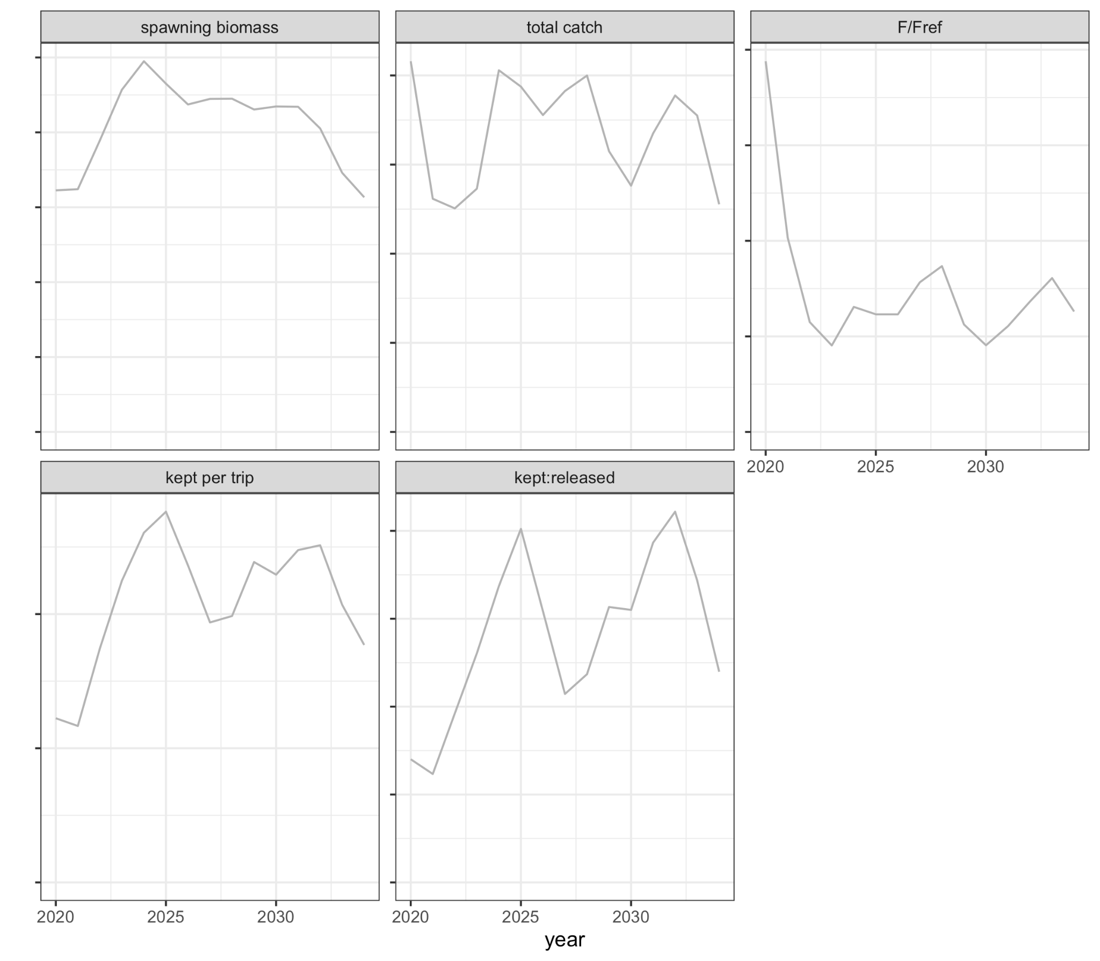
Time trajectory of projections for one complete simulation for the status quo scenario

Slide 9
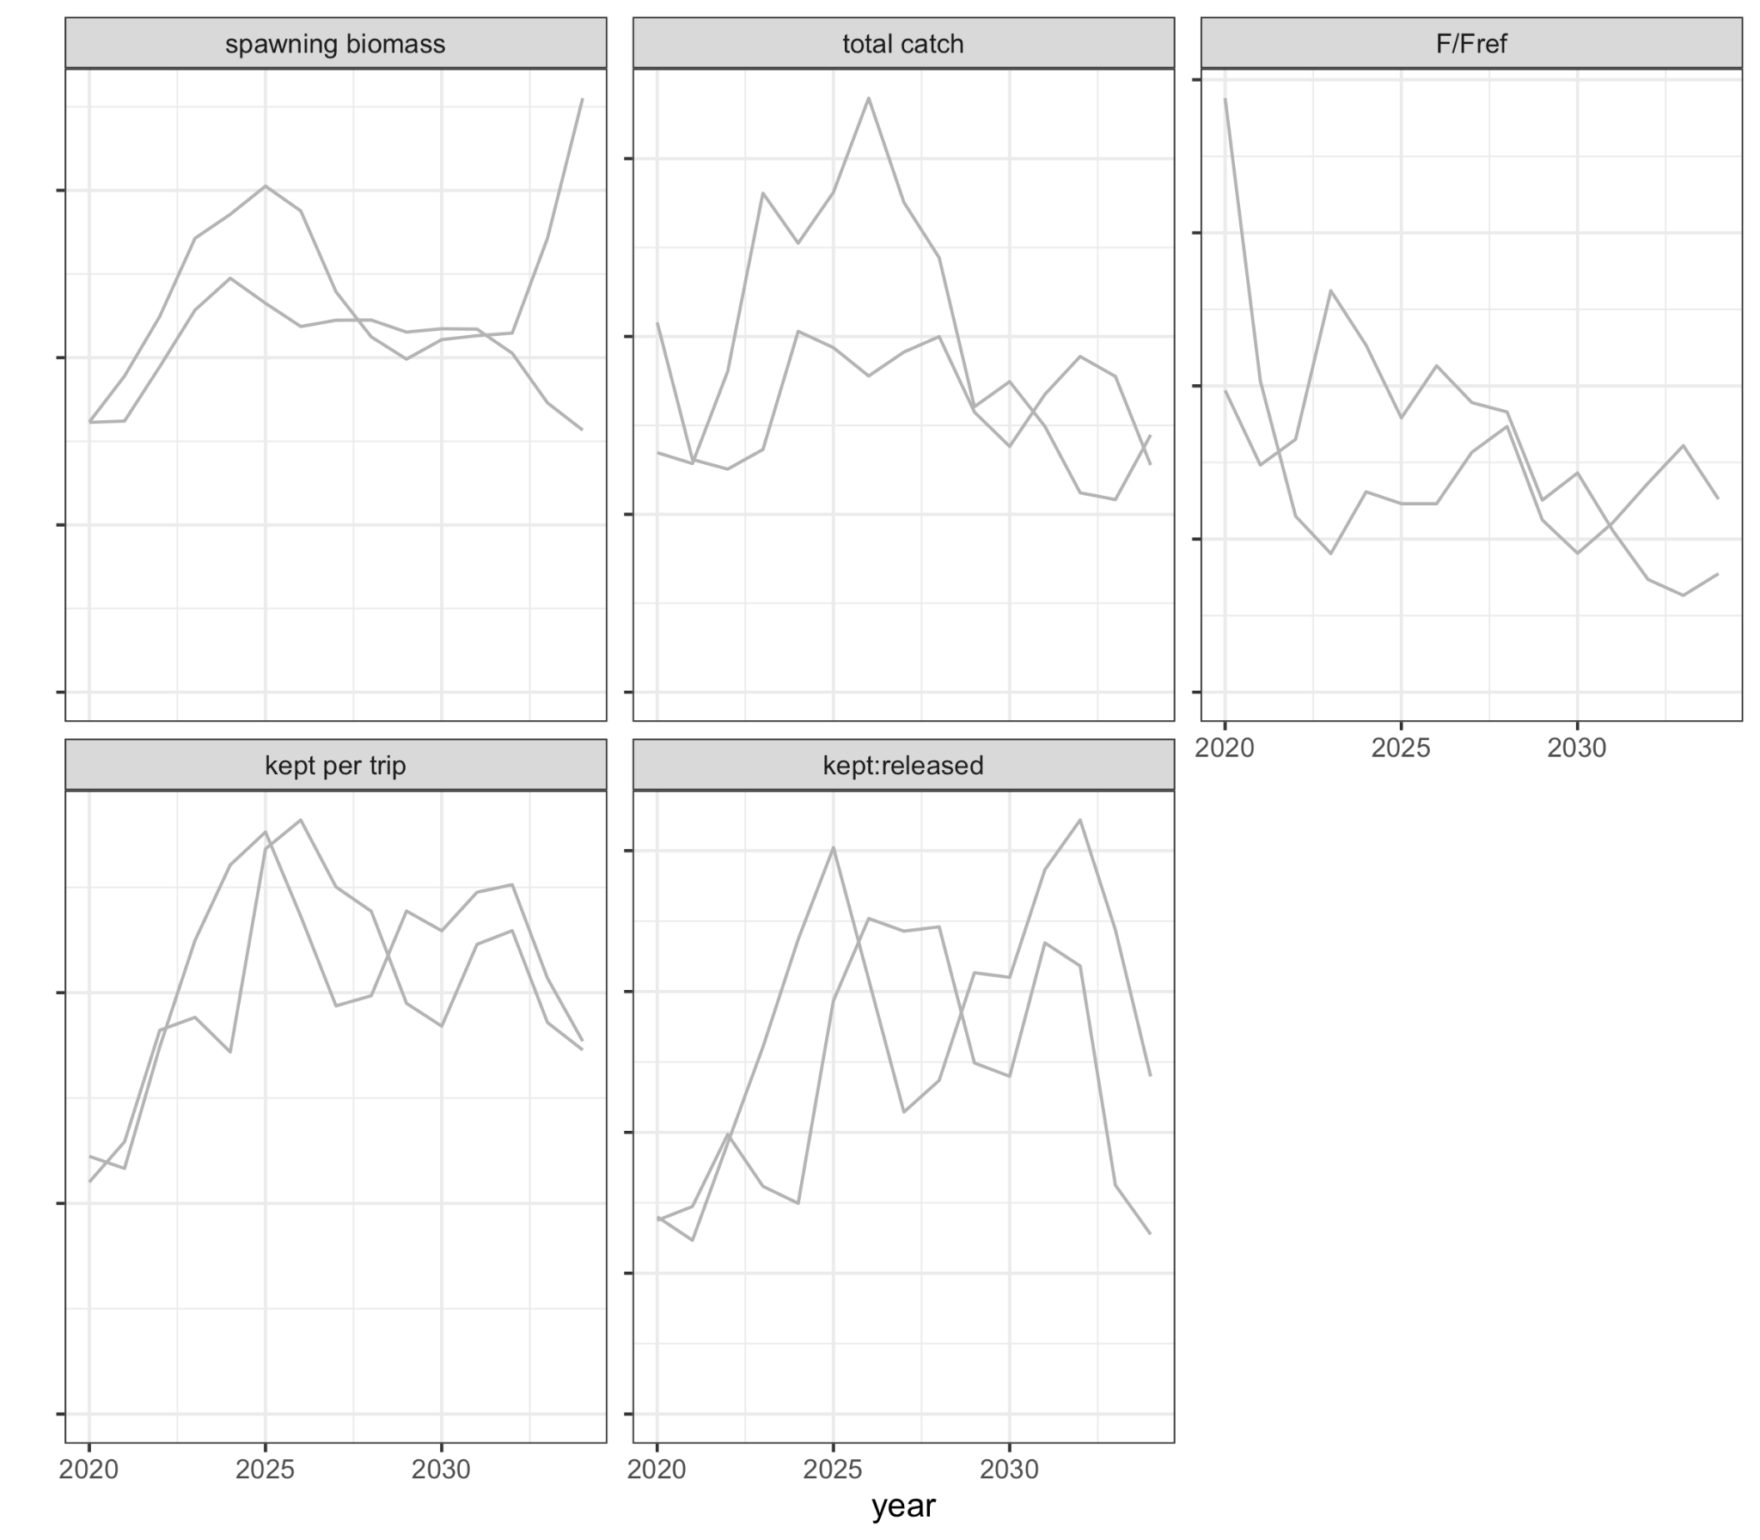
Add multiple simulations

Slide 10
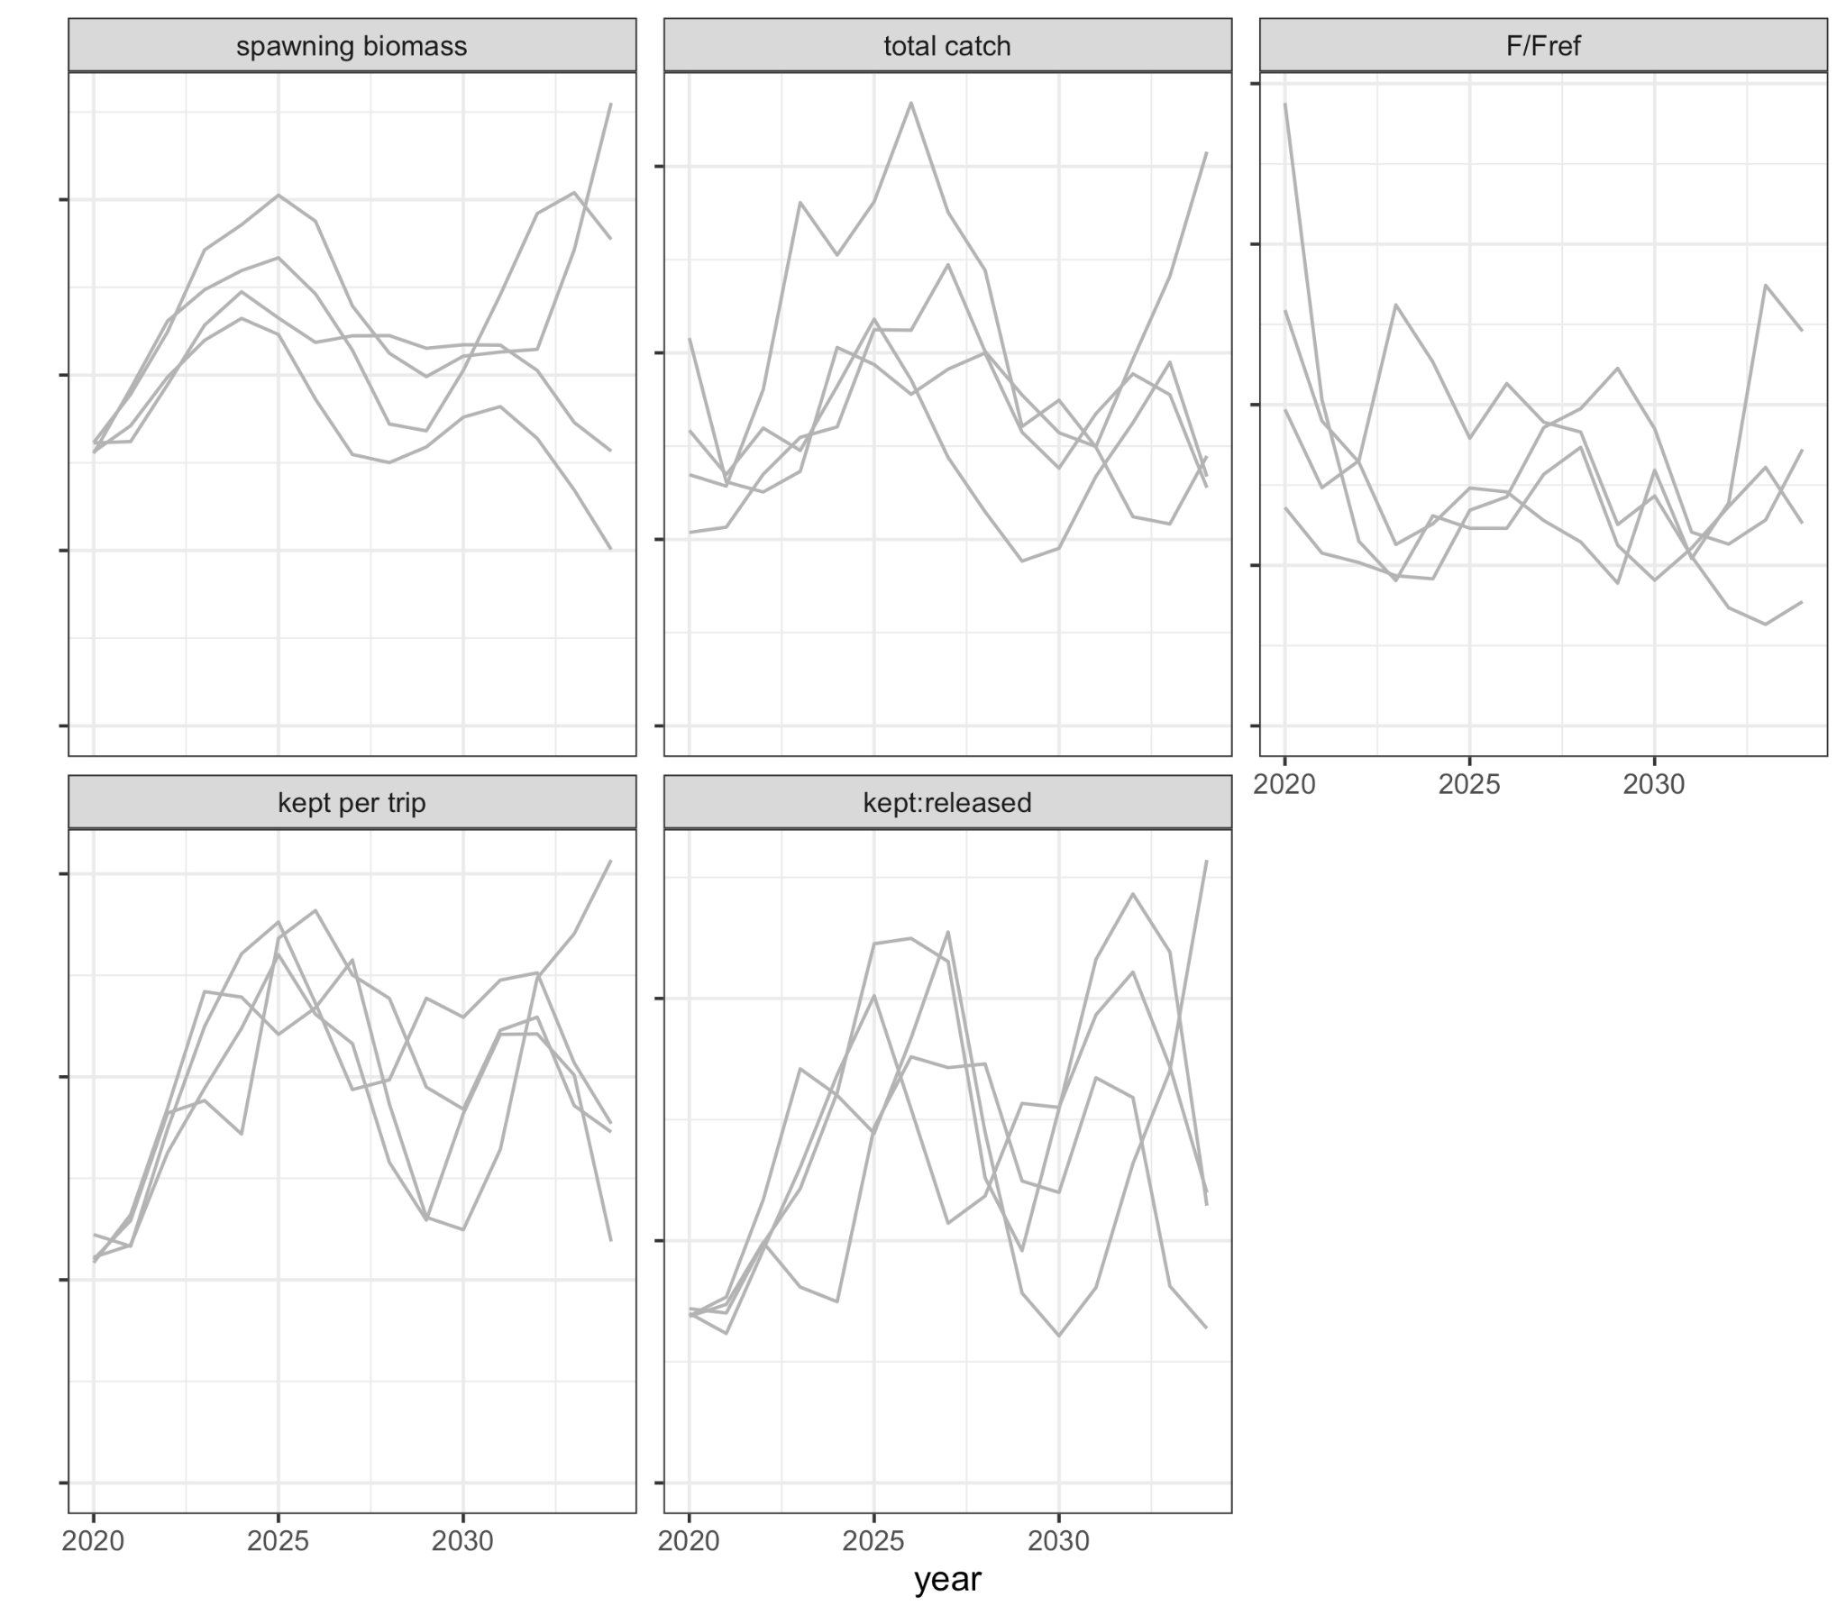
Add multiple simulations

Slide 11
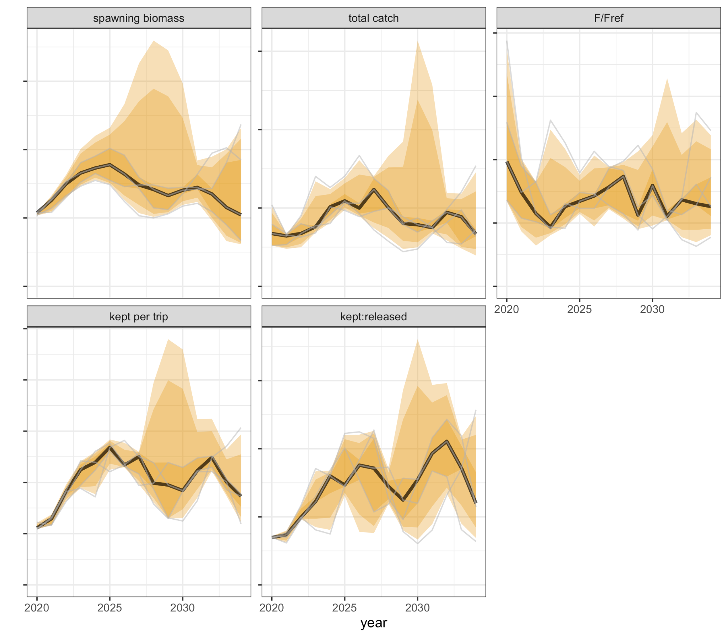
Summary distribution of the set of simulations for the status quo scenario

Slide 12
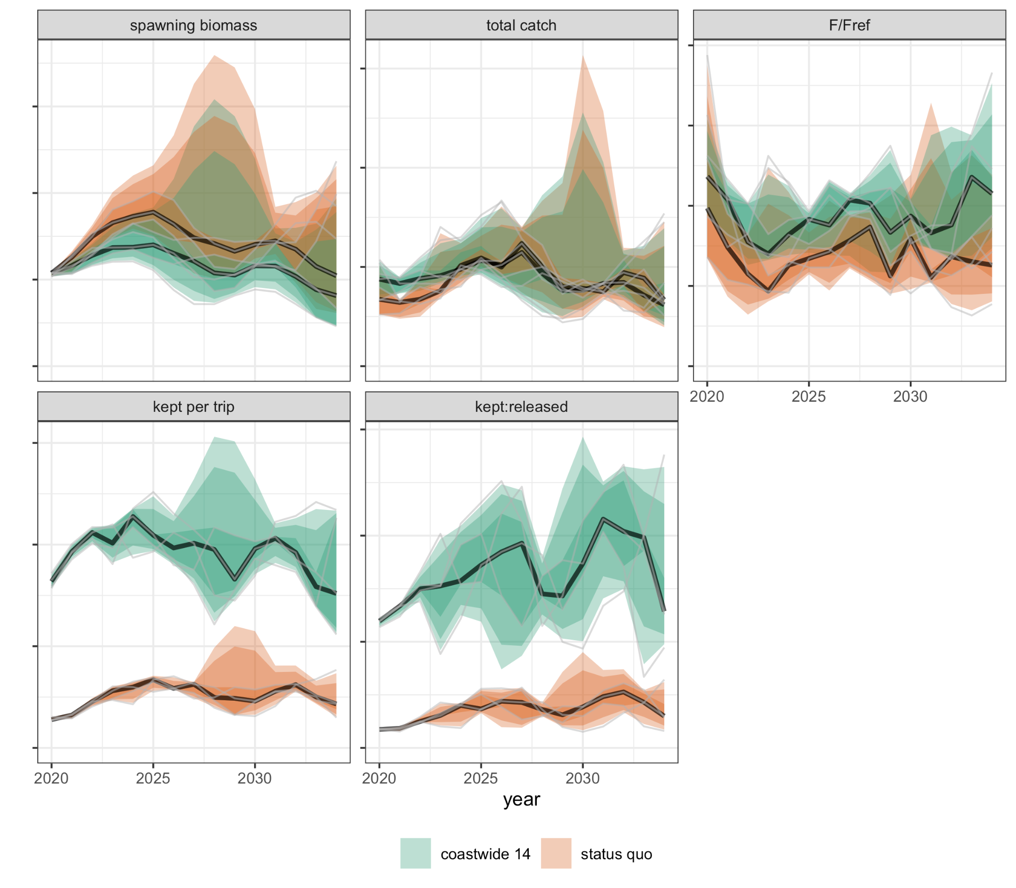
Compare among scenarios

Slide 13
Developing metrics
Calculate metrics by summarizing information from each simulation, e.g. here the average over time.

Slide 14
Developing metrics
Calculate metrics by summarizing information from each simulation, e.g. here the average over time.

Slide 15
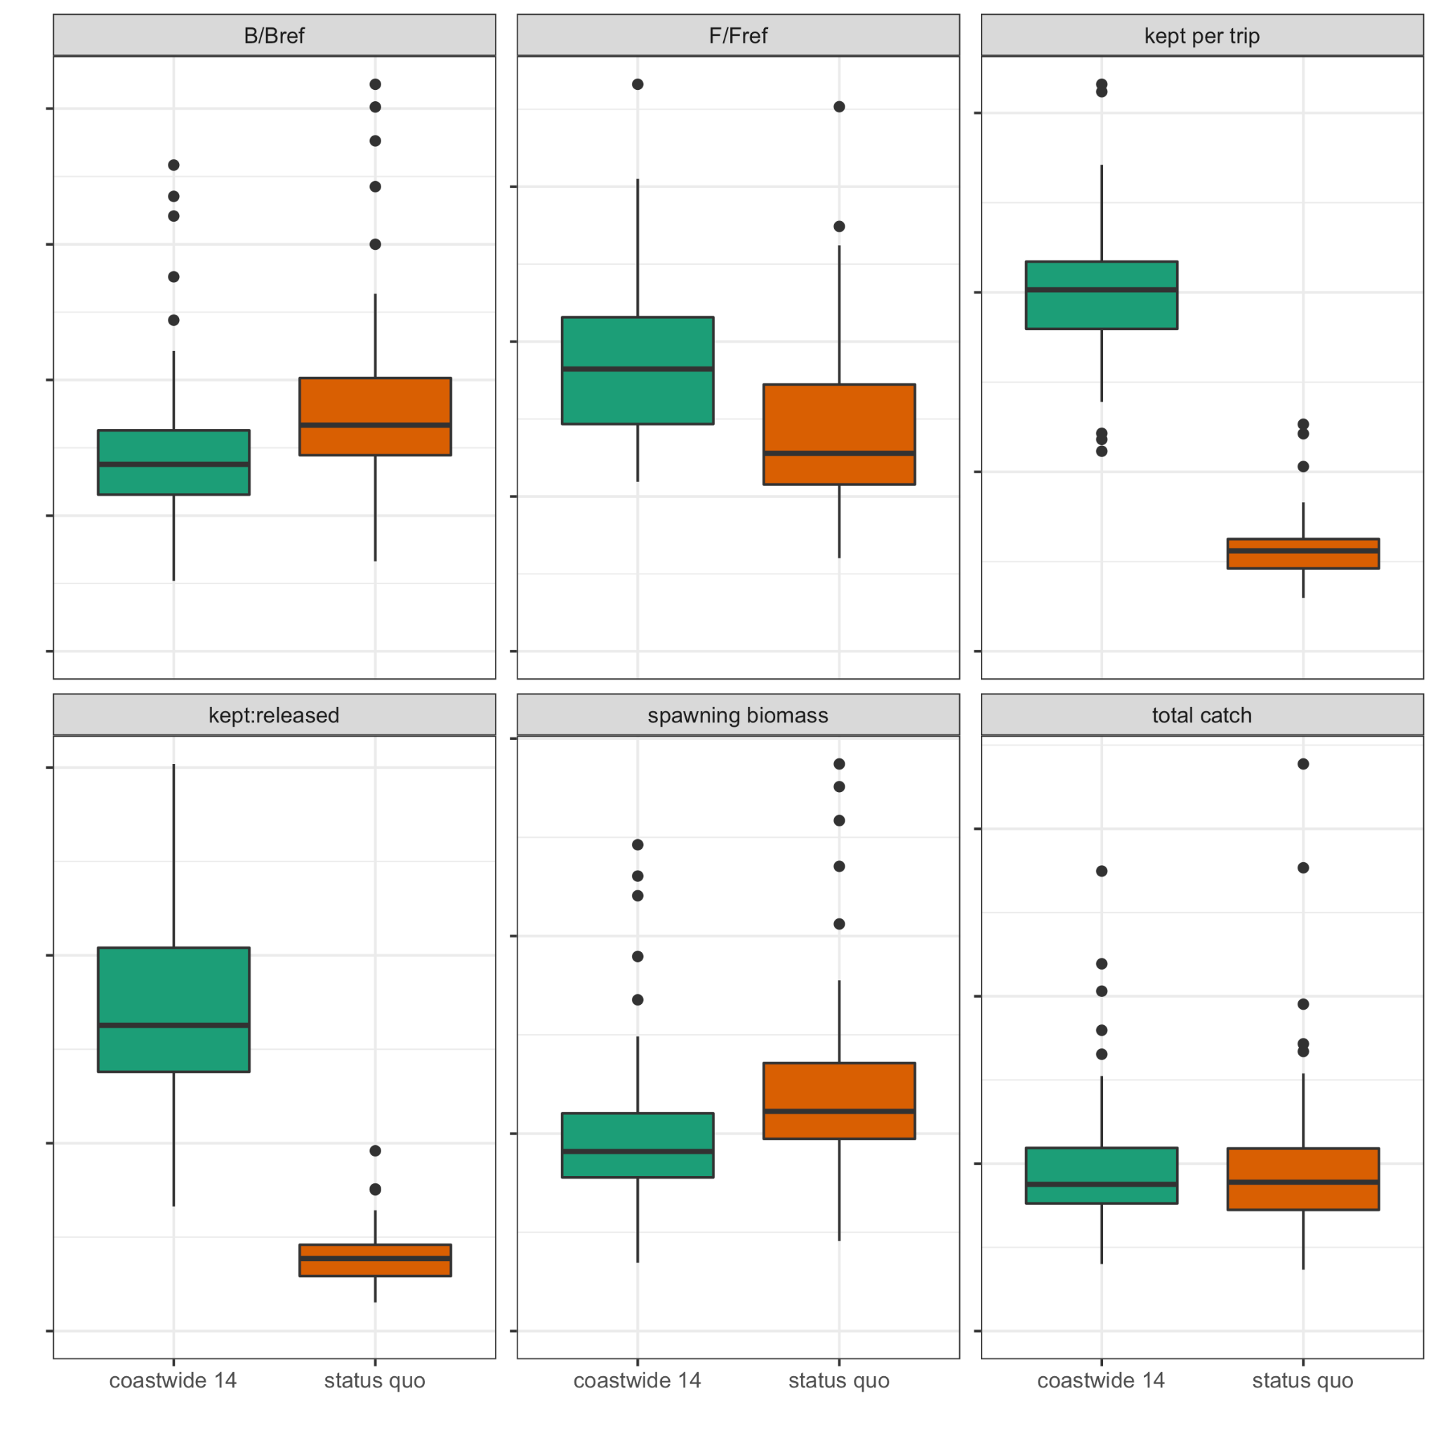
Developing metrics
We can show the distribution of these summary statistics over simulations for each scenario

Slide 16
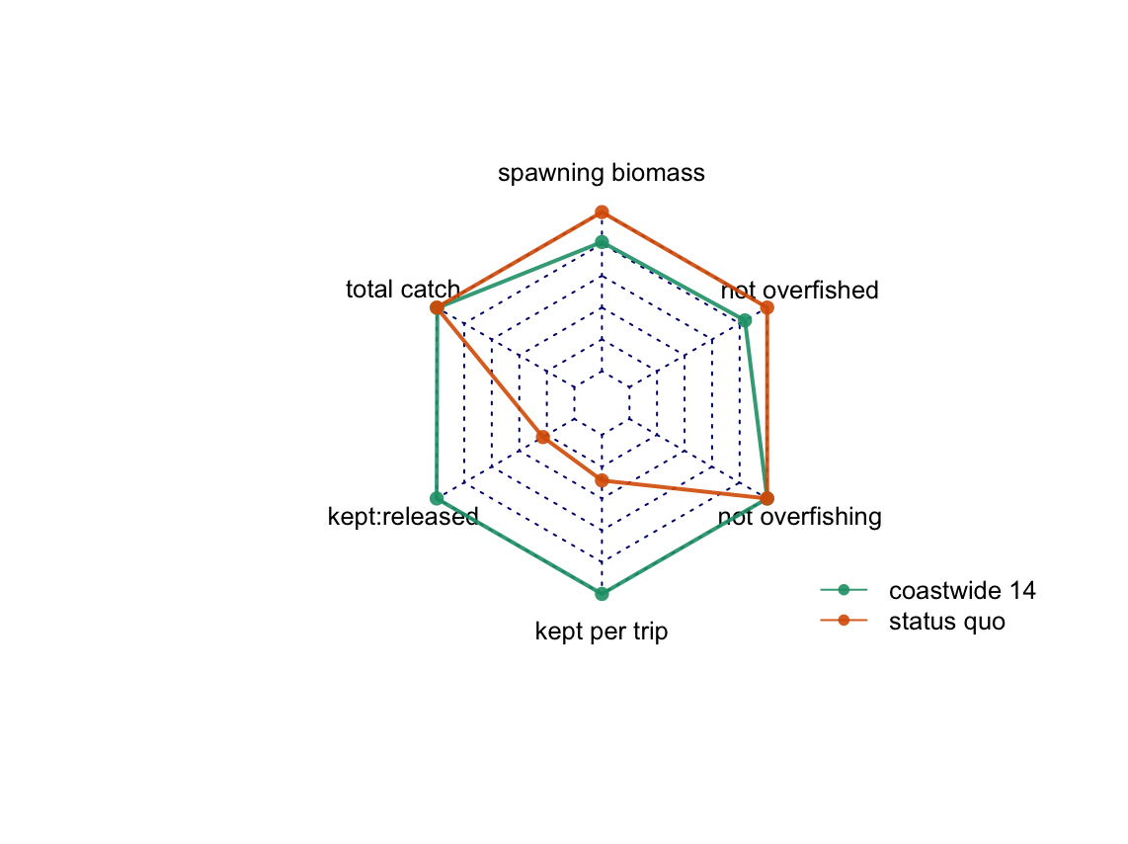
Visualizing multiple measures together to view tradeoffs
Here a single value for each performance metric is plotted for both scenarios. The farther out the point from the center the better the performance.

