Slide 1
Mid-Atlantic Fishery Management Council
EAFM Based Risk Assessment
NEFSC
October 11, 2017

Slide 2
Risk Elements
Clarify exactly what we are assessing and why
  What are we measuring = Risk Elements
  Why are we measuring it = Risk Definition
  How are we measuring it = Indicators Used

Slide 3
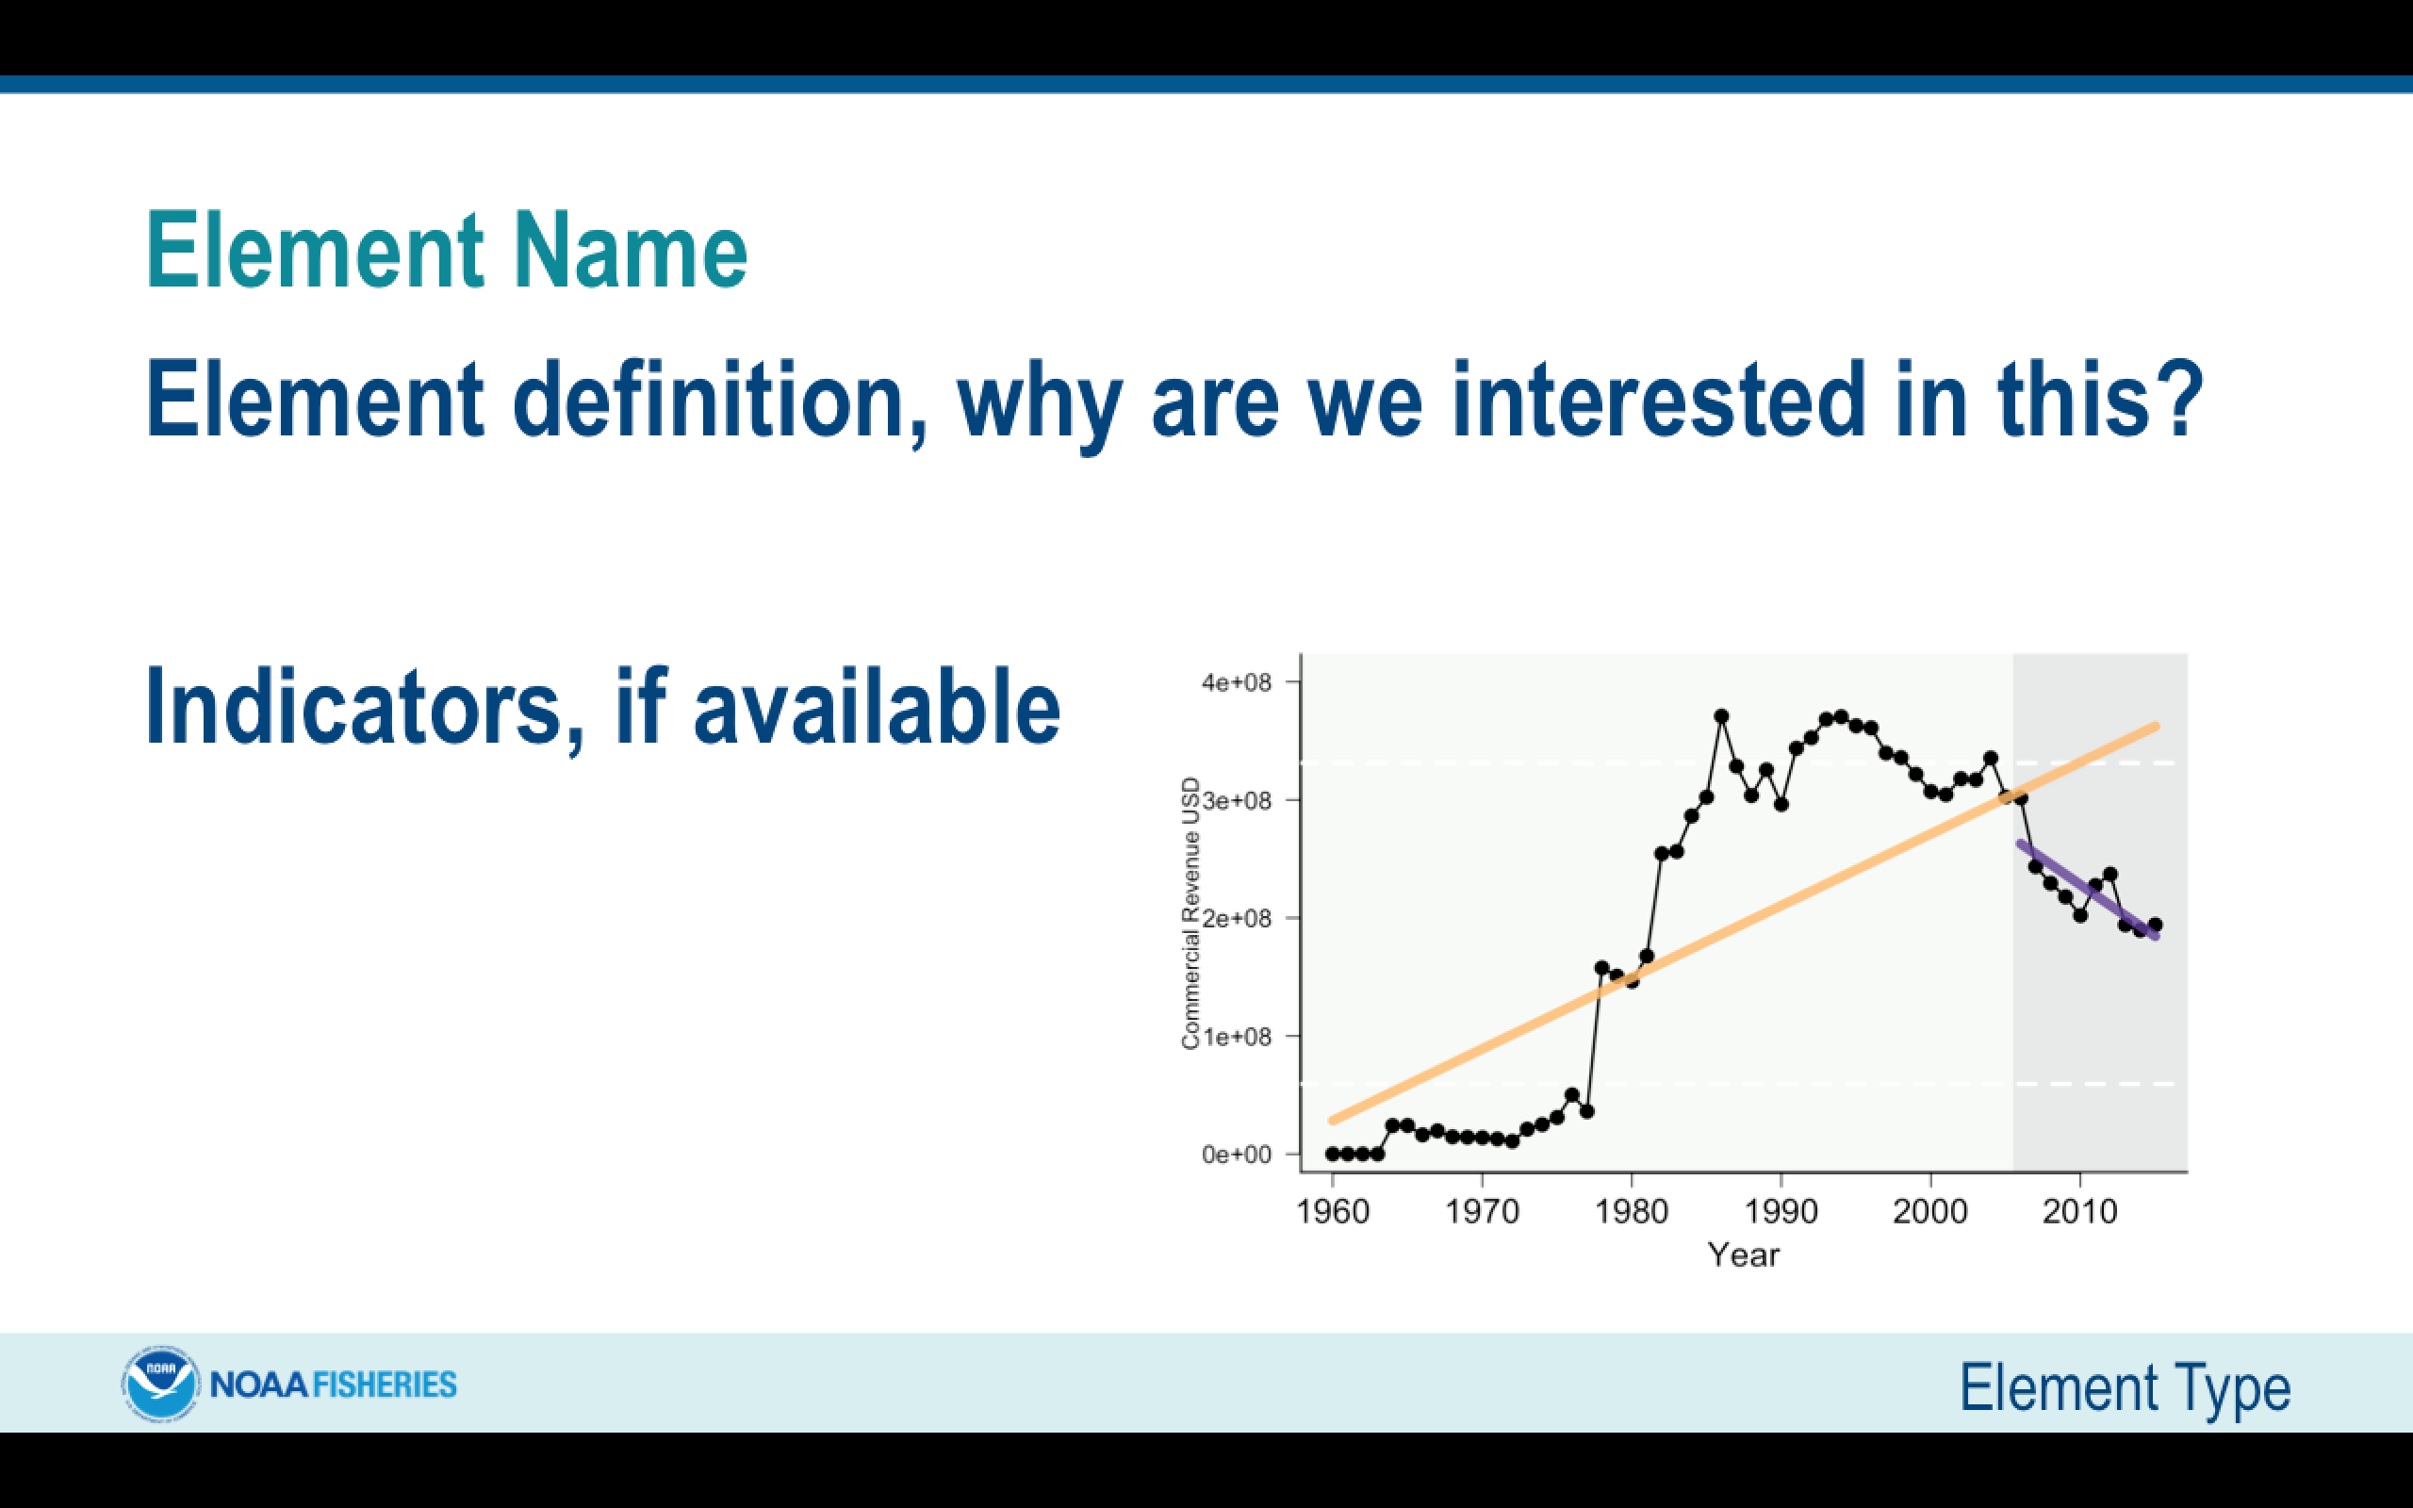
Types of Elements
Ecological
Economic
Social
Food Production
Management

Slide 4
Ecological Elements

Slide 5
F Status and B Status
These elements are applied at the species level. Fishing mortality (F) rates and biomass (B) levels relative to established reference points from assessments indicate the level of risk to achieving OY.

Slide 6
Assessment Type – Performance
This element is applied at the species level. Assessment methods and data quality vary. This risk element addresses risk to achieving OY due to scientific uncertainty based on analytical limitations.

Slide 7
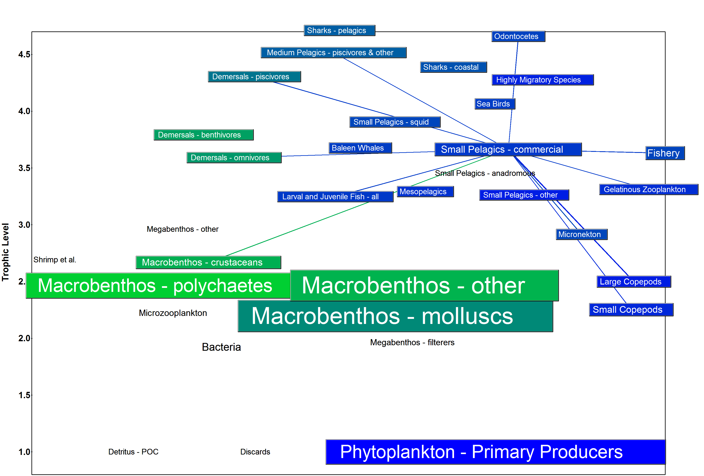
Food Web (1)
This element is applied at the species level, and ranks the risks of not achieving OY due to species interactions between MAFMC managed species. To rank these risks, the "importance" of each species as predator and or prey must be assessed. Diet information and a food web model can be used to develop thresholds.

Slide 8
Food Web (2)
This element is applied at the species level, and ranks the risks of not achieving protected species objectives due to species interactions with MAFMC managed species. As above, a food web model and updated protected species diet information can be used to establish thresholds of "importance" for predators and prey.

Slide 9
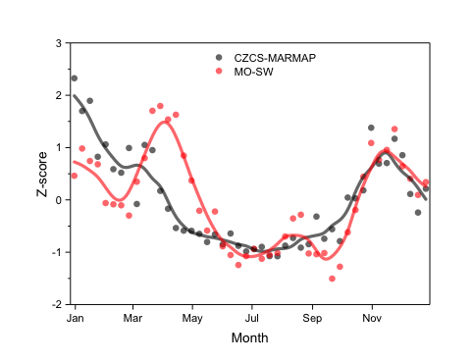
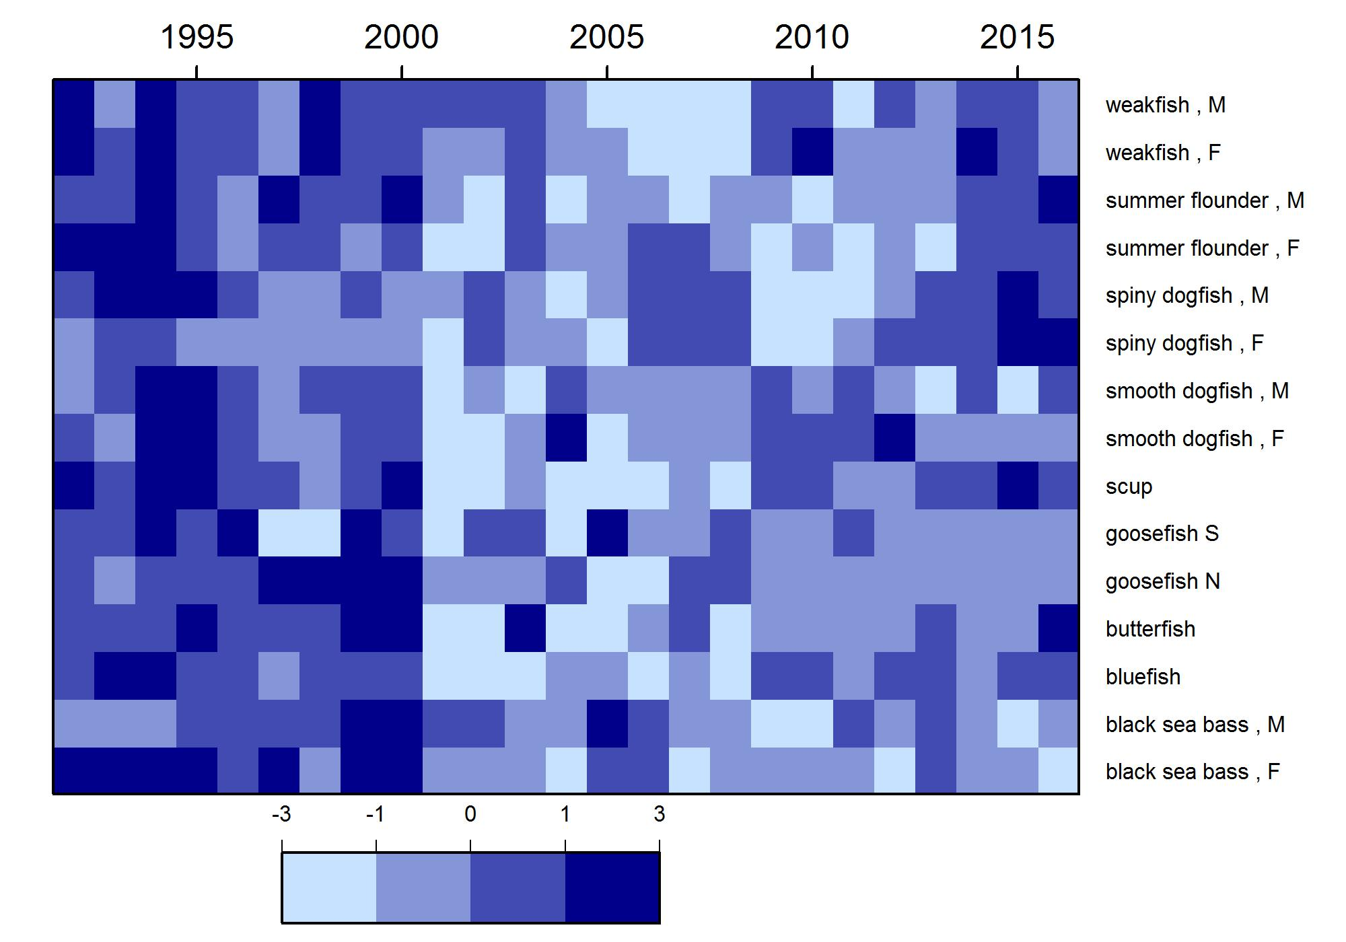
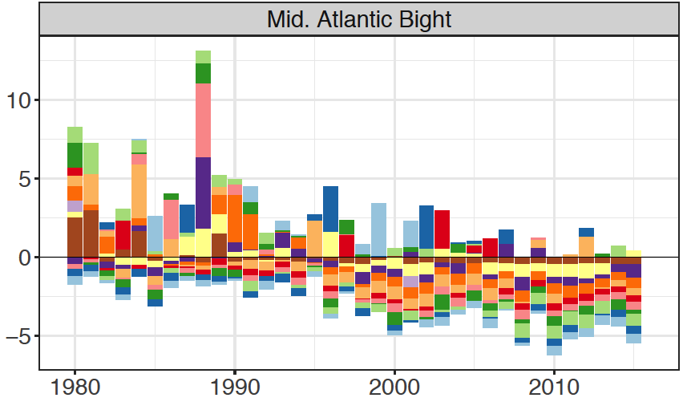
Ecosystem Productivity
This element is applied at the ecosystem level, and therefore poses the same risk to each species: the risk of not achieving OY due to changes in ecosystem productivity at the base of the food web. Four indicators are used together to assess risk of changing ecosystem productivity.

Slide 10
Population Diversity
This element is applied at the species level. Changes (particularly reduction) in diversity at the species/stock level (size, sex, reproductive) can be considered.
The EOP Committee and Advisors suggest removing this element from formal assessment until indicators are further developed and/or risk interpretation is clarified.

Slide 11
Ecological Diversity
This element is applied at the ecosystem level, and therefore poses the same risk to each species. The Council identified changes (particularly reduction) in species diversity as a risk element.
The EOP Committee and Advisors suggest removing this element from formal assessment until indicators are further developed and/or risk interpretation is clarified.

Slide 12
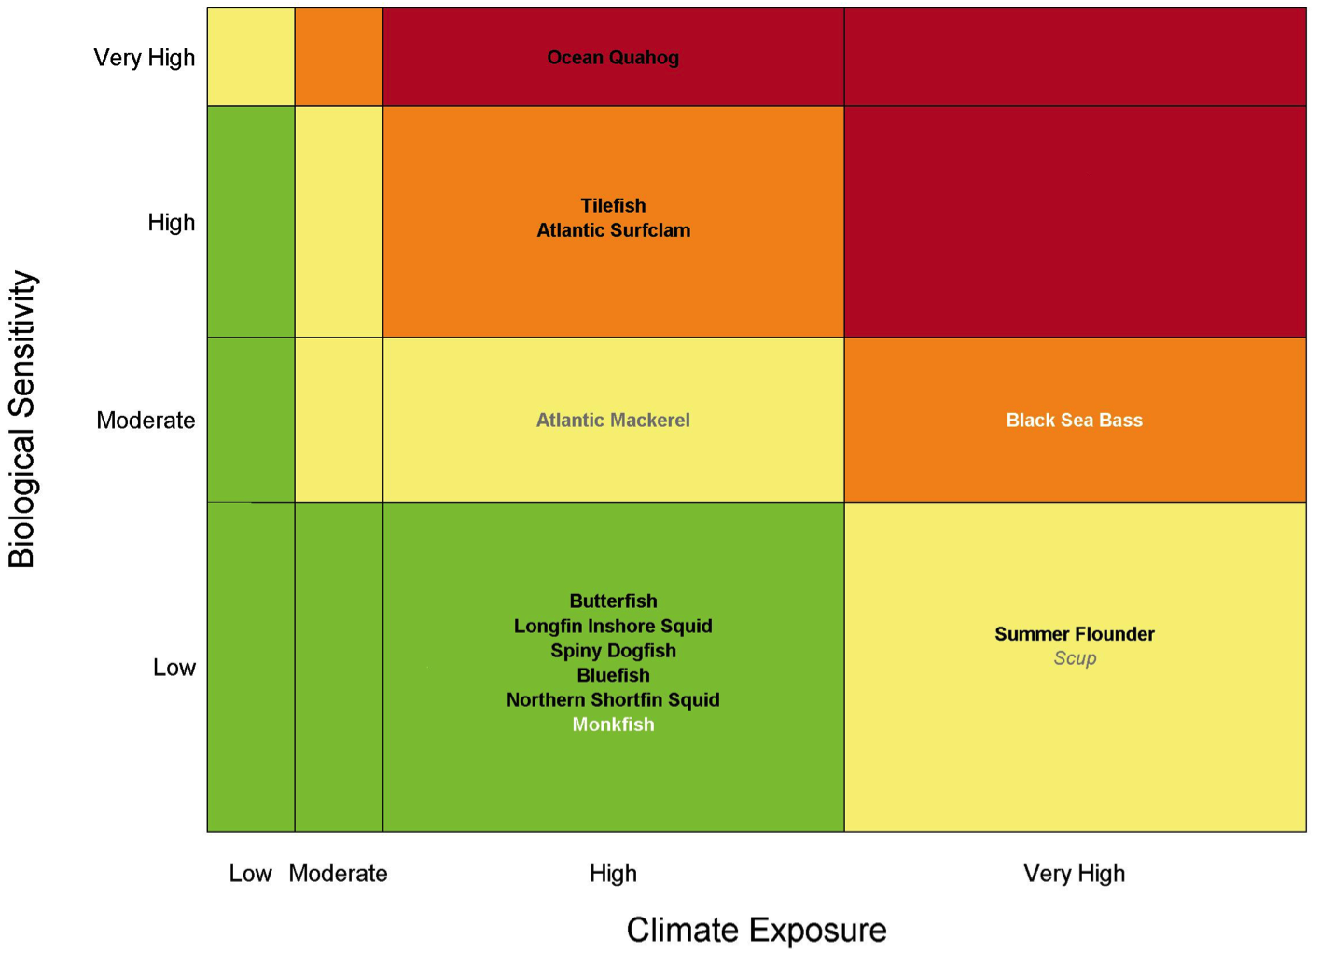
Climate
This element is applied at the species level. Risks to species productivity (and therefore to achieving OY) due to projected climate change in the Northeast US were evaluated in a comprehensive vulnerability assessment (Hare et al. 2016)

Slide 13
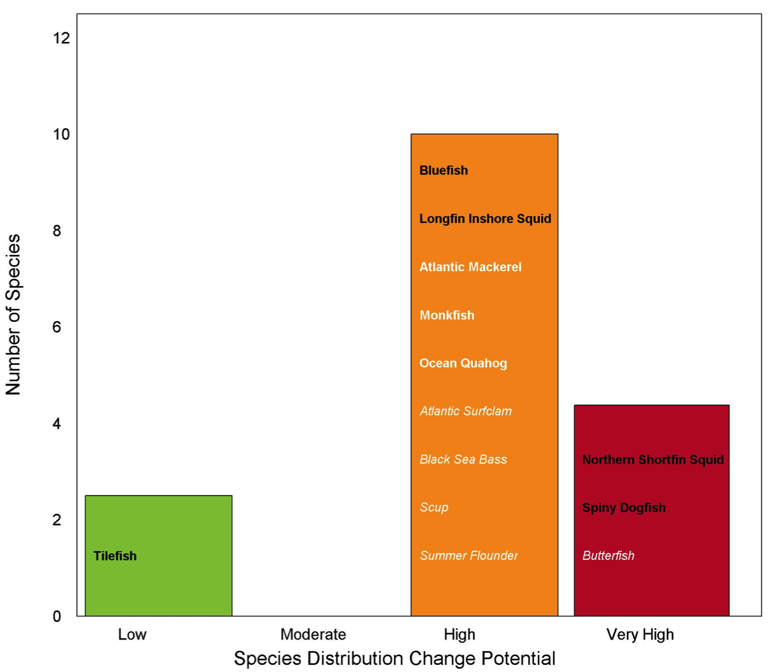
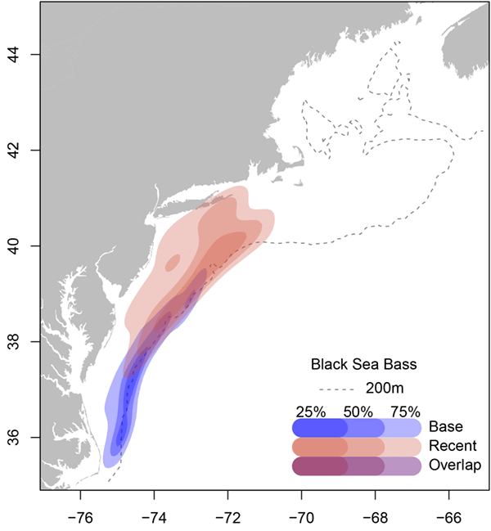

Distribution shifts
This element is applied at the species level. Risks of species distribution change (and therefore risks to achieving OY as well as straightforward allocation) due to projected climate change in the Northeast US were assessed in a comprehensive assessment (Hare et al. 2016) and can be monitored with multiple indicators.

Slide 14
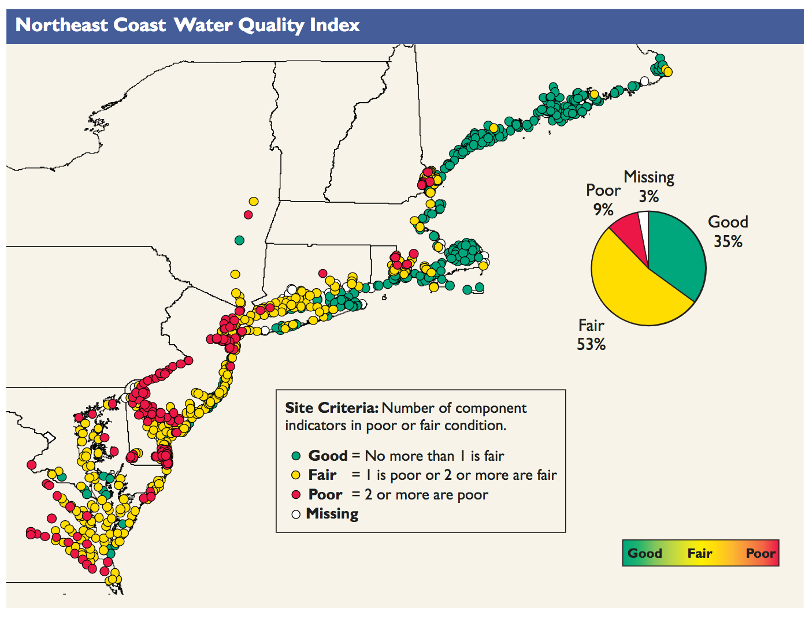
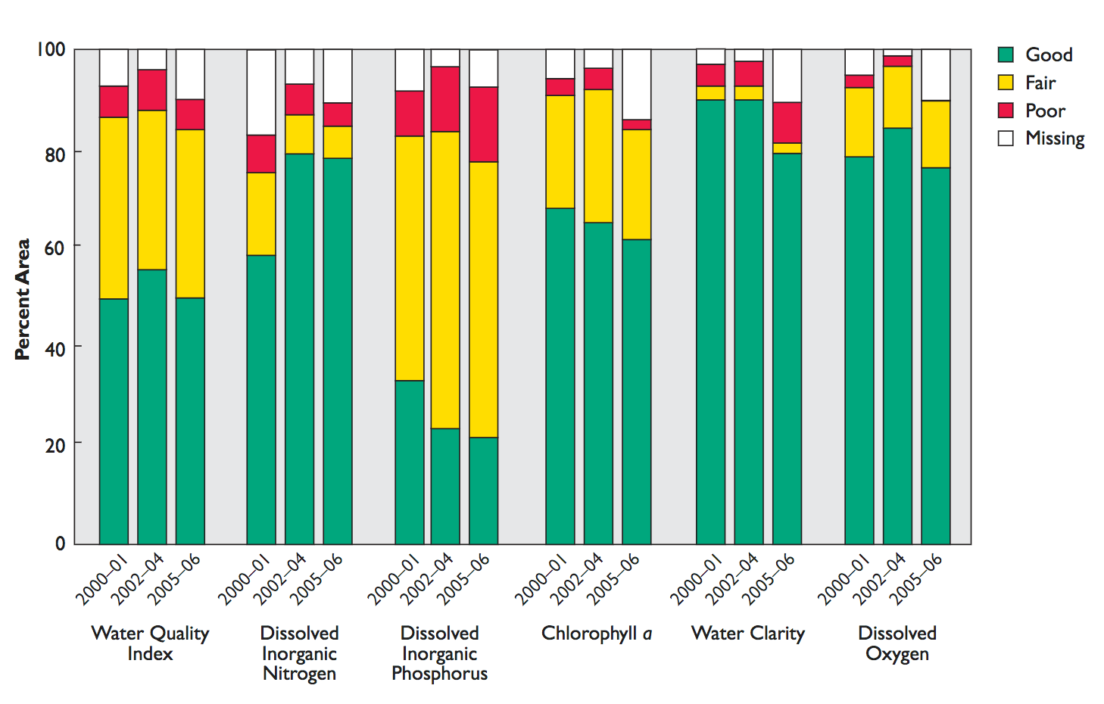
Estuarine and Coastal Habitat
This element is applied at the species level. Risk of not achieving OY due to threats to estuarine and coastal habitat/nursery grounds can be determined by first evaluating the estuarine and coastal dependence of species, and then by enumerating threats to estuarine and coastal habitat (US EPA 2012).

Slide 15
Offshore Habitat
This element is applied at the species level. The risk of achieving OY due to changes in offshore habitat quality and quantity can be assessed using trends derived from experimental species-specific habitat modeling.

Slide 16
Economic Elements

Slide 17
Commercial Profits
This element is applied at the ecosystem level. This element addresses the risk of not maximizing fishery value.
Economic Elements

Slide 18
Recreational Value
Risk of not maximizing fishery value will be evaluated using revenue, number of angler-days, and number of trips.
Anglers
Trips

Slide 19
Fishery Resilience 1
This element is applied at the individual business level and ranks the risk of reduced fishing business resilience due to over-reliance on individual species.

Slide 20
Fishery Resilience 2
Risk of reduced fishing business resilience due to capital access constraints
The EOP Committee and Advisors suggest removing this element from formal assessment until indicators are further developed and/or risk interpretation is clarified.

Slide 21
Fishery Resilience 3
Risk of reduced fishing business resilience due to insurance availability
The EOP Committee and Advisors suggest removing this element from formal assessment until indicators are further developed and/or risk interpretation is clarified.

Slide 22
Fishery Resilience 4
This element is applied at the ecosystem level and ranks the risk of reduced fishery business resilience due to shoreside support infrastructure by examining the number of shoreside support businesses.
Companies
Non-Employers

Slide 23
Fishery Resilience 5
Risk of reduced fishing business resilience due to access to emerging markets/opportunities
The EOP Committee and Advisors suggest removing this element from formal assessment due to overlap with Management Elements.

Slide 24
Commercial Employment
NY
This element is applied at the state level. This element ranks the risk of not optimizing employment opportunities in the commercial sector.
NJ
DE
MD
VA

Slide 25
Recreational Employment
NY
This element is applied at the state level. This element ranks the risk of not optimizing employment opportunities in the recreational sector
NJ
DE
MD
VA

Slide 26
Social Elements

Slide 27
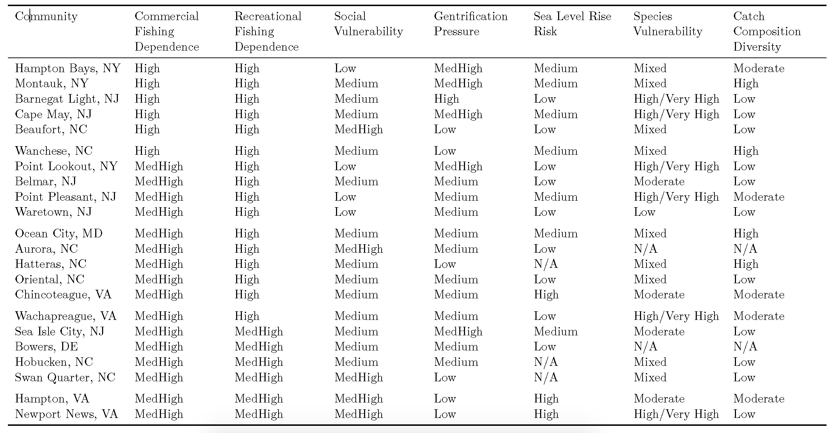
Risk of reduced community resilience
This element is applied at the ecosystem level and ranks the risk to maintaining human community resilience. The number of distinct fleets, diversity of revenue across fleets, and social vulnerability indicators evaluate community resilience.
Fleet Count
Fleet Diversity

Slide 28
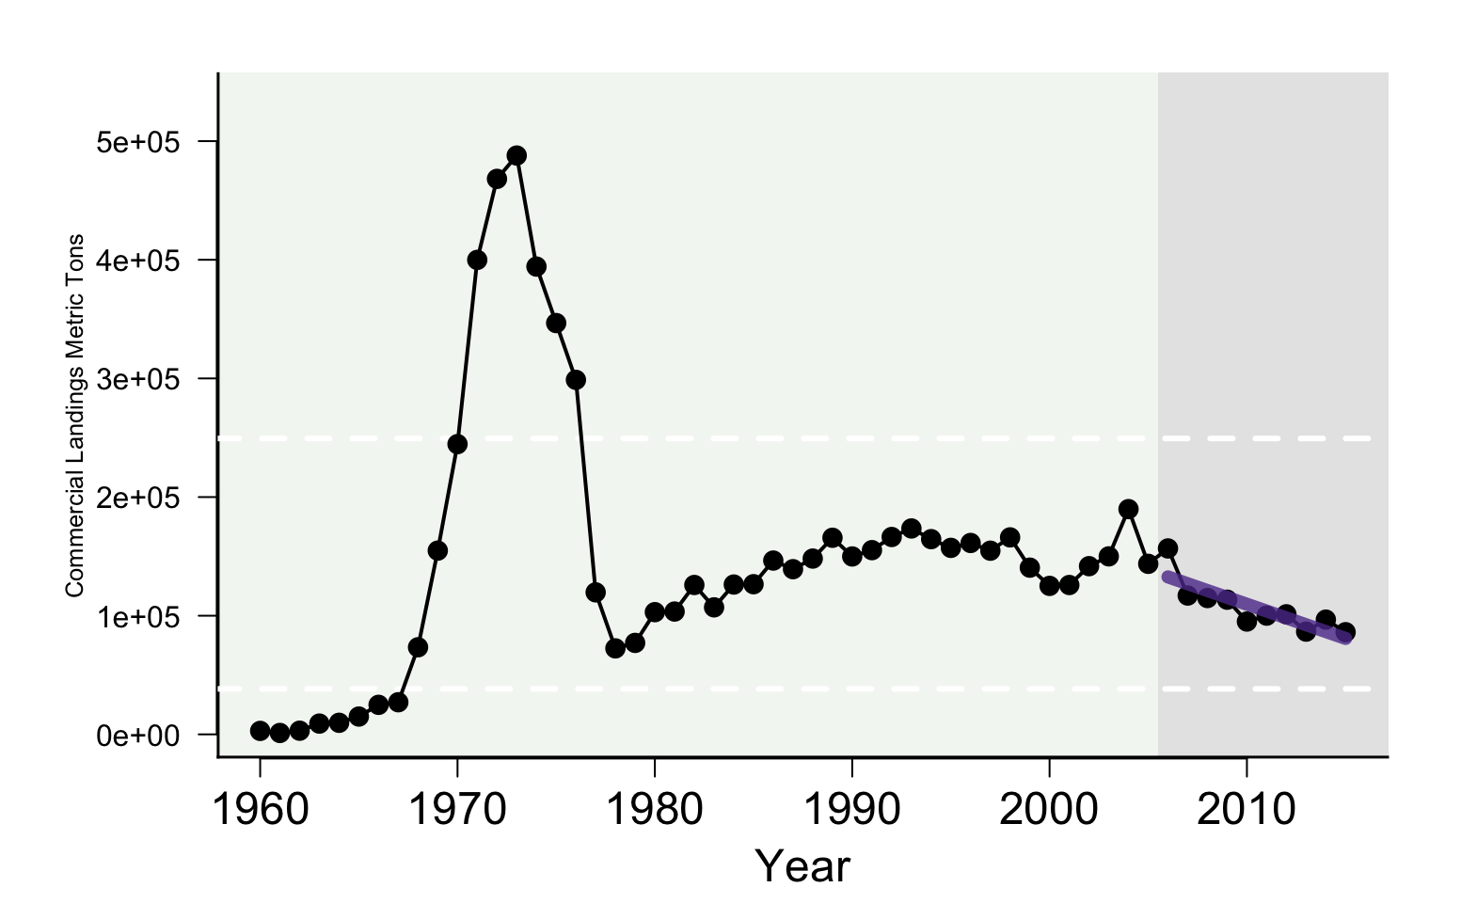
Commercial Food Production
This element is applied at the ecosystem level and describes the risk of not optimizing domestic seafood production from MAFMC managed species.

Slide 29
Recreational Food Production
This element is applied at the ecosystem level and describes the risk of not optimizing domestic seafood production from MAFMC managed species.

Slide 30
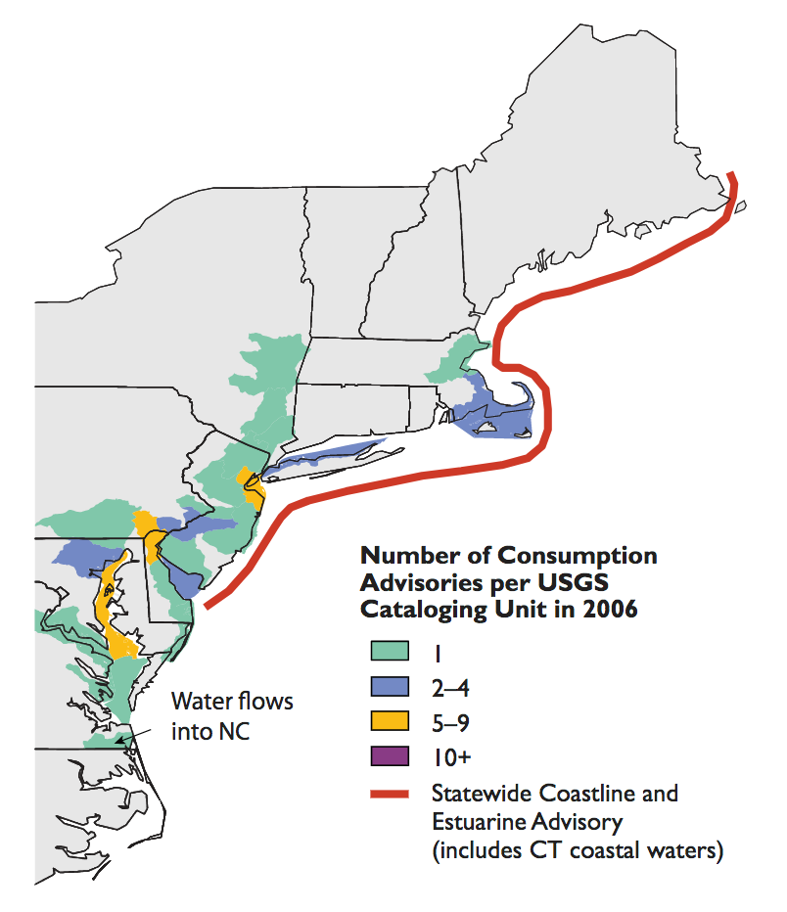
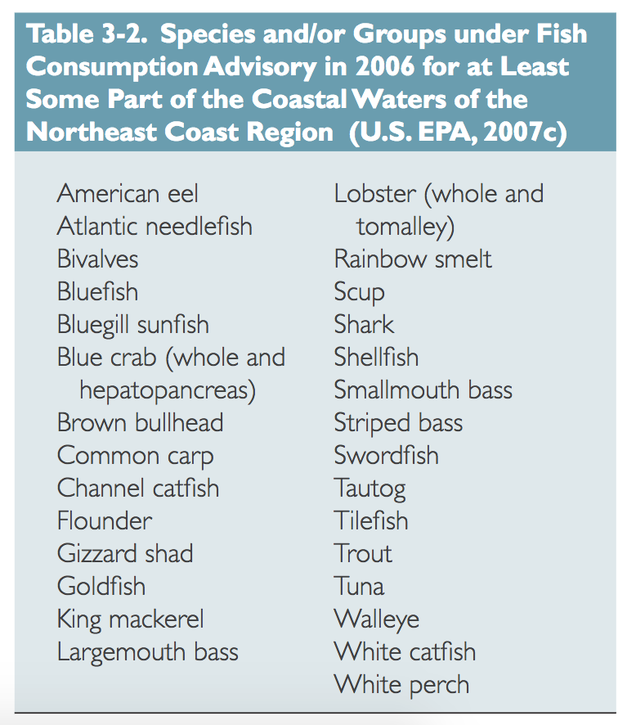
Seafood Safety
Risk of not maintaining market access, human health.
The EOP Committee and Advisors suggest removing this element from formal assessment.

Slide 31
Management Elements

Slide 32
Control
This element is applied at the species level. This element addresses the level of management control in terms of catch measurement and monitoring. Adequate management control indicates low risk of not achieving OY, while poor management control indicates higher risk of not achieving OY. Actual catch is compared with the specified ABC over the most recent five years of fishery history.

Slide 33
Technical Interactions
This element is applied at the species level. This element addresses the risk of not achieving OY due to interactions with non-MAFMC managed species, including protected species. Here the risk is caused by negative consequences from fishing activity regulated under MAFMC FMPs which interacts with species managed by other agencies, including bycatch of protected species.

Slide 34
Other Ocean Uses
This element is applied at the species level. This element addresses the risk of fishery displacement or damage of a fishery resource and/or habitat that supports it as a result of non-fishing activities in the ocean.

Slide 35
Regulatory Complexity and Stability
This element is applied at the species level. Constituents have frequently raised concerns about the complexity of fishery regulations and the need to simplify them to improve their efficacy. Complex regulations may lead to non-compliance and/or impact other fisheries.

Slide 36
Discards
This element is applied at the species level. Stakeholders have identified the reduction of discards as a high priority in the Council management program, especially those caused by regulations since they represent biological and economic waste. Discards of either the target or non-target species in the fishery would be taken into consideration.

Slide 37
Allocation
This element is applied at the species level. This element addresses the risk of not achieving OY due to spatial mismatch of stocks and management allocations. Indicators for difficulty of allocation include a combination of distribution shifts (see above) and the number of interests (sectors, states, etc.) requiring allocation.

Slide 38
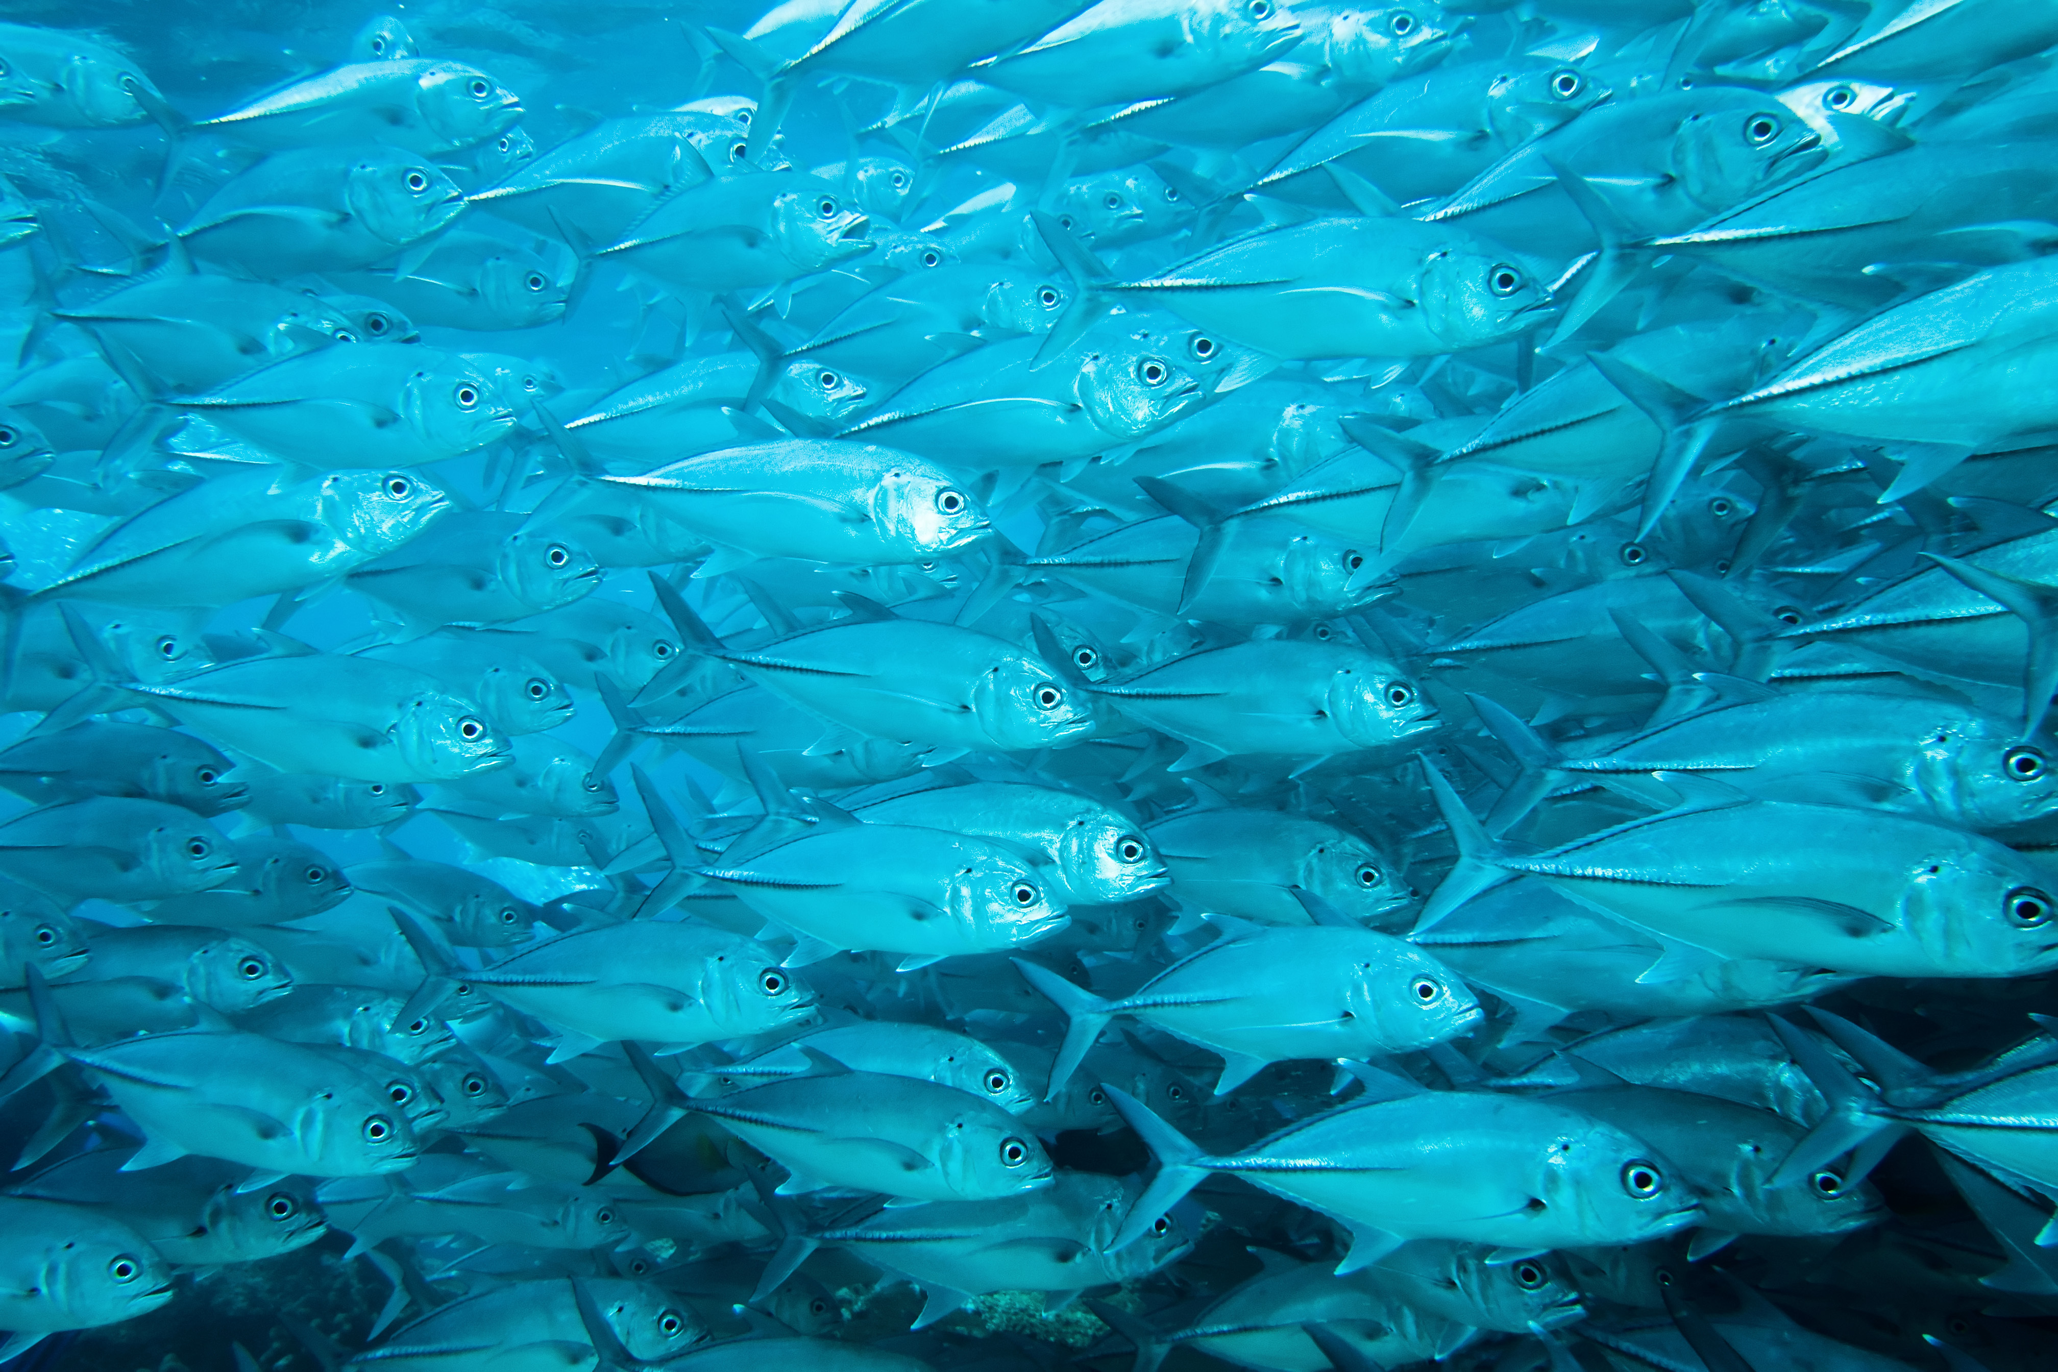

Slide 39
Species Groupings
HMS
Monkfish
Scallops
Shrimp
Skate
Herring
Ocean Quahog
Surf Clam
Tilefish
Fluke & Black Seabass
Butterfish & Silver Hake
Bluefish & Scup (separate for Mid-Atlantic)
Spiny Dogfish
Illex
Longfin Inshore Squid
Lobster
Menhaden
Offshore Hake
Sand Dab
Ocean Pout
Wolffish
Yellowtail Flounder
Winter Flounder
Unknown Hake
White Hake
Halibut
New England Groundfish
Mid-Atlantic Groundfish

Slide 40
Fleet Revenue
Lengths categories
  Less than 30 ft
  30 to 50 ft
  50 to 75 ft
  75 ft and above
Gear categories
  Bottom Trawl
  Scallop Dredge
  Clam Dredge
  Other Dredge
  Gillnet
  Hand Gear
  Longline
  Midwater Trawl
  Pot
  Purse Seine
  Other

Slide 41
Groundfish
New England
  Cod
  Haddock
  Pollock
  Winter Flounder
  Witch Flounder
  Yellowtail Flounder
  Plaice
  Redfish
  White Hake
  Monkfish
Mid-Atlantic
  Cod
  Haddock
  Wolffish
  Witch Flounder
  Plaice
  Unknown Hake
  Halibut
  Redfish
  Sand Dab
  Ocean Pout

Slide 42
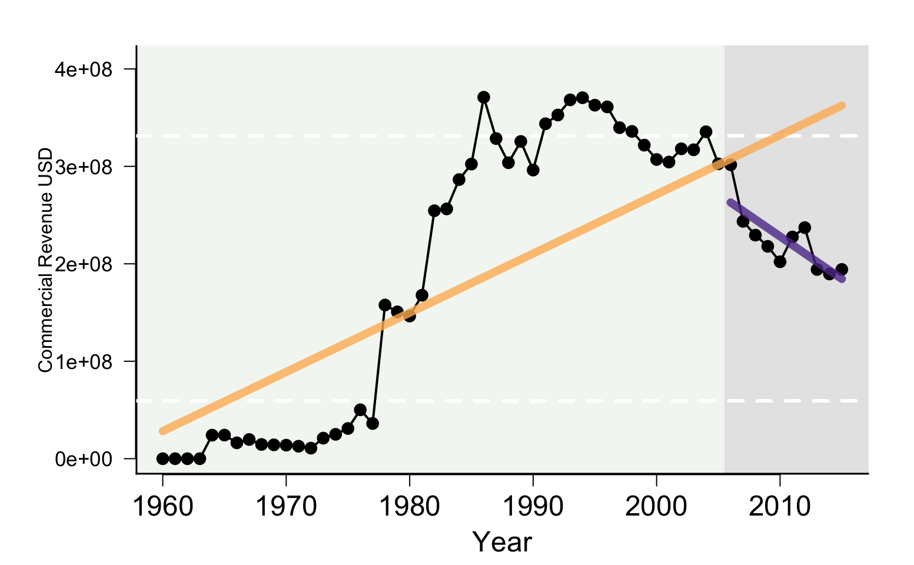
Element Name
Element definition, why are we interested in this?
Indicators, if available

