Slide 1
Potential approaches for assessment and management of forage stocks
MAFMC Forage Fish Workshop
Robert J. Latour
April 11, 2013

Slide 2
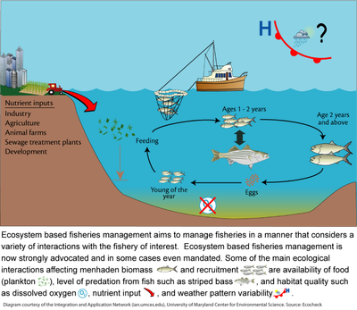
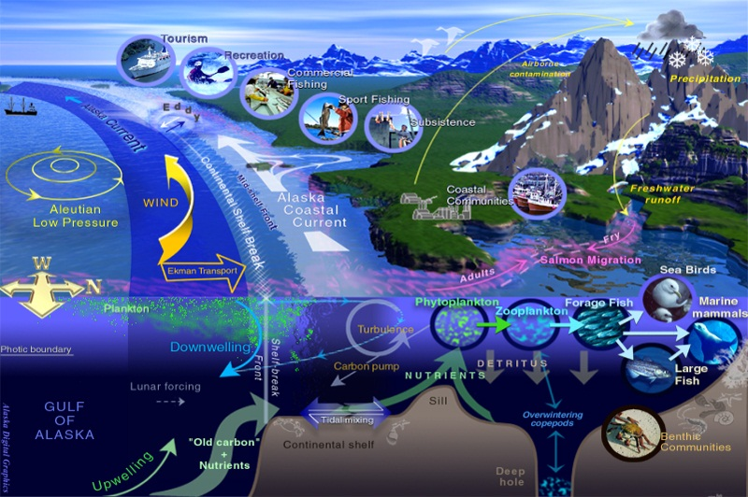
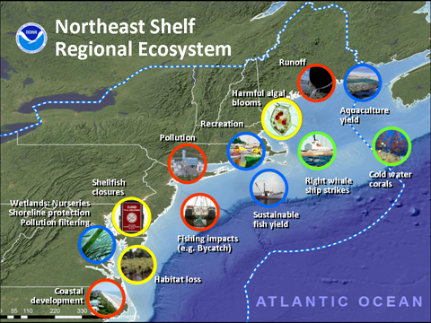
If you Google:
‘Ecosystem based fisheries management’
About 2,330,000 results (0.19 seconds)

Slide 3
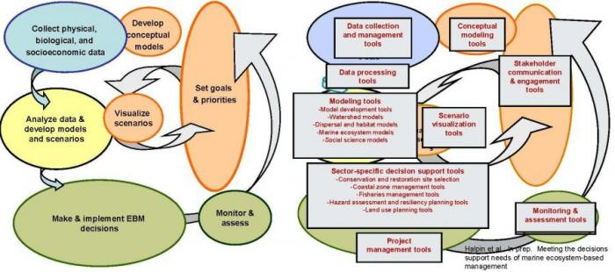
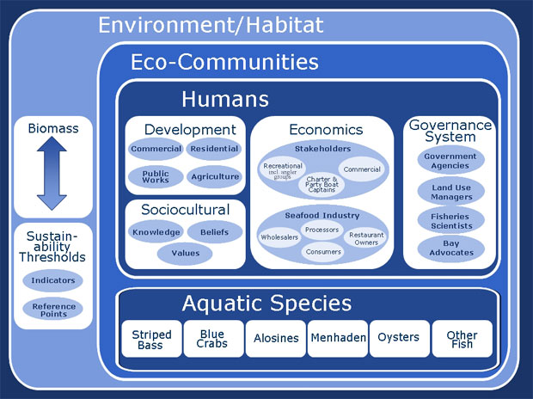
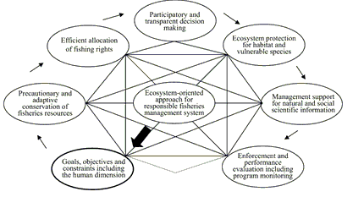
If you Google:
‘Ecosystem based fisheries management’

Slide 4
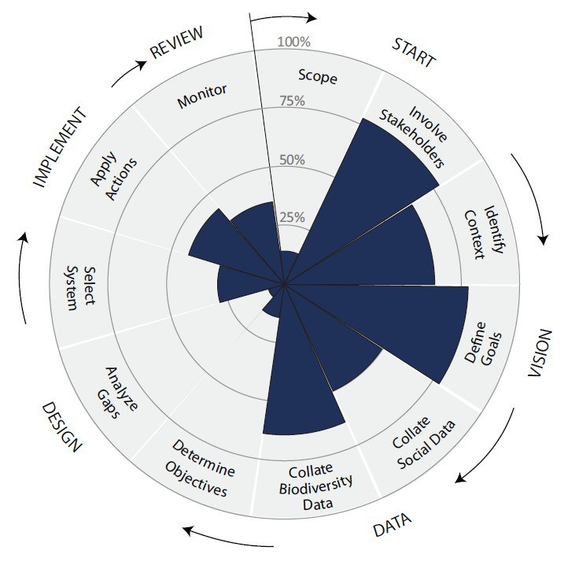
Building the management/scientific system
Unclear objectives, minimal scientific evaluation
Highlights the need for parallel activity amongst managers and scientists
Fair amount of consultation and data collection
Key objectives need to be detailed; limits of data/science must be articulated

Slide 5
Management strategies
Ecosystem management (EM): catch all phrase; generally holistic management; technically infeasible (managing humans).
Ecosystem-based management (EBM): resource sector focused, holistic, integrated
accounting for key factors & processes from ecosystem perspective. Start with ecosystem and work down to management sectors.
Ecosystem approaches to management (EAM): within sector management cognizant
of effects on other sectors. Start with sectors and work up to include factors associated with other sectors.
Management gradient
Ecosystem approaches to fisheries management (EAFM): within sector single- species management cognizant of effects on other fisheries, effects of other fisheries on sectors, effects of fisheries on ecosystem. Start with single stock and work up to include as many factors as possible.
Ecosystem-based fisheries management (EBFM): holistic management of fisheries; implies integration beyond fisheries. Start with ecosystem and address interactions among species and with environment.
Link 2010

Slide 6
Data/modeling strategies
Analytical gradient
Largely single-species BRPs
Group/guild BRPs
Pure single-species
assessment
Multispecies
assessments
Aggregated
biomass analyses
Entire ecosystem
model
Multiple coordinated single-species
assessments
Predatory fishes
Single-species
assessments with explicit M₂ or climate
Pelagic forage fishes
Benthic forage fishes
Link 2010

Slide 7
Natural mortality (M)
Forage stocks: more attention focused on natural mortality
How is M treated analytically?
Guestimate; constant over age & time
Empirical single-species estimate; may/not be age & time varying
M₂ modeled; partial suite of predators; may/not be age & time varying
M₂ modeled; ‘complete’ suite of predators; age & time varying

Slide 8
Where are we now?
Current management objectives
Compliance with Magnuson-Stevens Act, avoid overfishing: traditional single-species approaches
Current assessment objectives
OFL estimation and characterization of uncertainty: single-species BRPs
Buffer
OFL
ABC
25% Probability of Overfishing
P* = 0.40
Distribution of OFL
P* = 0.35
CV (100%), OFL = 100 mil lbs

Slide 9
Where do we want to go?
Possible future management objectives
Compliance with Magnuson-Stevens Act, avoid overfishing: EAFM, effects of fisheries on each other and ecosystem
Required future assessment objectives
Coordinated single-species assessments, efforts to formally include M₂ and/or climate drivers, multispecies models
Can management/assessment ‘harmony’ evolve together?
Degree of ‘harmony’ will modulate scientific uncertainty
Are the Terms of Reference (TORs) the portal?
Likely have single-species BRPs for a while

Slide 10
ABC control rule/Council risk policy
Option, link P* to treatment of M in assessment
ABC based on P* = P*-f(M gradient)
Formally defined forage stock
M gradient
Guestimate; constant over age, time
M₂ modeled; ‘complete’ suite of predators; age & time varying
Potentially plausible for Level 1, 2, 3* assessments
* when SSC elects to define OFL distribution

Slide 11
ABC control rule/Council risk policy
Level 4 assessments – ad hoc
Formally defined forage stock
M gradient
Guestimate; constant over age, time
M₂ modeled; ‘complete’ suite of predators; age & time varying
ABC = X% * OFL or OFL proxy, where X% represents acknowledged additional buffering for forage role
-f(M gradient) can be arbitrary; need scientific rationale for buffers

Slide 12
ABC control rule/Council risk policy
ABC based on P* = P*- f(M gradient)
Atypical life history:
– results in greater vulnerability to exploitation, and life history has not been
fully addressed through the stock assessment and BRP development process.
P* = 0.40
P* = 0.35
P* < 0.35

Slide 13
Accounting versus managing
Enhanced treatment of M within assessments serves to describe historical predation demand
‘Better’ M modeling = better accounting
Ecosystem structure and functioning goes well beyond better accounting
EAFM necessitates making choices/tradeoffs
ΣMSY_{SS} > MSY_{System}

Slide 14
Summary
Build the management/scientific system – detailed objectives
EAFM may be a plausible starting point
Effects of fisheries on each other and ecosystem via forage stocks….and climate drivers
EAFM requires modify assessment philosophy
Perhaps modify ABC Control Rule P* in relation to M modeling
Be mindful of accounting versus managing

