Slide 1
NEFMC SSC Update
National SSC Meeting
Williamsburg, VA
October 4-6, 2011

Slide 2
Since Last National SSC Meeting
New SSC members with staggered terms
Larger SSC (now 18 members)
1-3 years initially
3 year terms in the future as initial terms expire
White paper on Ecosystem Based Fishery Management
Socioeconomic issues
ABC Uncertainty
New process for updating assessments
Risk policy team being formed

Slide 3
SSC EBFM White Paper
At request of the Council, the SSC developed a white paper on possible pathways toward EBFM in the Northeast.
Presentations to the full council at the November 2010, February 2011, and April 2011 meetings.
White paper describes:
Ecological Production Units as possible management units
Transition strategy to full EBFM
Eight step process to implement full EBFM
Principal elements of scientific approach to implement EBFM in Region

Slide 4
EBFM Developments
September NEFMC meeting, a strategy was outlined to develop an Ecosystem-Based Fishery Management Plan in three phases:
Phase I. Establish Goals and Objectives. Establish Ecosystem Production Units (EPUs) (1 Year).
Phase II. Identify management and scientific requirements to implement EBFM. Combine Multispecies Groundfish, Skate, and Monkfish Plans accounting for biological interactions. Consider new reference points based on new modeling efforts for the species complex. (2 years)
Phase III. Implement EBFM. Implement quota-based management in all EPUs. Allocate all fishery resources to each EPU. Establish accumulation limits, transferability requirements, and permitting and monitoring requirements. Develop EIS for new plan. (3 years)
Council Vote at November Meeting

Slide 5
Social Science Issues
No specific TORs this past year
Recommended that NEFMC consider inclusion social science considerations in ABC control rules
Future work will focus on
Risk and ABC Buffers
MSE
Mixed Stock Exemption
EBFM

Slide 6
ABC Uncertainty
Multiple meetings with PDTs to provide methodological guidance
Skates
New discard mortality rate, consistently applied
Whiting/Hakes
No analytical assessment, so no risk analysis
Large sudden increase in catch for some stocks
Groundfish
APDT projection simulations
Using 75%Fmsy to account for uncertainty

Slide 7
New Update Process
Groundfish stocks not assessed since GARM III
Assessment Oversight Panel (AOP)
Reduced TORs and documentation
Provide quick update of assessment using previously accepted method
Fallbacks defined in advance if train goes off the track
Will be conducted this winter

Slide 8
Risk Policy Team
In development
Representatives from SSC, Council, Council staff, Science Center, and Regional Office
Examine trade offs between different types of risk
Holistic approach, but will be applied to each FMP separately

Slide 10
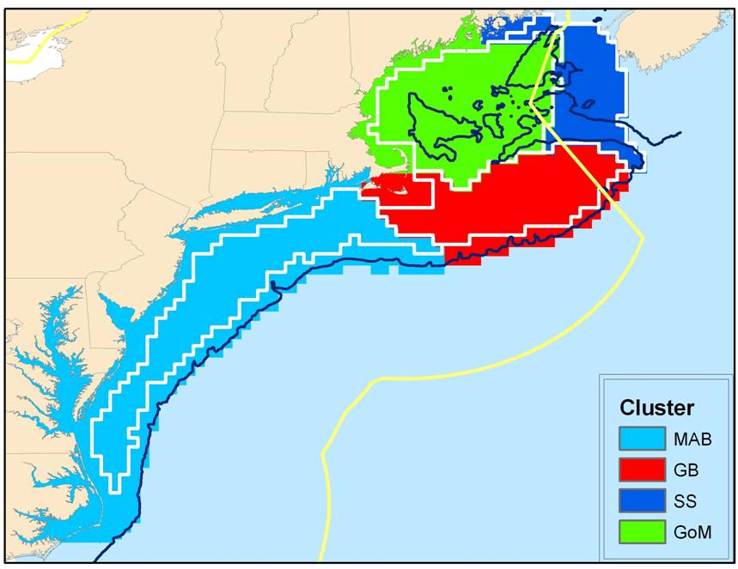
Ecological Production Units

Slide 11
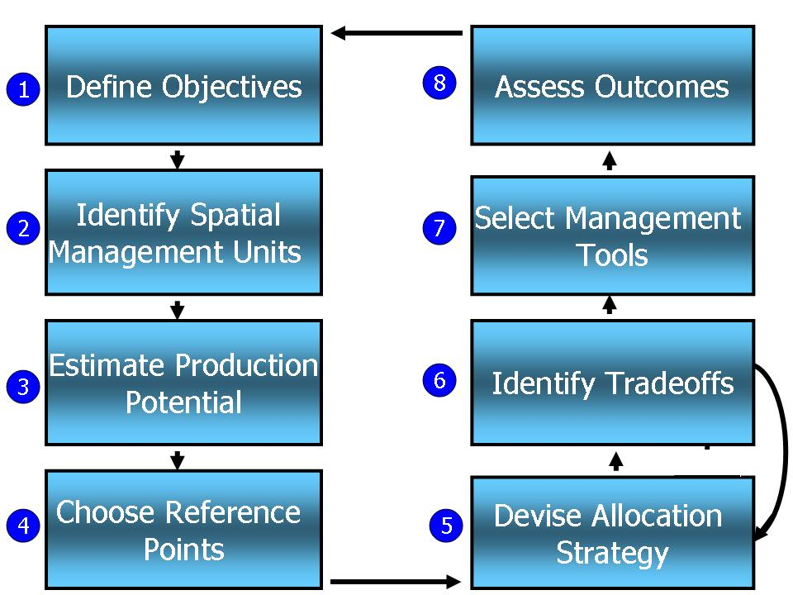
Roadmap to Full EBFM

Slide 12
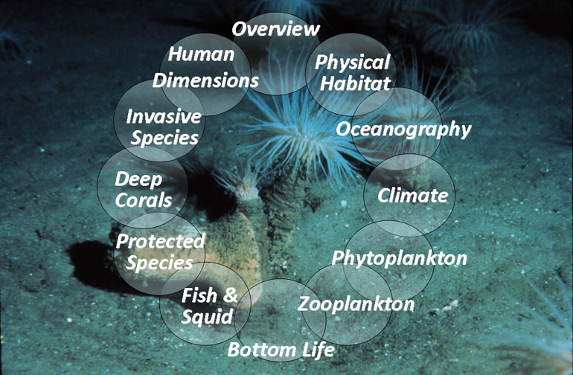
Foundations for Ecosystem-Based Fisheries Management Ecology of the Northeast U.S. Continental Shelf
For More Information on Ecosystem-Based Management see
http://www.nefsc.noaa.gov/ecosys/
Or Google NEFSC Ecosystem Considerations

