Slide 1
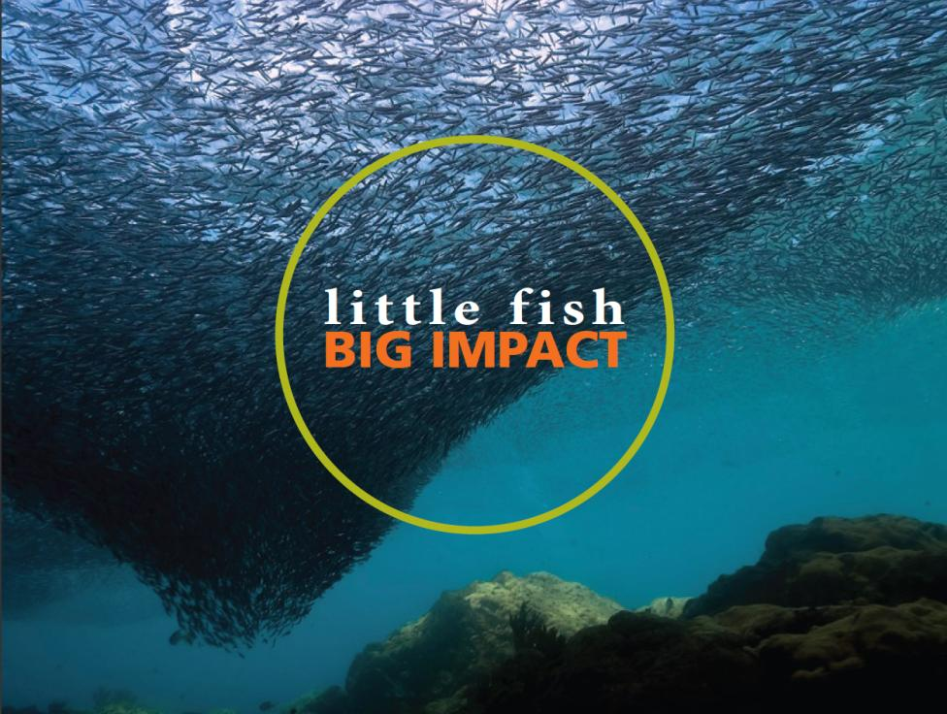
A REPORT FROM THE LENFEST FORAGE FISH TASK FORCE
Little Fish, Big Impact
A SUMMARY OF NEW SCIENTIFIC ANALYSIS
Managing a crucial link in ocean food webs

Slide 2

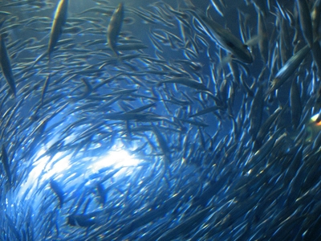
What Are Forage Fish?
Crucial species in food webs
Small, often schooling pelagic species
Sardines, anchovies, sand eels, krill, herring…
Feed on plankton and transfer energy to upper trophic levels
Notes:
So many predators depend upon forage fish for food.

Slide 3
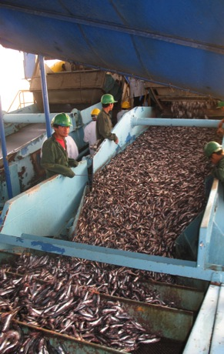
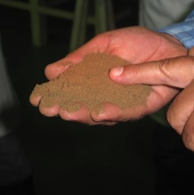
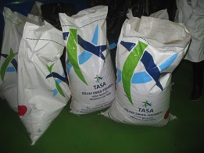
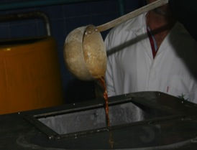
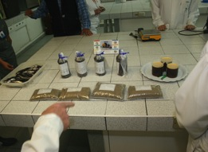
37% of the world’s marine catch is forage fish
(Alder et al. 2008)
Fish meal
Fish oil
Anchoveta processing plant. Paracas, Peru 2011
3
Notes:
Forage fish are becoming increasingly exploited by humans and are a major conservation concern. Global landings = 31.5 million tonnes annually, or 37% of the global wild marine fish catch. The largest fishery in the world (Peruvian Anchovy fishery) is a forage fish fishery. Demand is high and increasing.
90% of forage fish catch is processed, or “reduced,” to fishmeal and fish oil, which are then used primarily for agriculture, aquaculture, and industrial purposes.
3

Slide 4
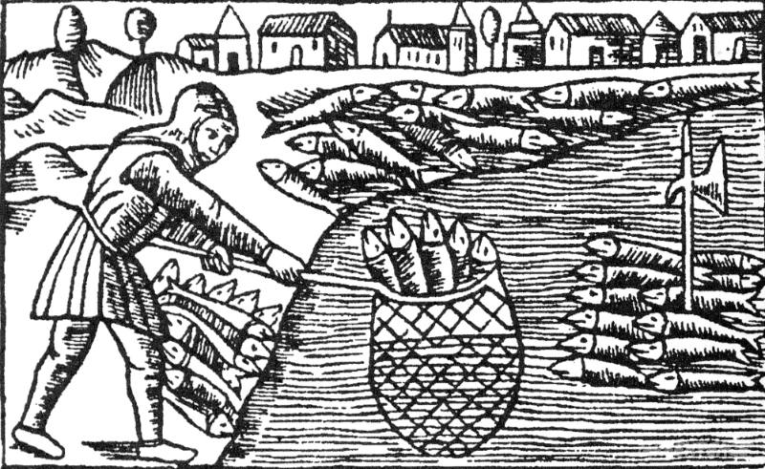
Important Forage Fish Characteristics
Historical view: forage fish are beyond the capacity of man to deplete.
Notes:
Top figure: Herring fishing around 1550 Baltic Sea – herring schools reputed to be so thick that an axe thrust into their midst would remain upright p 21 Callum Roberts
But, forage fish are: Highly variable, Sensitive to the environment, Vulnerable to collapse

Slide 5
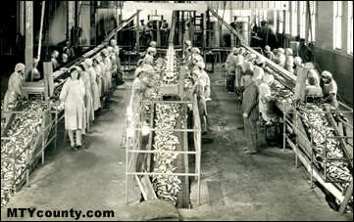
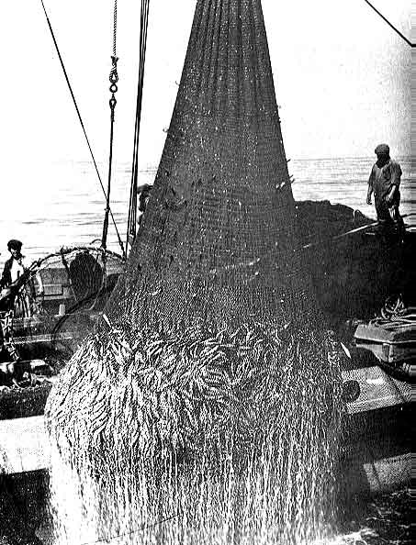
Collapses have occurred
California sardine- 1950s
Peruvian anchoveta- 1970s
Namibian sardine-1970s
Japanese sardine- 1990s
Notes:
See small pelagic fish and climate change book, chapters 3 and 9 for details
1st Photo from: http://www.startitup.org/c_row/student_reports/Final_Tech_Report_Anton.htm
2nd photo from: http://www.mtycounty.com/pgs-misc/cannery-row.html

Slide 6


Task Force Members
Objective: Develop consensus recommendations on sustainable management of forage fish which accounts for their vital role in ocean ecosystems.
Dr. Ellen K. Pikitch, Chair
Dr. P. Dee Boersma
Dr. Ian L. Boyd
Dr. David O. Conover
Dr. Philippe Cury
Dr. Tim Essington
Dr. Selina S. Heppell
Dr. Edward D. Houde
Dr. Marc Mangel
Dr. Daniel Pauly
Dr. Éva Plagányi
Dr. Keith Sainsbury
Dr. Robert S. Steneck
Notes:
6
Note the many disciplines and geographic areas we have represented on our panel

Slide 7
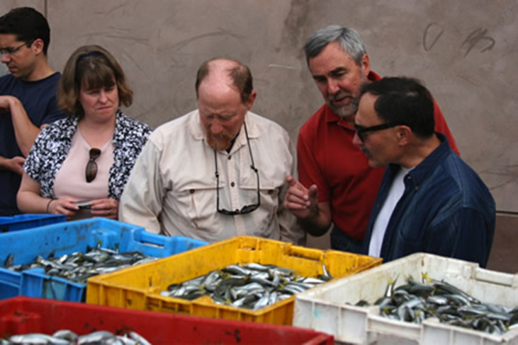
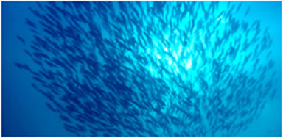
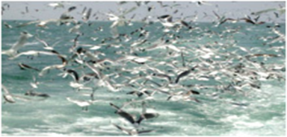
Task Force Approach
  Workshops and site visits
  Review of theory and practice
  Case studies - ecosystems
  Data – forage fish and predators
  New science
    Ecopath models
    Ecosim models
    Predator Response to Exploitation of Prey (PREP) equation

Slide 8
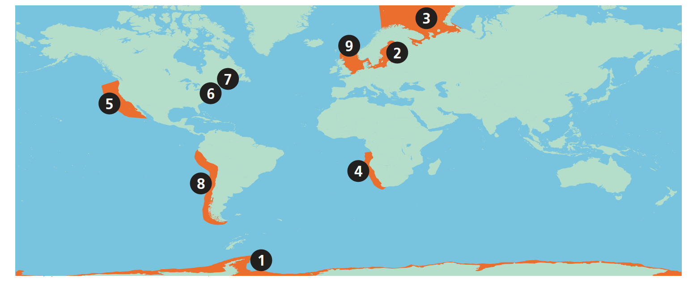
Forage Fisheries Case Studies: Learning from examples
Antarctic
Baltic Sea
Barents Sea
Benguela Current
California Current
Chesapeake Bay
Gulf of Maine
Humboldt Current
North Sea

Slide 9
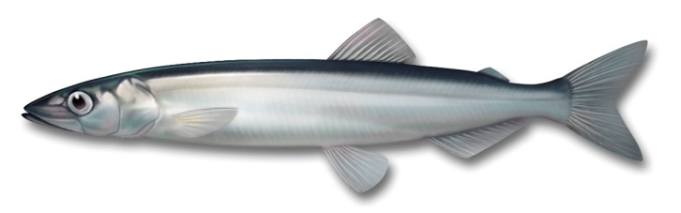
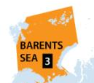
Case Study: Barents Sea
An Effective Threshold
capelin
To protect the world’s largest stock of cod, Norway and Russia prohibit fishing for capelin if its biomass falls below 200,000 tonnes. Since adopting this rule, capelin collapses attributable to fishing have not been repeated, and many fish stocks are now abundant.
Norway
Russia
Notes:
Illustrates a management tool the TF found useful, effective, and worthy of inclusion in our recommendations.
.

Slide 10
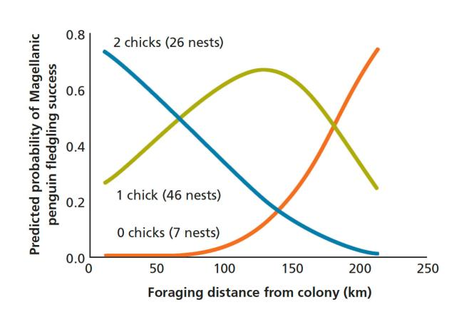
Foraging Distance & Magellanic Penguins
Foraging-trip distance predicted Magellanic penguin reproductive success in Punta Tombo, Argentina. (Boersma and Rebstock 2009)
Notes:
example that illustrates how forage abundance impacts seabird breeding success.

Slide 11
Cury, Boyd et al 2011, Science
Notes:
14 bird species, 7 ecosystems

Slide 12
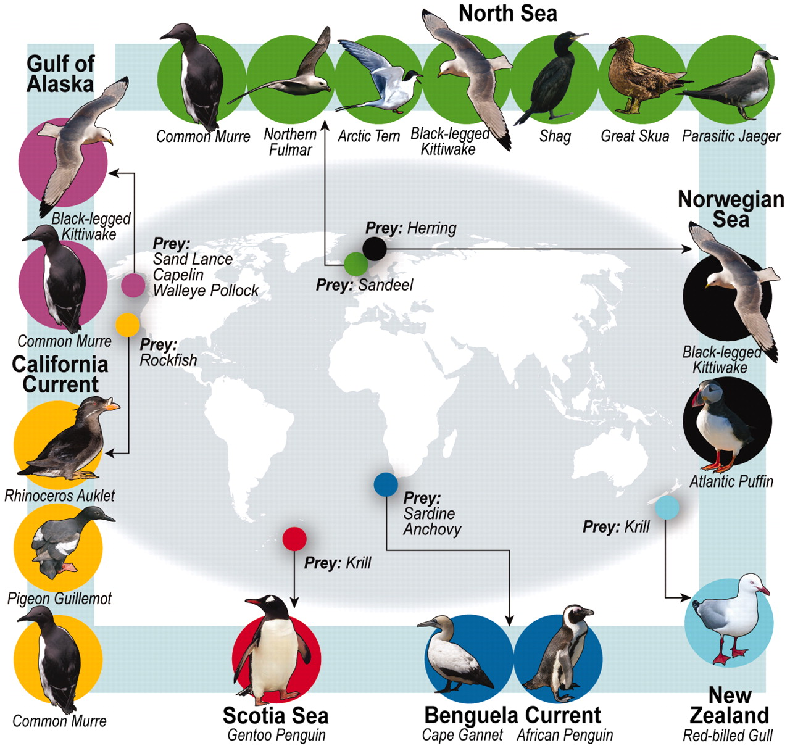
Cury et al. Science 2011;334:1703-1706
Notes:
Cury et al. 2011 used decades-long data sets across multiple marine systems to quantify the effects of forage fish
population size on reproductive success in seabirds, which represent a large group of marine predators.
Map of the distribution of seabird and prey species considered in our analysis.

Slide 13
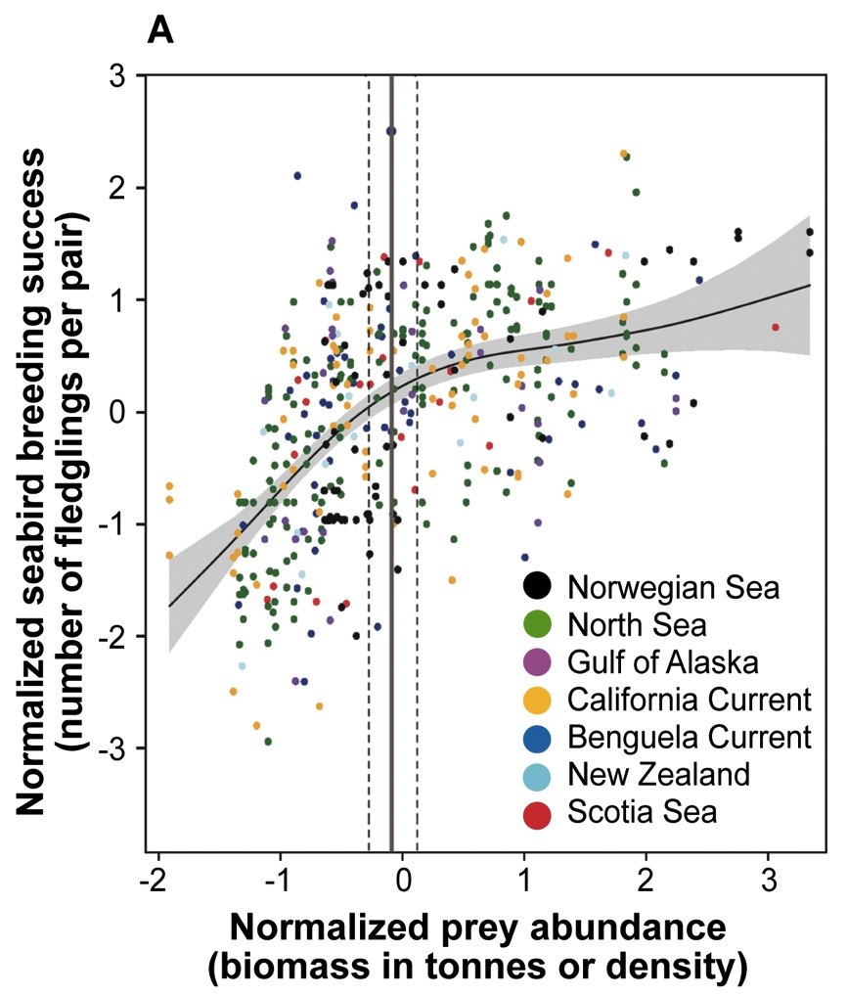
Meta-analysis: one third for the birds
7 marine ecosystems
14 seabird species
438 years of observation

Slide 14
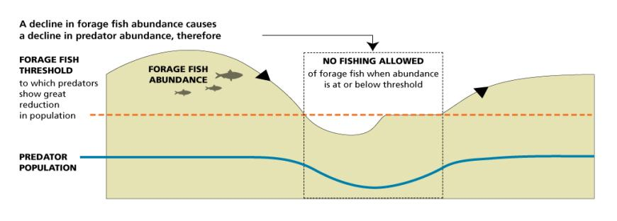
Minimum Biomass Threshold
Notes:
Because predators need a lot of fish in the water, we need a minimum biomass threshold, below which no fishing is allowed… This is a feature of the “precautionary” fishing strategies that we compared using simulation models.. [transition]

Slide 15
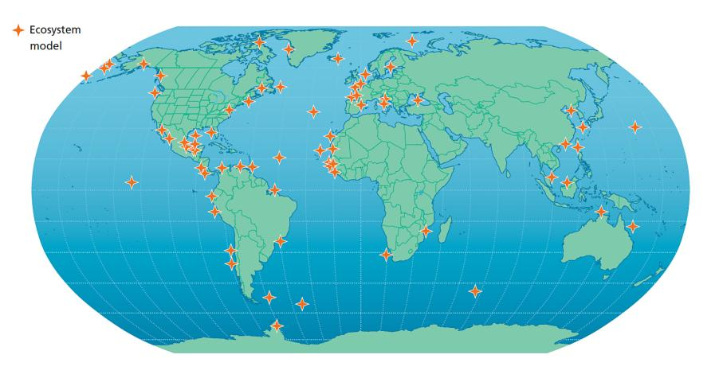
Approximate locations of the 72 Ecopath models used in this analysis
Pikitch, Rountos et al. 2012, Fish and Fisheries

Slide 16
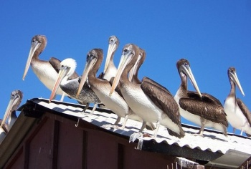
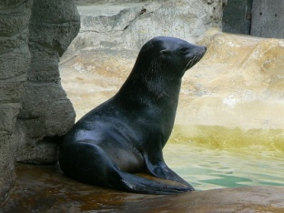
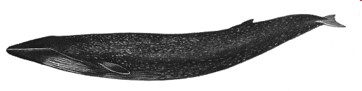
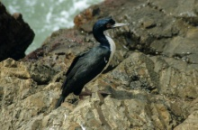
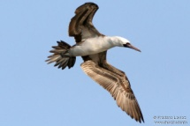
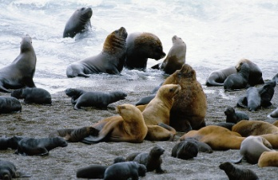
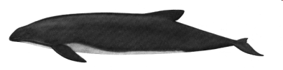
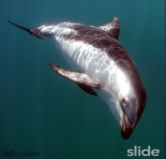
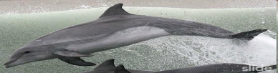
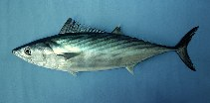


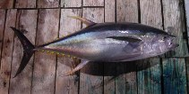




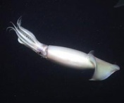

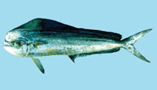


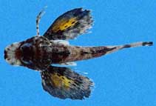
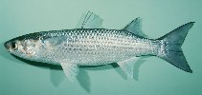
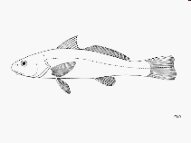
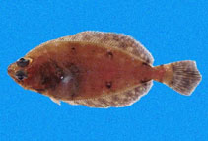
Ecological Importance
Seabirds
95%
39%
Pinnipeds
Cetaceans
10%
62%
33%
Mackerel
Chondrichthyans
83%
3%
15%
Horse Mackerel
Forage Fish
Jumbo squid
29%
Other large pelagics
Hake
28%
3%
22%
12%
46%
Benthic elasmobranchs
Sea robin
Medium demersals
Flatfishes
16
Medium sciaenids
Notes:
This shows the LEVEL of dependency, not just predator composition in this ecosystem
For many predators, FF make up >25% of their diets
Seabirds, Other large pelagics (Tuna…), Mackerel, Flatfishes, Pinnipeds, and Chondrichthyans are Highlighted predators which may have a strong dependency on FF species

Slide 17
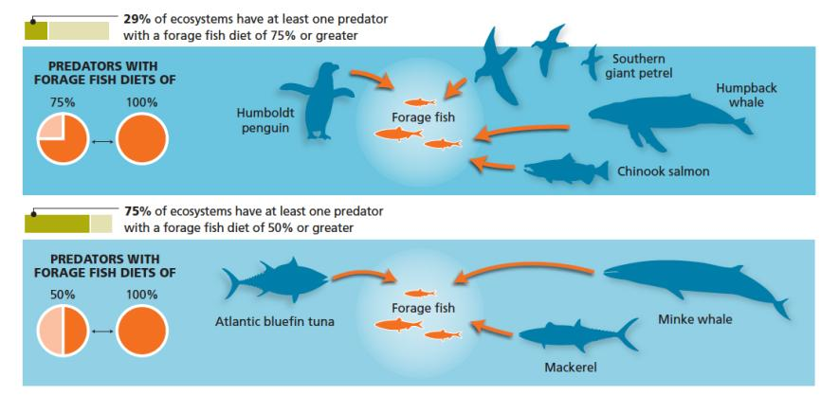
Ecological Importance of Forage Species
The Task Force found that 75% of the ecosystems studied have at least one highly or extremely dependent predator.
Notes:
Highly dependent predators are commonly found in marine ecosystems. Also mention that seabird tended to have particularly high diet dependence and were more sensitive to forage fish declines than other species.

Slide 18
Economic Importance
Mackerel
Chondrichthyans
Horse Mackerel
Jumbo squid
Forage Fish
Other large pelagics
Hake
Medium demersals
Benthic elasmobranchs
Flatfishes
Medium sciaenids
Notes:
18
Use this slide to describe how the task force evaluated the value of the direct catch and supportive catch of ff.
In many ecosystems:
FF are landed directly (red arrow)
And so are many other fish species which consume FF (blue arrows)
Therefore FF contribute in two ways to fisheries value:
1: By direct value of FF fisheries
2: By the value of the other species supported by FF
Box: In the N. Humboldt FF fisheries value is much greater than the Fisheries it supports, but this is not the case for all ecosystems (like North Sea, Chesapeake) (Values using 2006 Prices in USD)

Slide 19
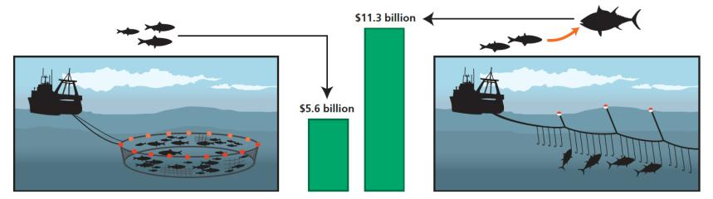
Economic Value of Forage Fish
Direct value of commercial catch = $5.6 billion
Supportive commercial value = $11.3 billion
Total global commercial value = $16.9 billion
Value in 2006 dollars
First ever estimate of total value of forage fish to all fisheries
FORAGE FISH DIRECT VALUE
FORAGE FISH SUPPORTIVE VALUE
Notes:
slide is self-explanatory. After providing numbers, please mention that this only describes ex-vessel value of commercial catch attributable to ff. There are other economic contributions we did not measure (eg. Recreational catch, ecotourism, etc.)

Slide 20
Ecosim modeling approach
Ecosystem Modeling Setup
  Ecosim with MSE Batch Module: Allows for examination of implementation error and a wide variety of harvest strategies
10 Ecosystem models
  2 upwelling (N. Humboldt & Northern California)
  1 Semi Enclosed Sea (Baltic Sea)
  3 Non-Upwelling Coastal (Gulf of Mexico, North Sea, Western English Channel)
  3 Arctic-High Latitude (Aleutian Islands, GoA, Barents)
  1 Estuaries/ Bay (Chesapeake Bay)

Slide 21
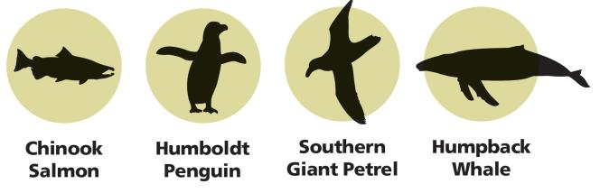
Forage fish are valuable as prey
Many predators are highly dependent on forage fish...
…and decline when forage fish decline.
Predators that have a higher proportion of forage fish in their diet generally exhibit greater declines as forage fish abundance decreases.

Slide 22
Minimum Biomass Threshold

Slide 23
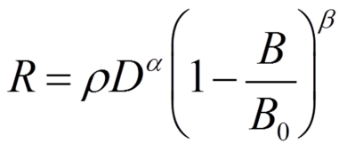
Results: Critical biomass levels
Critical forage fish biomass needed to avoid a 50% decline in predators.
Predator Diet (% forage fish) | Biomass needed (proportion of B₀) for 95% confidence of success
 | All groups | Seabirds
25% | 0.79 | 0.74
50% | 0.85 | 0.88
75% | 0.88 | 0.90
Max | 0.90 | 0.91
Results from PREP Equation (Predator Response to Exploitation of Prey):
R = Predator Decline (as %); D = Diet Dependency (as a fraction of the total diet); B = Forage Fish Biomass
Notes:
We found you need lots of fish in the water so that predators can eat.

Slide 24
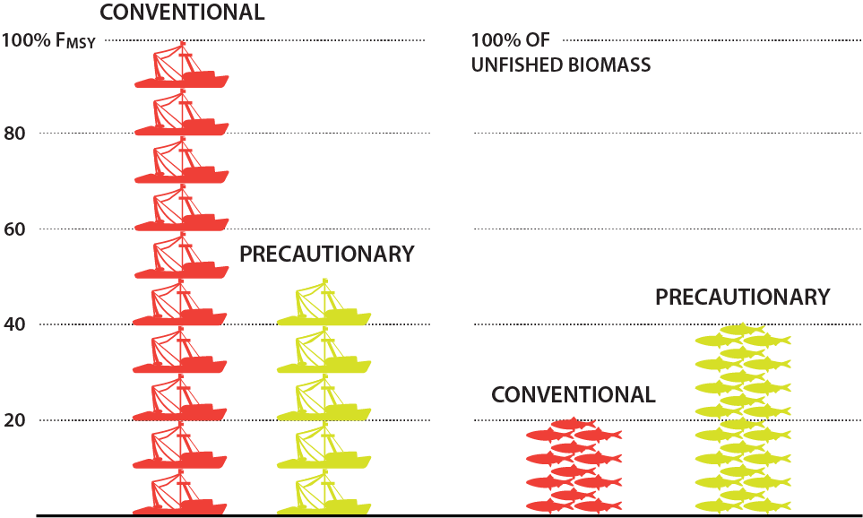
Comparing Fishing Strategies
Six fishing strategies were compared using simulation models. Here we compare the most precautionary strategy with conventional management.
Notes:
NOTE from Ed: This slide more or less gives the “conventional” strategies, but in fact since the 2006 Magnuson-Stevens revision, conventional management has become more precautionary and usual recommendations by Sci and Stat committees for regional management councils are to fish at no more than 75%MSY levels (e.g., New England Council) and to maintain Bo levels at higher levels than in the past. For forage species, while there is increasing sensitivity to need to conserve biomass for predators, there are relatively few specific management rules to accomplish this. In any case, in the U.S. and Europe, recommendations to set MSY as the target are becoming more and more uncommon.

Slide 25
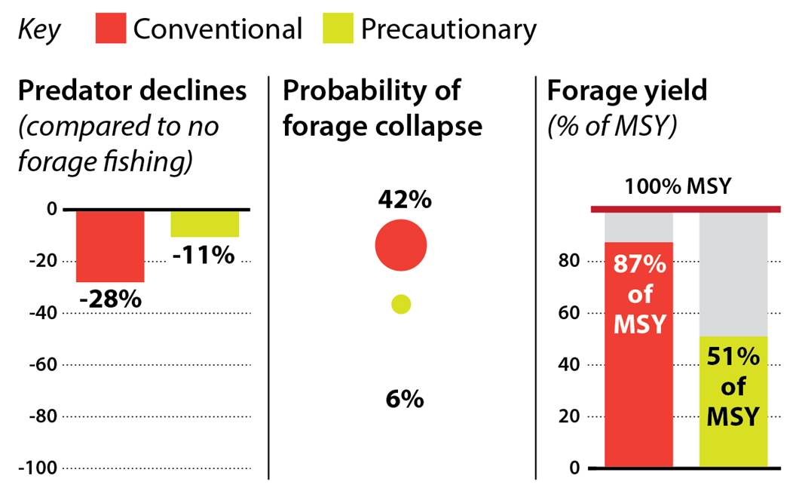
Only Precautionary Management Protects Predators and Fisheries
Notes:
Summary of key findings
Acknowledge that 100%MSY strategy may not be the usual situation but management in North America and Europe is moving to even lower levels. Not sure this is true in Asia. I suspect that the lower levels are becoming routine in Australia, New Zealand, and South Africa.

Slide 26
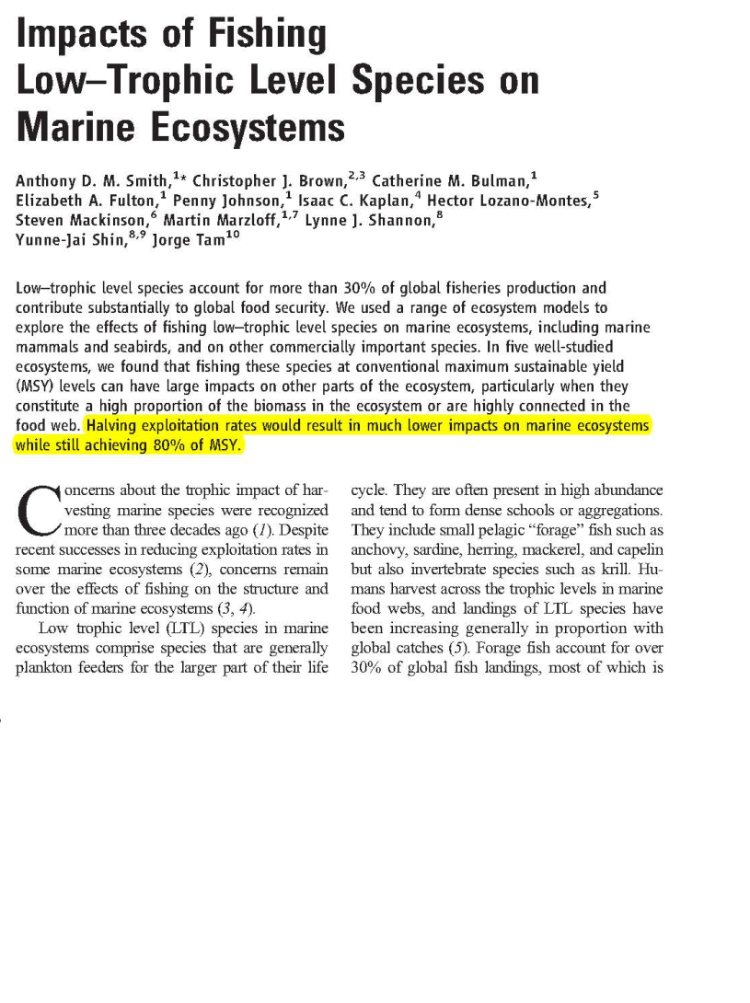

Slide 27
Key Recommendations
Focus on predators
Consider spatial & temporal management
Cut forage fishing in half and leave twice as much fish in the ocean compared with conventional management in many ecosystems.
Tailor management to available information
Notes:
27

Slide 28
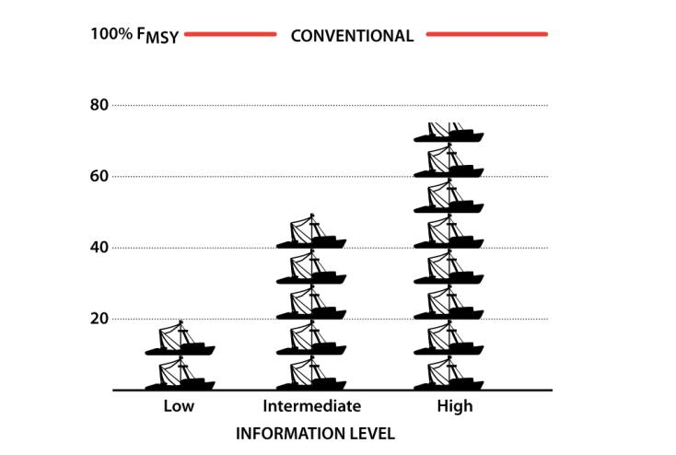
A Lower Ceiling on Forage Fishing

Slide 29
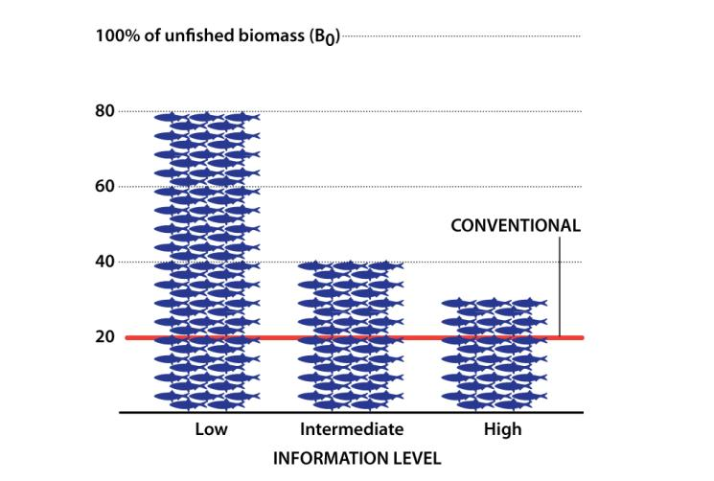
A Higher Floor on Forage Fish Biomass

Slide 30
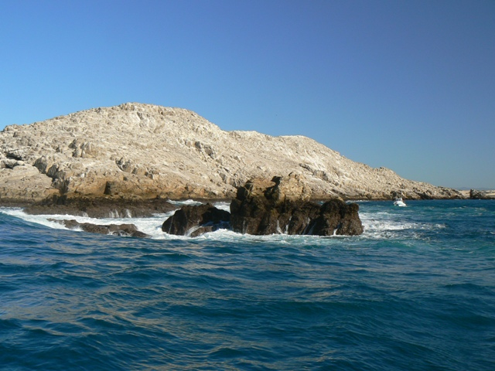
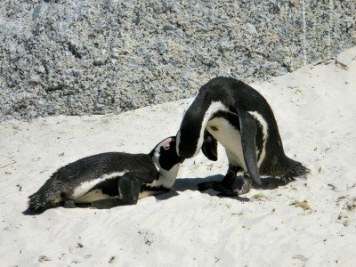
Scope of Management Strategies
Time and space-based management
fireflyafrica.blogspot.com
Credit: themaxfiles.blogspot.com

Slide 31
Concluding Remarks
Step toward ecosystem-based management
Benefits both the ecosystem and fisheries
  Maintains ecological roles and support services
  Reduces risk of forage fishery collapse
  May increase catch of commercially valuable fish
  Positive incentives for increasing knowledge

Slide 32
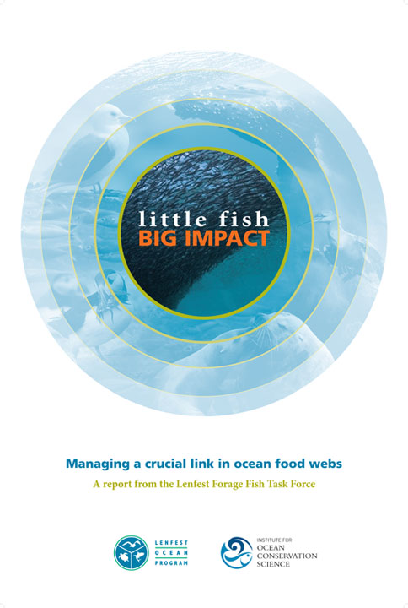
Notes:
32

Slide 33



Special Thanks To:
Task Force Members
Christine Santora, Project Director
Konstantine Rountos
Kristin Broms
Tess Geers
Natasha Gownaris
Steve Munch
David Conover
Jesse Bruschini
Shaily Rahman
Joel Rice

Slide 34


Slide 35

Comparison of
harvest control rules
Constant yield and constant fishing (CF) mortality rules.

Slide 36

Comparison of
harvest control rules
Biomass limit rules.

Slide 37

Comparison of
harvest control rules
Hockey stick rules.

Slide 38

Predator Criterion
“Dependent Predator Performance Criterion”
  Adopt harvest strategies and management measures so that there is a greater than 95 percent chance that fishing on forage fish will not deplete any dependent predator population to levels that would meet the IUCN “vulnerable” criteria.
Notes:
Ideally, one would apply this criterion in choosing a harvest policy based on simulations from an ecosystem model - but we also wanted to see if we could come up with advice that could be used in the absence of such a model. That’s what motivated the large scale simulation testing that follows.
Because of findings like these (i.e. previous slide), the Task Force decided that we needed a criterion that would help fisheries managers to protect predators, not just forage fish. So we developed what’s called a “dependent predator performance criterion”…
Managers must take into account the current status of predators (e.g. if they are already really declined)

