Slide 1
Scup (Stenotomus chrysops): 2012 Update
Managed as a unit stock from New England to
Cape Hatteras, NC
Maximum size & age fish in NEFSC SVs and fishery samples:
SV: 1973 - 41 cm FL at age 14; 1976, 1978 - 38 cm at age 14; 2001 - 41 cm FL at age 9
Comm land: 1970s - 45-46 cm FL at ages 8-10, 40 cm at 14
50% mature at age 2; M = 0.20
Commercial trawl fishery; recreational rod and reel fishery
Comm. landings ~50%; Comm. discards ~30%
Rec. landings ~20%; Rec. discards <1%
NEFSC SVs peaked in late 1970s, early 2000s
Comm landings (and probably total catch) peaked in 1955-1965

Slide 3
Assessment history Scup (Stenotomus chrysops)
First analytical assessment: 1995 SAW 19 - ADAPT VPA
High CVs on estimated Ns; uncertain comm discards (constant ratio for 1984-1988; high variability in rates for 1989-1994)
1997 SAW 25: “Poor quality of input data” (Discard estimation, landings length sampling); assessment downgraded to
“exploratory VPA” to provide general trends
1998 SAW 27: “Exploratory VPA” and ASPIC production model rejected as basis for management; index approach adopted; NEFSC, MADMF, RIDFW, CTDEP, NJBMF available
NEFSC Spring used for Biomass BRP = SSBMSY Threshold; SAW 19 YPR Fmax = FMSY

Slide 4
Assessment history Scup (Stenotomus chrysops)
1998 SAW 27: Recommended move to index-based assessment
1955-1965: Sustainable commercial landings ~20,000 mt – stock at BMSY
Late 1970s: closest NEFSC SV peak – commercial landings at about one-half of 1955-1965 level – stock at one-half BMSY
NEFSC Spring used for Biomass BRP = SSBMSY Threshold = 1977-1979 mean = 2.77 SSB kg/tow; SAW 19 YPR Fmax =
FMSY = 0.26
SAW27 Recommendations adopted in FMP Amendment 12 as basis for BRPs
Amendment 14 formalized proxy BMSY = 2*2.77 = 5.54 SSBkg/tow

Slide 5
Assessment history Scup (Stenotomus chrysops)
2000 SAW 31: Index-based for biomass (NEFSC Spring SBBkg/tow) and F (catch curves); F => 1.0 for ages 0-3
2002 SAW 35: Index-based; Relative Exploitation Index (landings/index) developed to help set quotas; F = unknown
2003-2008: MAFMC Monitoring Committee updates of NEFSC Spring SSB Index basis for biomass status; No reliable F estimates – use REI to monitor F

Slide 6
Data Poor Stocks Working Group (DPSWG) 2008 Scup (Stenotomus chrysops)
ASAP model: sufficient as basis for stock assessment
Non-parametric BRPs: SSB/R, Y/R to get Fmax, F40% (M= 0.20)
R from 1984-2007 (period with fishery and SV age data)
MCMC for year T+1 Ns for AGEPRO
AGEPRO for SSBMSY, 2009 TAC
Considered multiple configurations and model settings to evaluate sensitivity and uncertainty

Slide 7
Data Poor Stocks Working Group Scup (Stenotomus chrysops): December 2008
Scup not overfished, overfishing not occurring
in 2007
Improved R and low F, SSB increased to 119,000 mt in 2007, F decreased to 0.05 in 2007, relative to:
SSBMSY = SSB40% = 92,044 mt
FMSY = F40% = 0.177 (M = 0.2)
MSY = 16,161 mt total catch; 13,134 mt landings;
3,027 mt discards

Slide 8
Data Poor Stocks Working Group Scup (Stenotomus chrysops): December 2008
DPSWG 2008 Peer Review Panel Advice:
"...rapid increases in quota to meet the revised MSY would be unwarranted given uncertainties in recruitments. A more gradual increase in quotas is a preferred approach reflective of the uncertainty in the model estimates and stock status.“
TAC 2009: 7,049 mt = 15.54 mlbs
TAL 2009: 5,071 mt = 11.18 mlbs

Slide 9
Scup (Stenotomus chrysops): 2009 Update
Status for 2008: Not Overfished, Not Overfishing
SSB2008 = 188,000 mt;
F2008 = 0.042 (fully recruited ages 2-7+);
R2008 = 192.4 million age 0 fish
TAC for 2010: 7,752 mt (17.090 mlbs)
TAL for 2010: 6,400 mt (14.110 mlbs)
Increase of 10% over 2009 TAC

Slide 10
Scup (Stenotomus chrysops): 2010 Update
Status for 2009: Not Overfished, Not Overfishing
SSB2009 = 155,000 mt;
F2009 = 0.043 (fully recruited ages 2-7+);
R2009 = 140 million age 0 fish
ACL for 2011: 14,479 mt (31.920 mlbs)
TAL for 2011: 12,020 mt (26.500 mlbs)
Increase of 87% over 2010 TAC

Slide 11
Scup (Stenotomus chrysops): 2011 Update
Status for 2010: Not Overfished, Not Overfishing
SSB2010 = 186,000 mt;
F2010 = 0.040 (fully recruited ages 2-7+);
R2010 = 44 million age 0 fish
ACL for 2012: 18,543 mt (40.881 mlbs)
TAL for 2012: 16,749 mt (36.925 mlbs)
Increase of 163% (2.6 x) over 2009 TAC (ACT)

Slide 12
Scup (Stenotomus chrysops): 2012 Update
Update Landings and Discards through 2011
Update Survey Indices through 2011
Age compositions use 2011 ALKs
Retain DPSWG 2008 Assessment ASAP configuration and run model
Update status for 2011
Assume 2012 TAL (landings quota) is caught
Make projection to determine 2013 OFL

Slide 30
Scup (Stenotomus chrysops): 2012 Update
Status for 2011: Not Overfished; Not Overfishing
SSB2011 = 190,000 mt;
F2011 = 0.034 (fully recruited ages 2-7+);
R2011 = 154 million age 0 fish
Currently no “internal” retrospective patterns

Slide 36
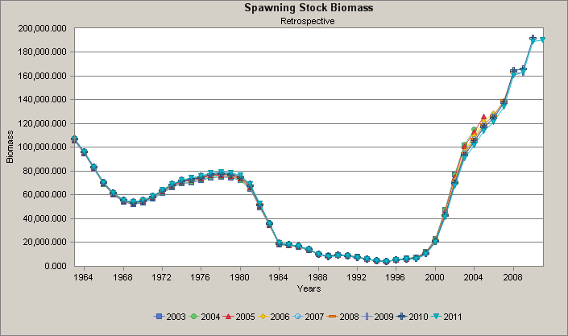
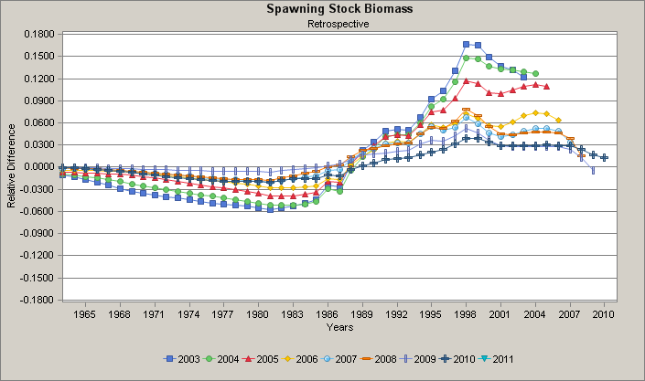

Slide 37
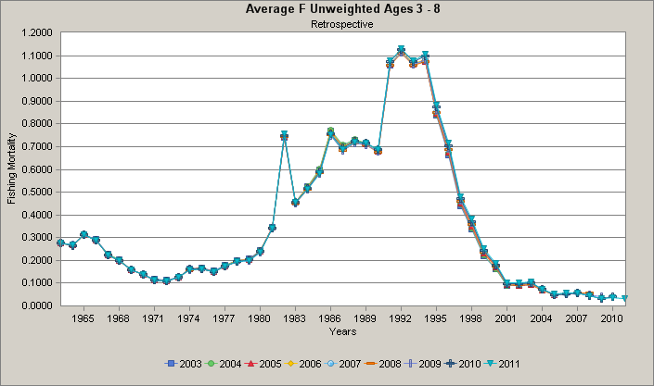
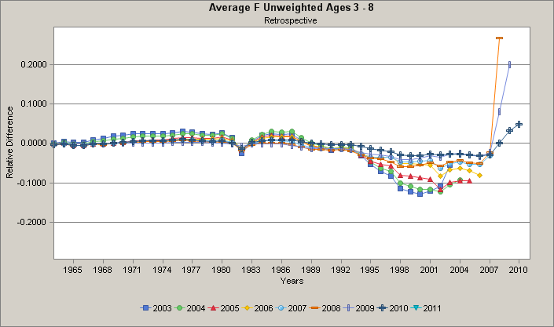

Slide 38
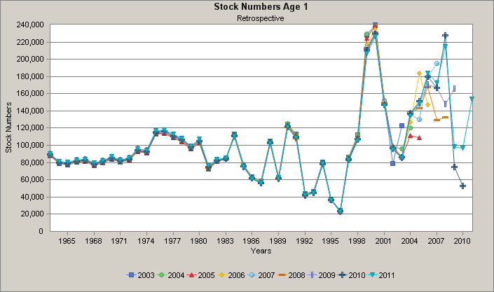
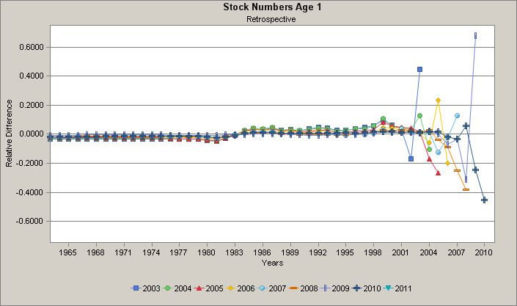

Slide 39
Scup (Stenotomus chrysops): 2012 Update
A between-assessment comparison provides another measure of assessment uncertainty due to “historical retrospective” in model estimates
The 2012 update SSB and F estimates are intermediate with respect to the 2008 DPSWG assessment and 2009 update estimates and close to the 2010-2011 update estimates;
The 2012 recruitment estimates are in general larger compared to the 2011 assessment

Slide 43
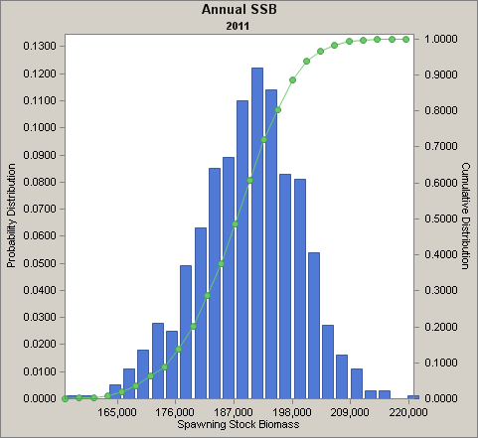

Slide 44
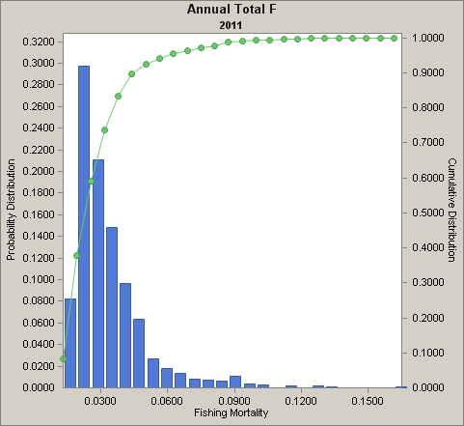

Slide 45
Scup (Stenotomus chrysops): 2012 Update
Short term projection for 2013 OFL
Use 2008 DPSWG BRPs (SSBMSY = 92,044 mt; FMSY = 0.177)
AGEPRO stochastic projection
resample 1984-2011 CDF of age 0 recruitment
Note MSY = 13,134 mt of Total Landings + 3,027 mt Total Disc =
16,161 mt of Total Catch
Specify Landings in 2012 = TAL = 16,749 mt;
Median Discards = 3,334 mt; median Total Catch = 20,083 mt
Median F2012 = 0.158, below FMSY
Median SSB2012 = 204,000 mt, above Btarget

Slide 46
Scup (Stenotomus chrysops): 2012 Update
Specify F in 2013 = FSMY = 0.177
Total Catch = 21,680 mt = Overfishing Limit (OFL for 2013)
Landings = 17,981 mt and Discards = 3,721 mt
(note: independent medians so do not exactly total)
Median SSB2013 = 196,000 mt, above Btarget

