Slide 1
The future of GAMEFISH is in the hands of informed an “The future of GAMEFISH is in the hands of informed anglers….” William Mote Founder, Snook & Gamefish Foundation

Slide 2
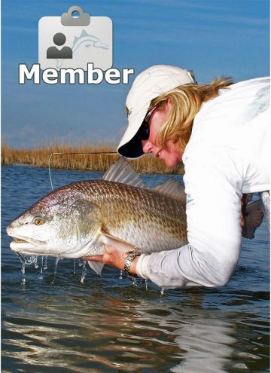
SGF goal:
The long term benefit of gamefish through
direct angler action in
research, education, and outreach.

Slide 3
Need for Recreational Angler data
Dramatic increase in rec fishing requires changes in fishery management strategies (FL forecasts 30M trips this year)
The need to assess whole catch (discard rate as well as harvest) has never been greater.

Slide 4
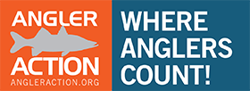
Angler Action Program
The Angler Action Program meets a need for greater collaboration between the recreational fishing community and fisheries management to improve data collection.

Slide 5
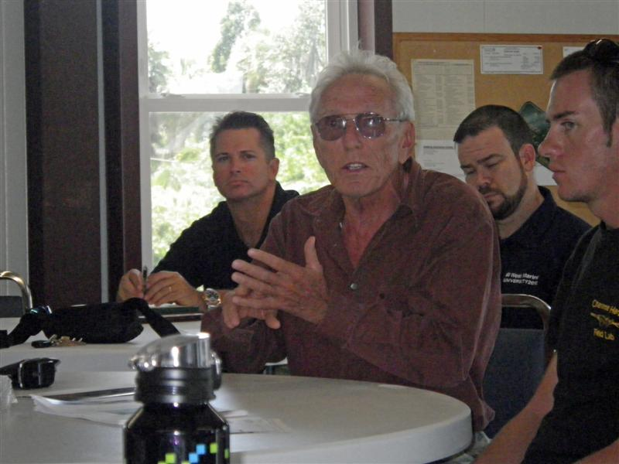
Angler Action is a service project of SGF undertaken in partnership with FWC
Thanks to FWC staff for their commitment , partnership and professionalism.

Slide 6
Recreational Anglers
Can Supply Critical information
Trip Characteristics
Target Species
Time targeting each species (lines in the water)
Geospatial information (protected)
Fish lengths and slot ranges for both discarded and harvested fish
Condition upon release
Harvested numbers
Angler Contact info

Slide 7
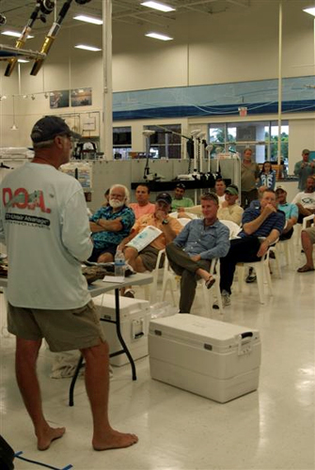
Essential Angler Education
Report all sizes
Report locations
Report ‘0’ Catch Trips
Record on the water for accuracy; Log online soon after your trip
Include comments
Use cell phone app if you can
Ask if you have a question

Slide 8
Collaboratively Developed On the Water Catch Record

Slide 9
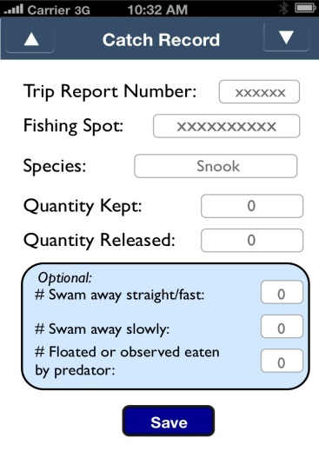
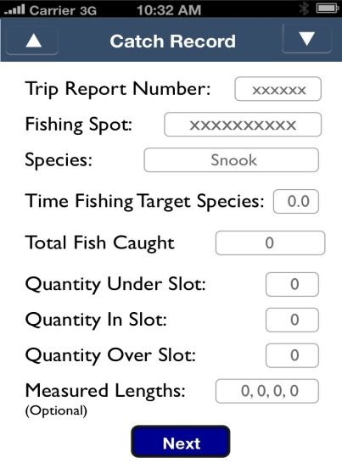
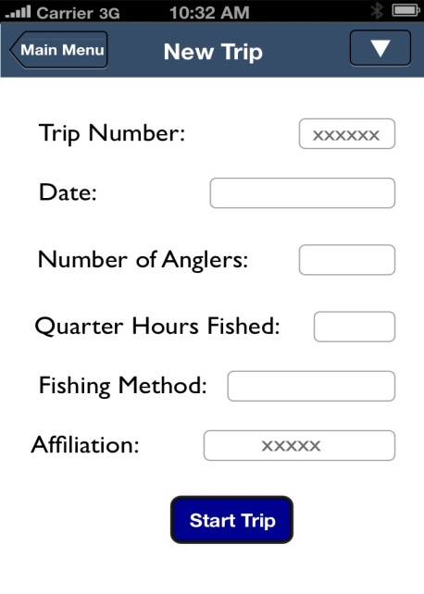
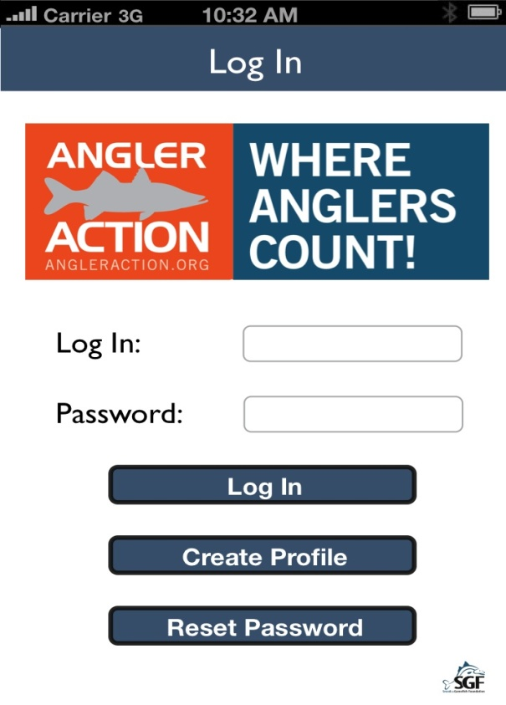
Phone apps launch Apr 2012

Slide 10
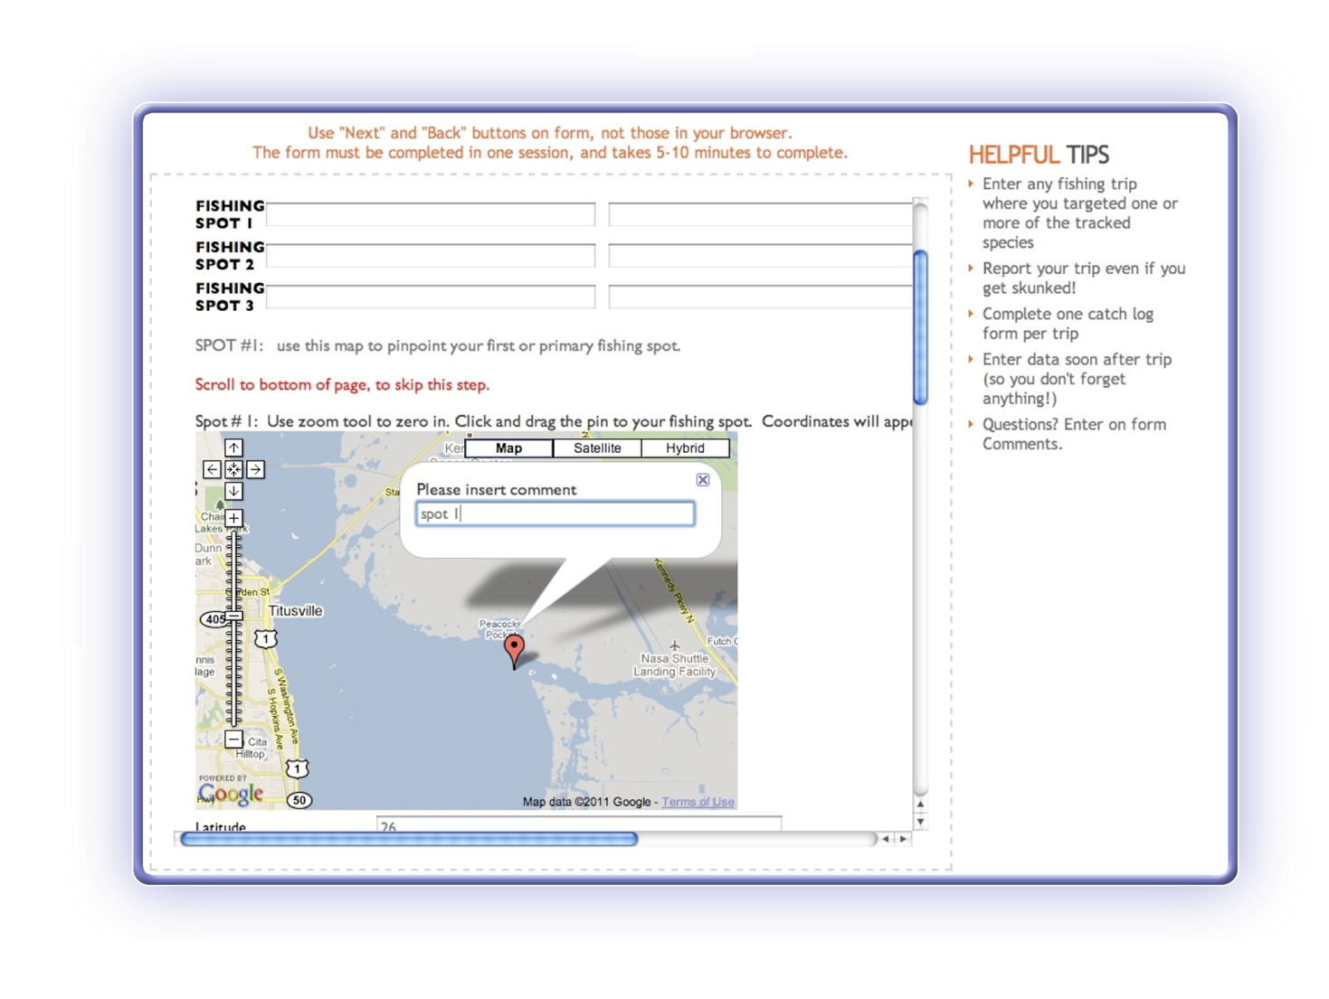
Spot information is protected

Slide 11
By angler request, data are generalized in reports to prevent disclosure of information about individual production and fishing spots.
95% of all fish reported were released.
Notes:
Data is summarized so individual or local performance does not become an issue.

Slide 12
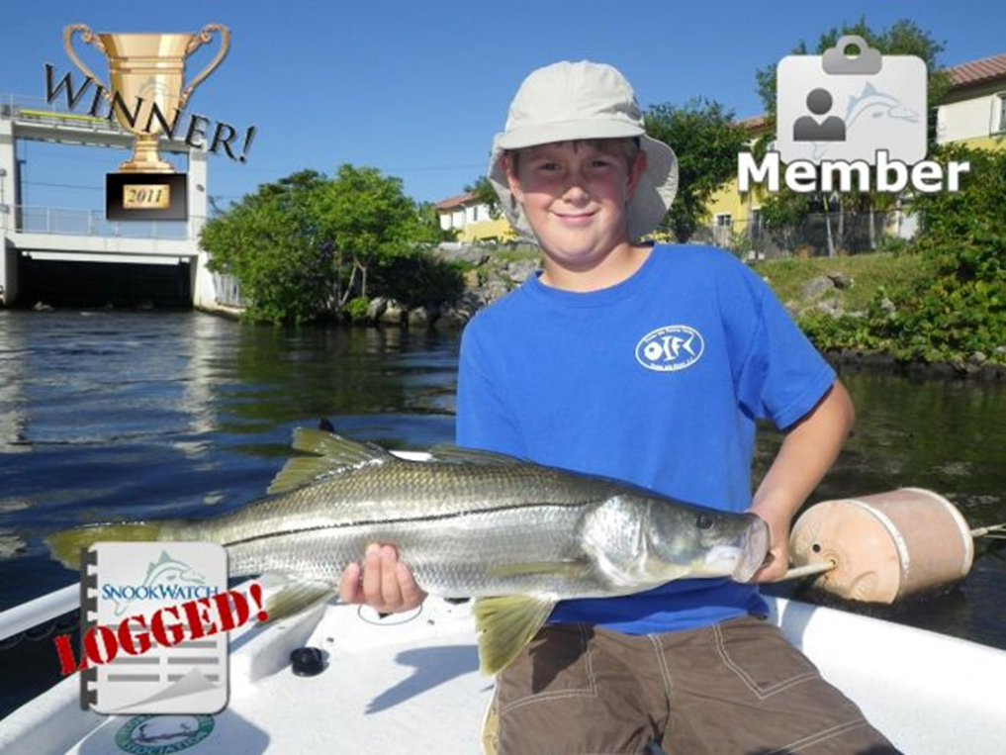
Anglers are encouraged to
post a photo of
their catch.

Slide 13
User Feedback from weekly Q.A. review
“Get a Phone app!”
“Easy enough”
“Add More species”
“More Feedback reports”
Incentive #1: seeing how my data are being used

Slide 14
AAP Data in Use: 2011 FWC Snook Stock Assessment
“These data were very important in 2010 and 2011 because of the information on proportion of fish that are released alive. I was pleased that your survey covers both coasts, both trip information, and fish data which consisted of lengths. Thanks for the use of the data.”
Dr. Robert Muller, Florida Fish and Wildlife Commission, Florida Marine Research Institute Oct 10, 2011

Slide 17
Participant Comments (2011 User Survey)
“The AA Program is one of the most important ways that we can influence fishing …to protect the future.”
“Hard data wins every time over tears, moans and groans. Constant carping does nothing.”
“I like that sport data is being included… a reminder email every two weeks or so might get people to enter more trips.”
“What I like best is knowing that the data that S&GF collects actually helps shape the future of our fishery.”
“I like that the data that is collected and presented is taken seriously among the regulatory community. Great job to all involved!”

Slide 18
Become a Partner
Angler Action Partners make a commitment to participate in one or more areas: data collection tool & db development analysis and applications outreach and education
www.angleraction.org rick@snookfoundation.org 407 302 5550
www.snookfoundation.org

Slide 19
Thanks to Partners!
Florida Wildlife Research Institute
Florida Fish and Wildlife Conservation Commission
University of Florida
National Park Service
Mosquito Creek Outdoors
West Marine
Gause Built Boats
National Fish and Wildlife Foundation
Turner Foundation
Teen Anglers, West Palm Beach Fishing Club, Kayak Fishing ClassicS
And the many individuals, clubs and organizations who are adding their numbers daily.

